Slide 1
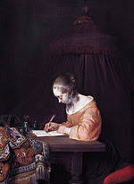
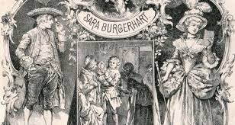
Canoniek en revolutionair: Sara Burgerhart
Lotte Jensen
Radboud universiteit Nijmegen

Slide 2
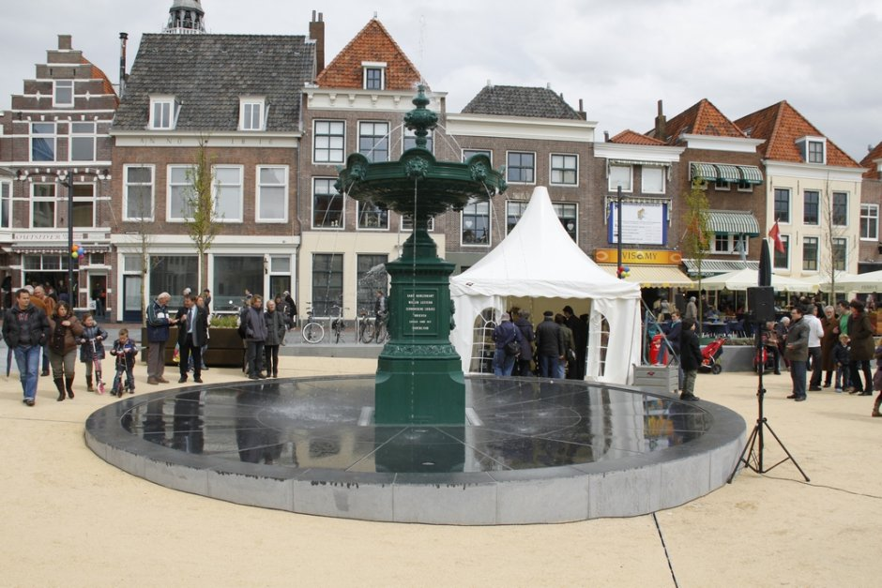
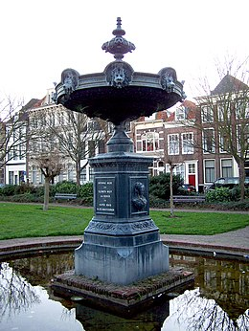
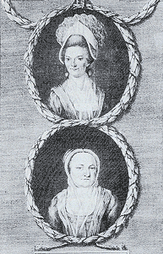
Betje Wolff & Aagje Deken
Bestseller: Sara Burgerhart (1782)

Slide 3

De Nederlandse klassieke literaire werken volgens leden van de
Maatschappij der Nederlandse Letterkunde
Multatuli, Max Havelaar (1860)
[anoniem, Willem], Van den vos Reynaerde (13de eeuw)
Gerard Reve, De avonden (1947)
Joost van den Vondel, Gysbreght van Aemstel (1637)
W.F. Hermans, De donkere kamer van Damocles (1958)
Nicolaas Beets (Hildebrand), Camera Obscura (1839)
[anoniem], Beatrijs (midden 13de eeuw)
[anoniem], Karel ende Elegast (einde 12de eeuw)
W.F. Hermans, Nooit meer slapen (1966)
P.C. Hooft, Lyriek (17e eeuw)
[anoniem], Mariken van Nieumeghen (begin 16de eeuw)
Louis Couperus, Eline Vere (1889)
Herman Gorter, Mei (1889)
Betje Wolff & Aagje Deken, Sara Burgerhart (1782)

Slide 4
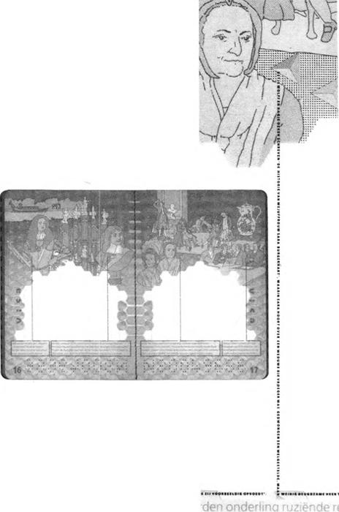
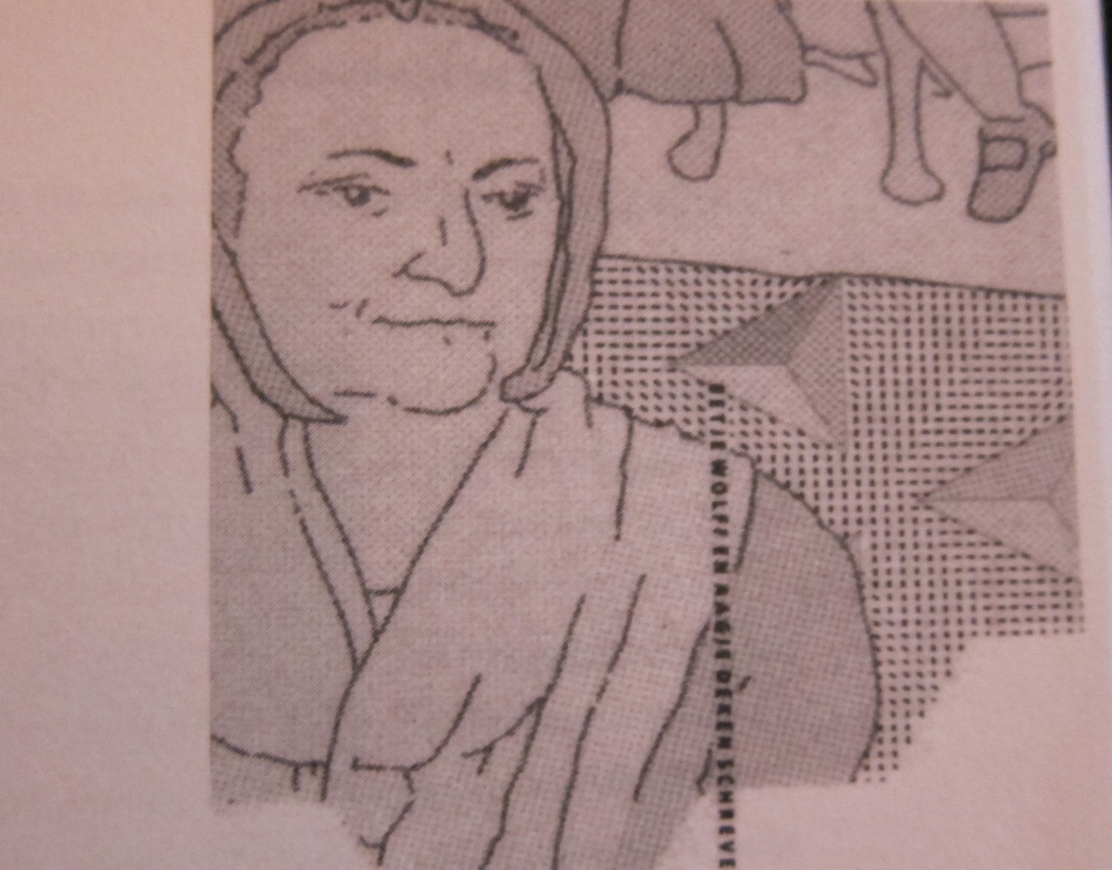
Paspoort 1994

Slide 5
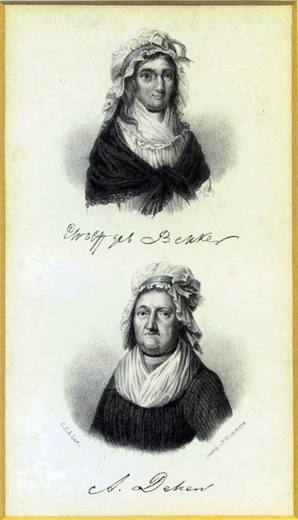
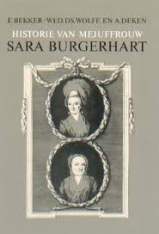
Bestseller!
Twee schrijfsters
Eerste oorspronkelijk Nederlandstalige briefroman
Vooruitstrevende inhoud
Typisch verlicht
Typisch Nederlands

Slide 6
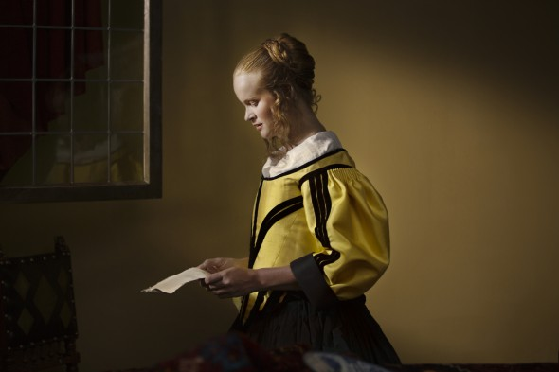
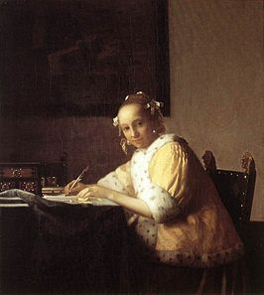
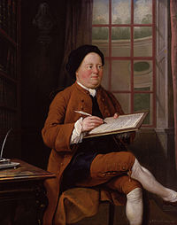
Briefkarakter uitgebuit
WRITING TO THE MOMENT

Slide 7
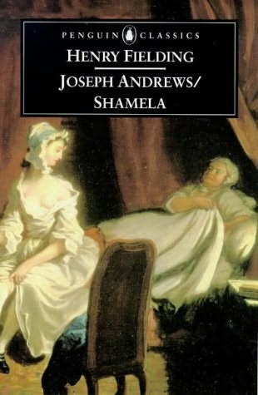
SATIRE!
Henry Fielding
An Apology for the Life of Mrs. Shamela Andrews (1741)
Thursday Night, Twelve O’Clock
Mrs. Jervis and I are just in Bed, and the Door unlocked; if my Master should come – Odsbobs! I hear him just coming at the Door. You see I write in the present Tense, as Parson Williams says. Well, he is in Bed between us, we both shamming a Sleep, he steals his Hand into my Bosom, which I, as if in my Sleep, press close to me with mine, and then pretend to awake. – I no sooner see him, but I scream out to Mrs. Jervis, she feigns likewise but just to come to herself.

Slide 8
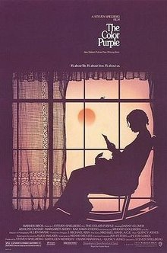
Alice Walker, The Color Purple (1982)
Dear God,
I am I have always been a good girl. Maybe you can give me a
Sign letting me know what is happening to me (3)
Bible say, Honor father and mother. […] But he my husband (39).
All three of us go down to Harpo’s. Mr. and me sit at the same table.
Mr. drink whiskey. I have a cold drink. First Shug sing a song by
somebody name Bessie Smith. She say Bessie somebody she know.
Old friend. […] Then I hear my name. Shug saying Celie. Miss Celie.
And I look up where she at. She say my name again. She say this son
I’m bout to sing is call Miss Celie’s song. (64/65).
Dear God. Dear stars, dear trees, dear sky, dear peoples. Dear
Everything. Dear God (242)

Slide 9
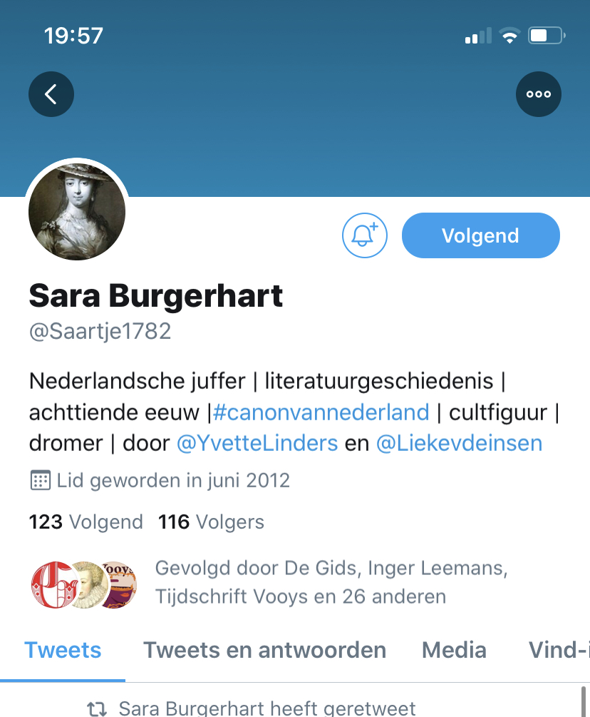

E-mail roman
Where r u??? I’m waiting at airport. Me and dad have been here for hours. I tried ur house phone & mobile.
Don’t know where else 2 call. Hope everythings’s ok’

Slide 10
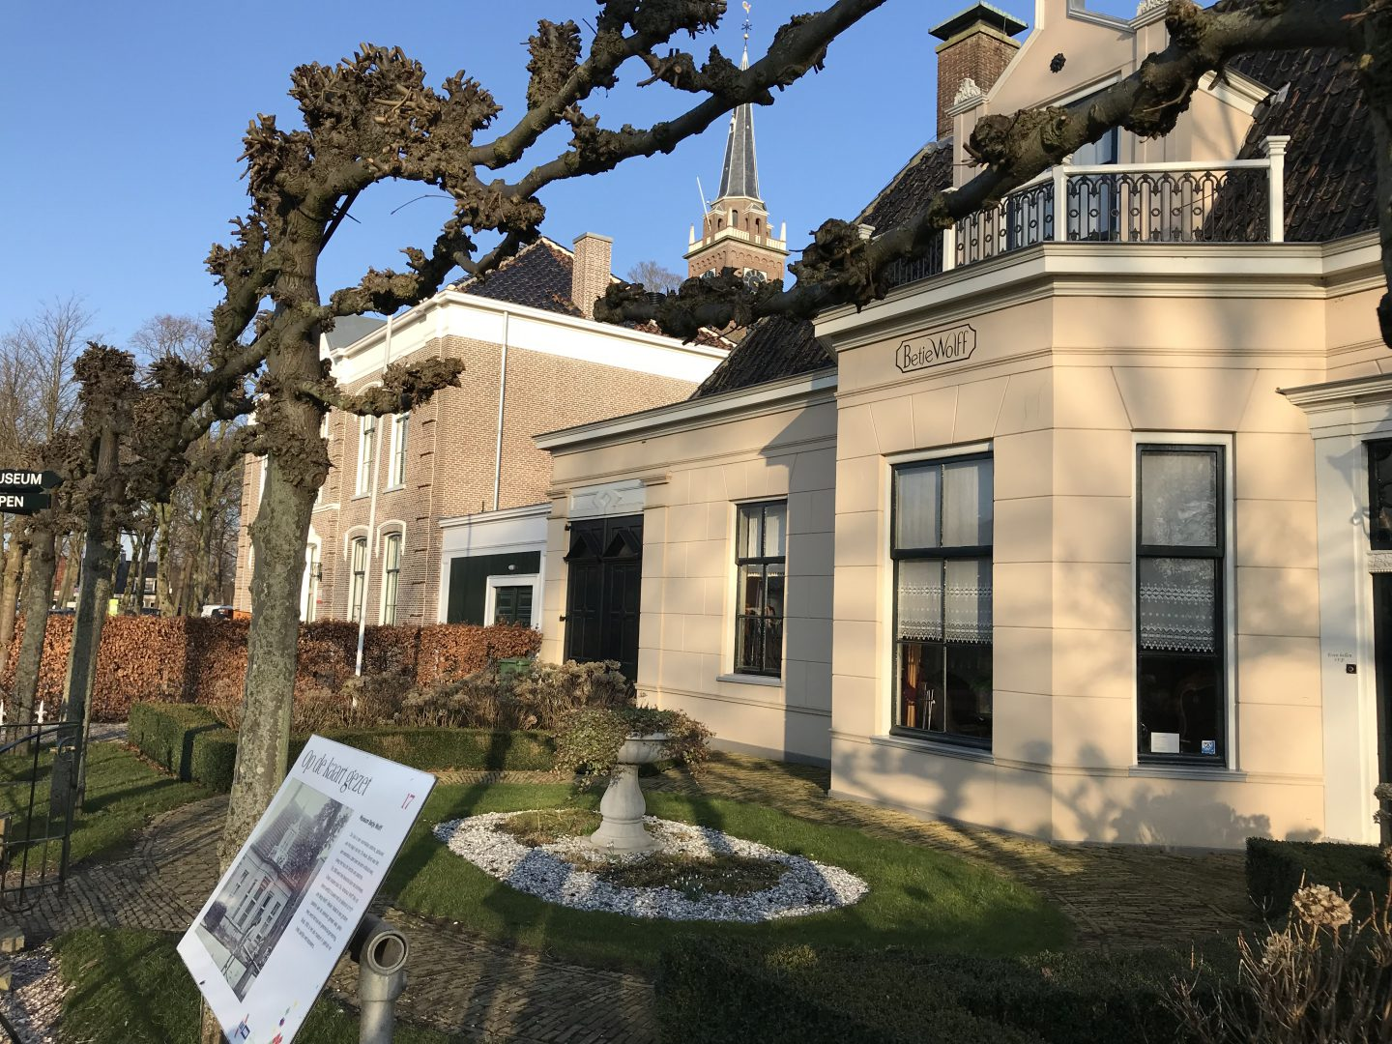
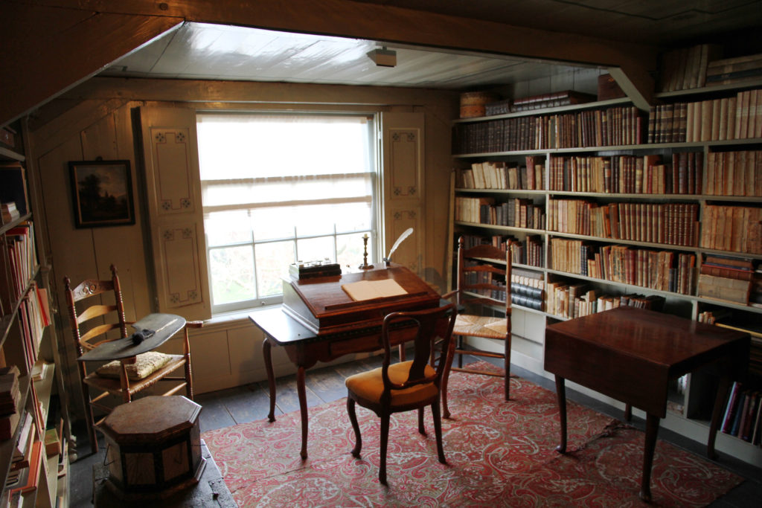
Naar de Beemster
TWEE vensters in een klap
Een schrijfkamer voor jezelf
A Room of One’s Own

