Slide 1
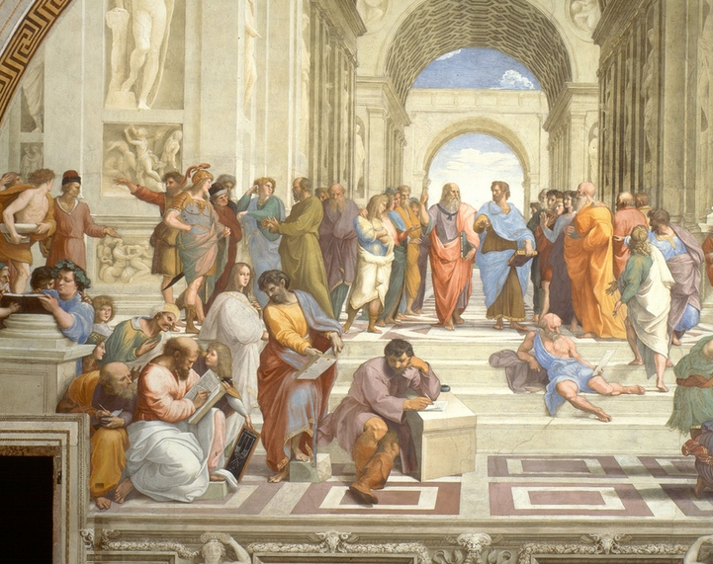
§3.4 Greek culture: philosophy!
Ms. Dijkstra
1AT1
8 December 2022

Slide 2
Today
Warming up
Learning goals
Explanation ancient philosophy
Assignment
Conclusion

Slide 3
Learning goals
At the end of the lesson you can define philosophy
1
At the end of the lesson you can name at least three subjects of philosophy
2
At the end of the lesson you can explain what Plato’s ideal state looked like
3

Slide 4
Think, pair, share
Can you give an example of a time you wanted two contradictory things at the same time?
Contradictory = opposing
‘boring is the contradiction of interesting’.

Slide 5
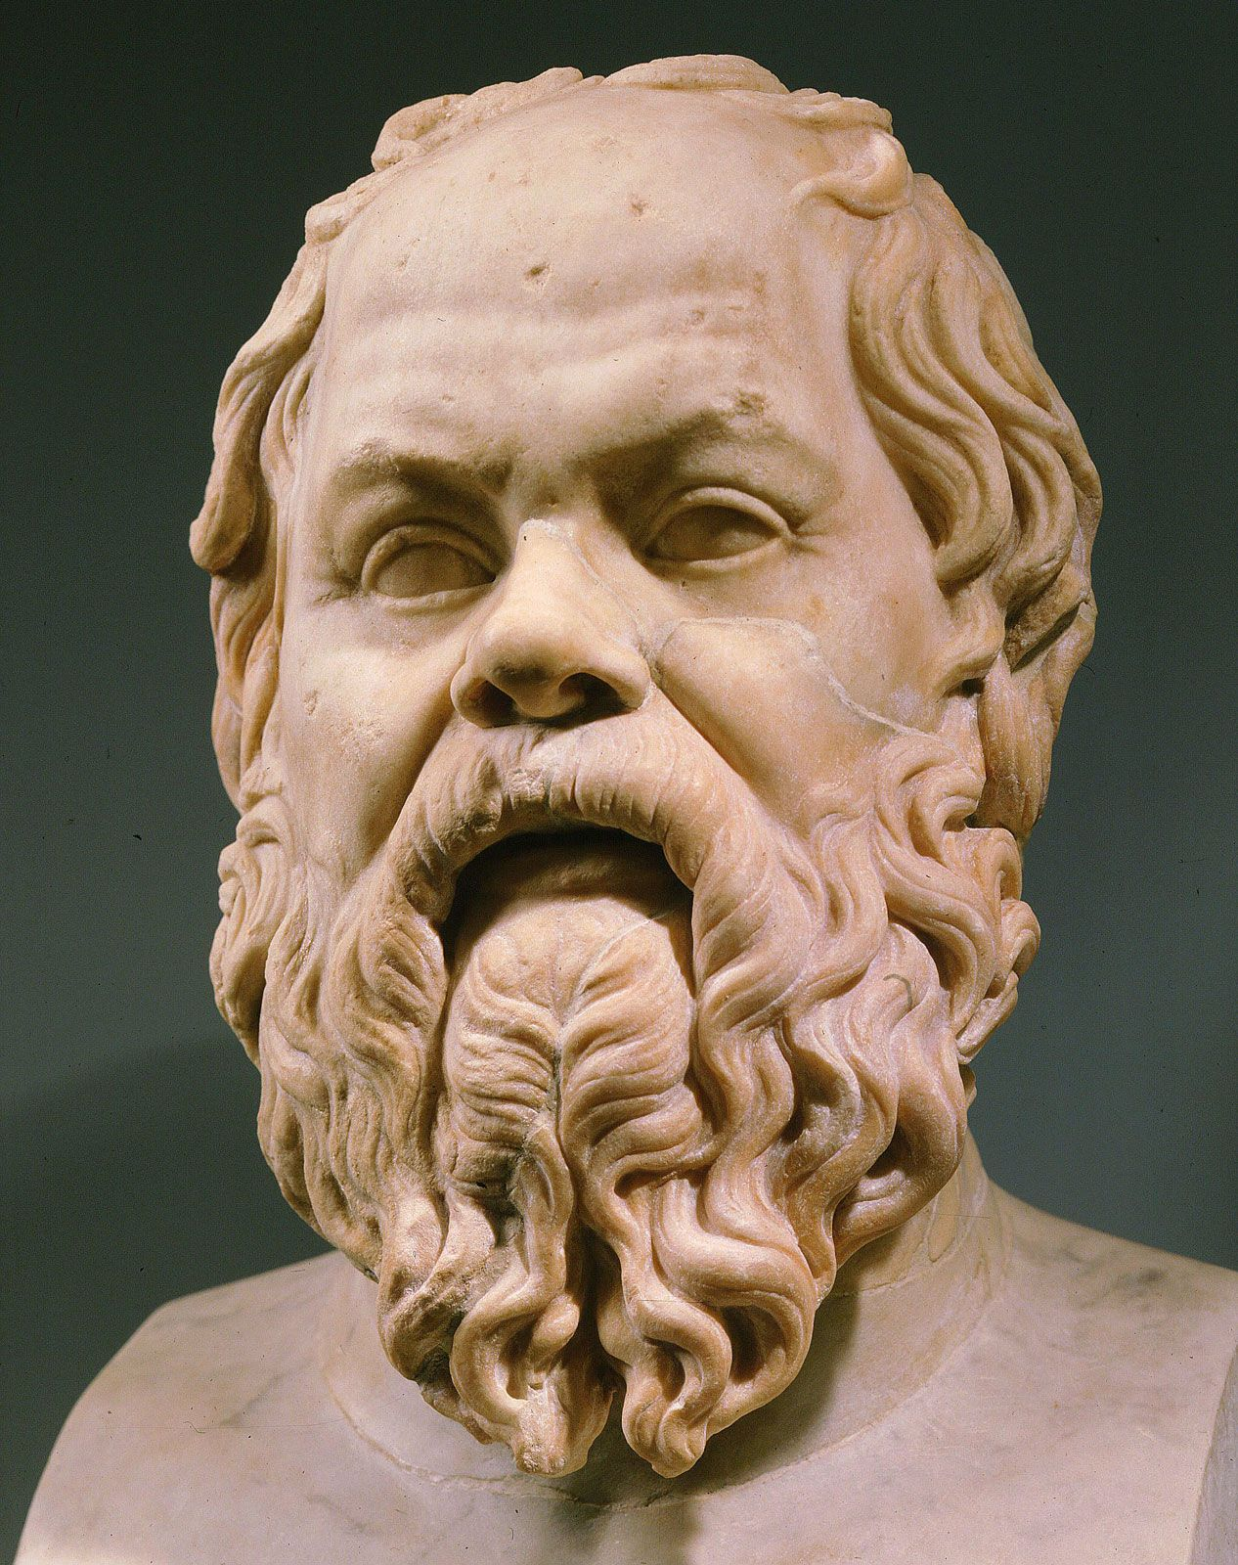
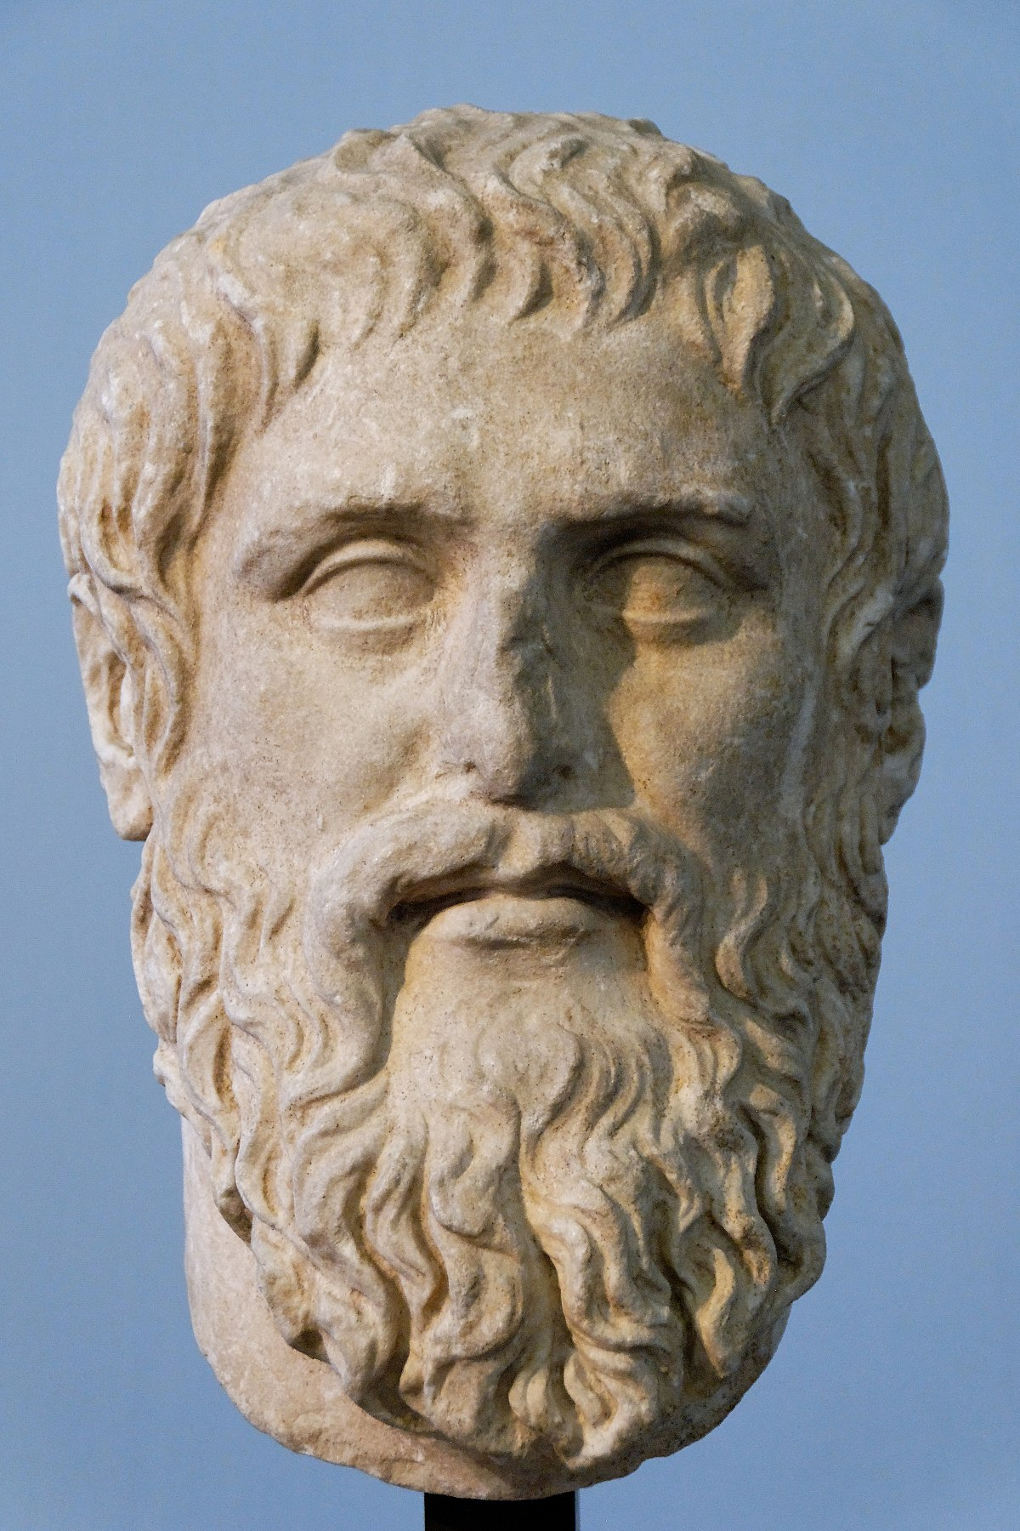
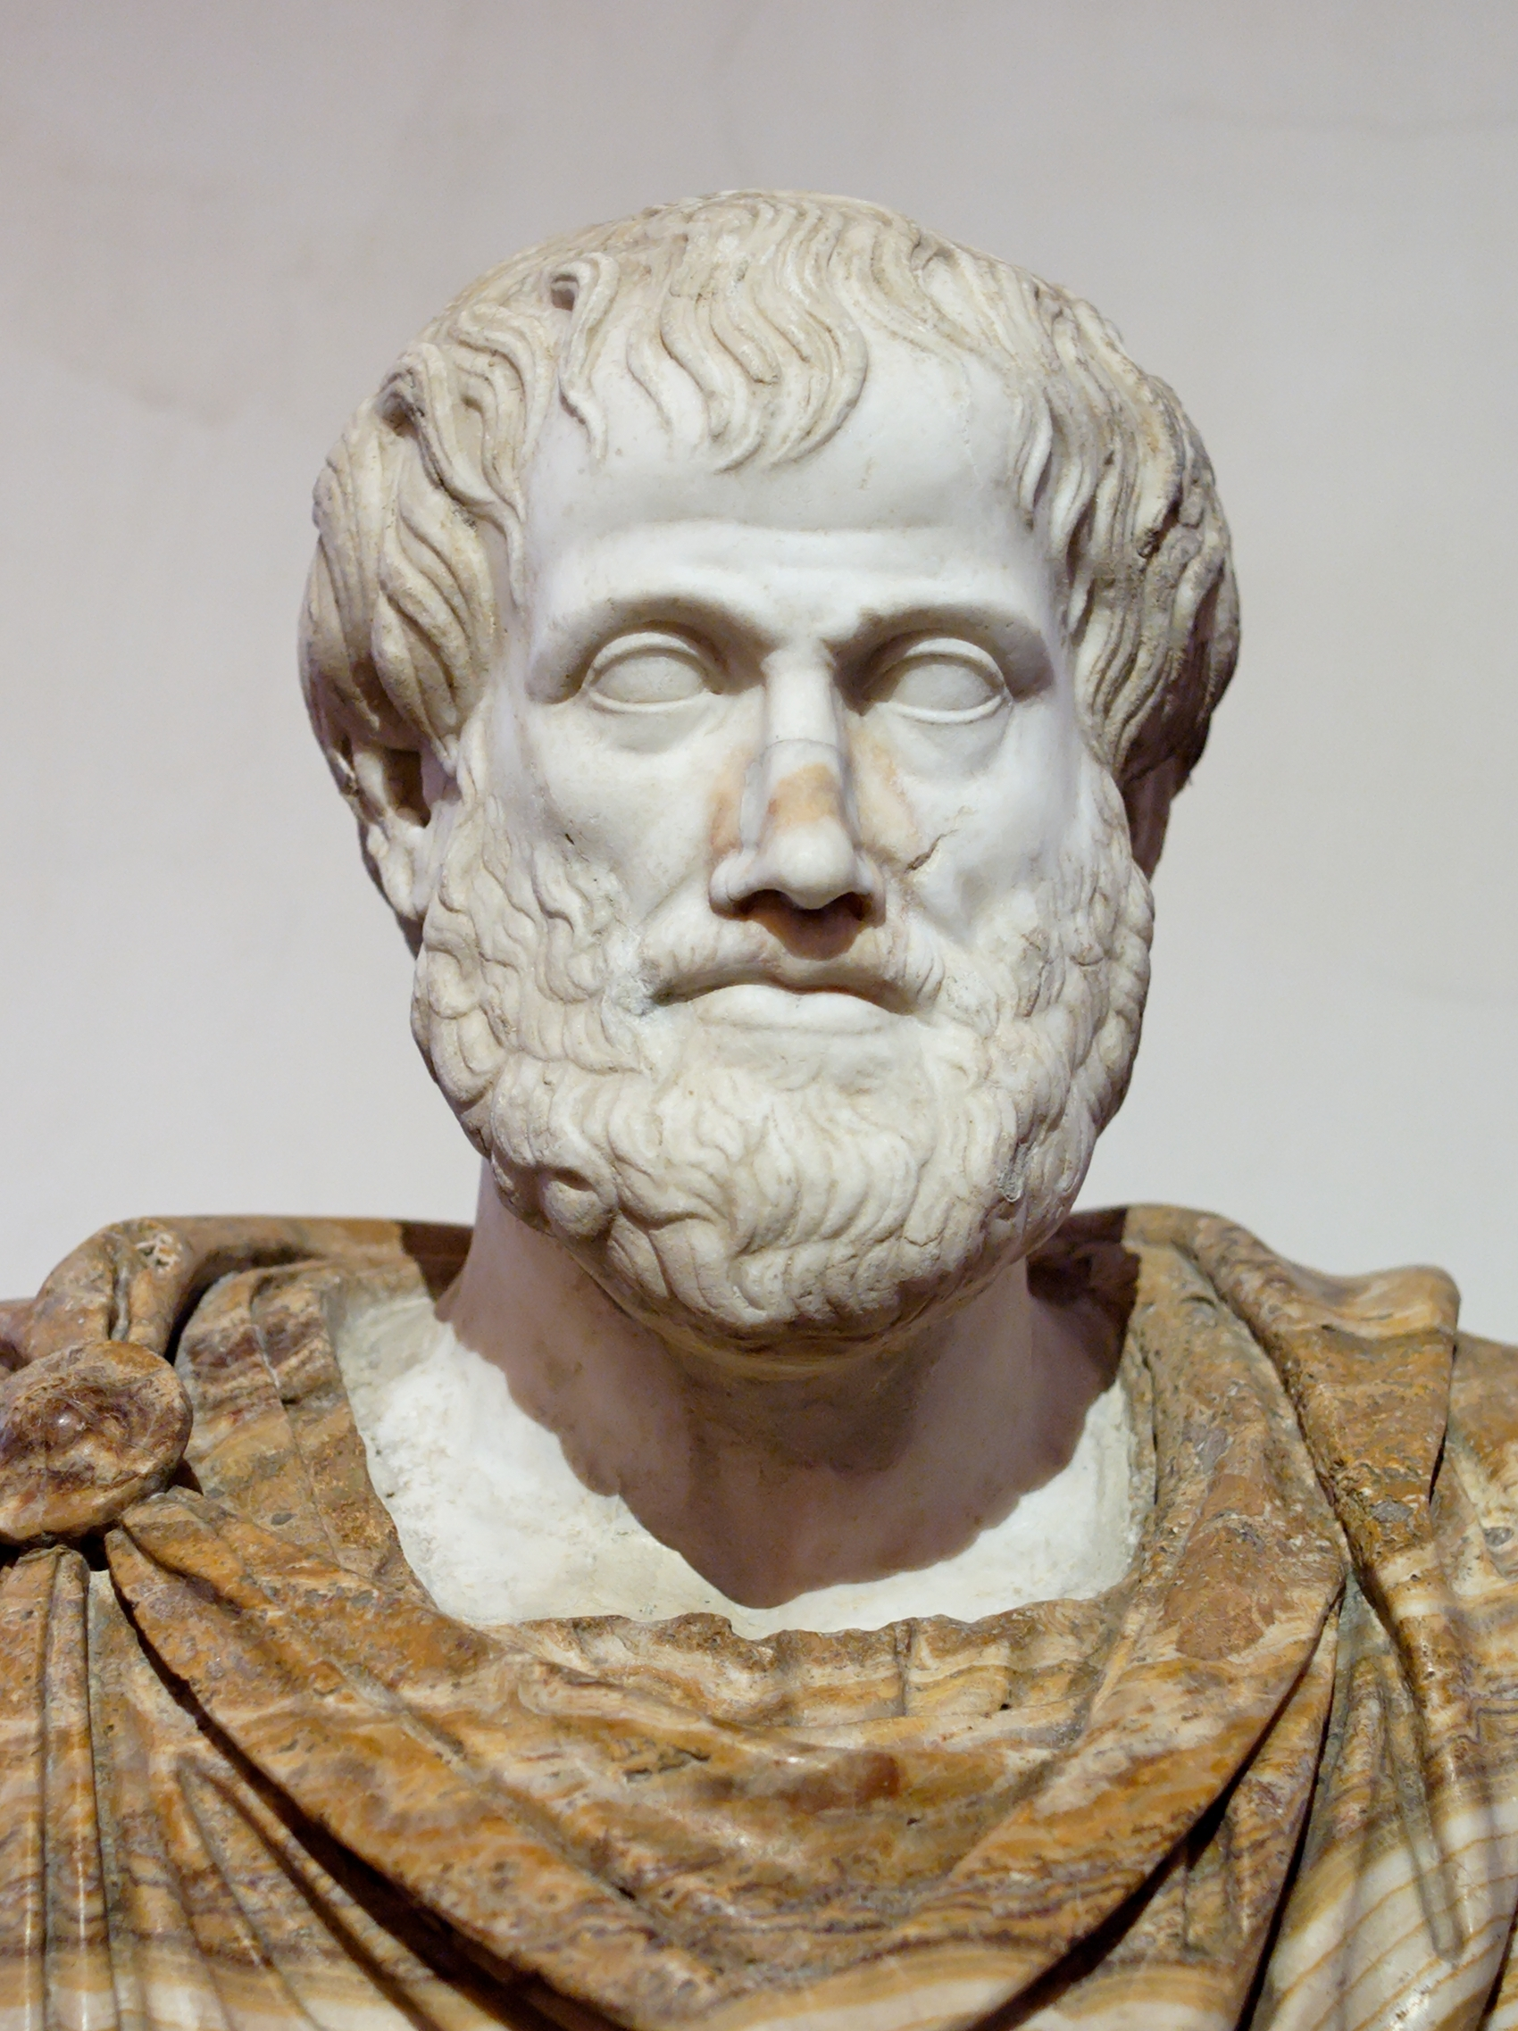
Philosophy
Philo = love sophia = wisdom
→ philosophy = the love of wisdom
Philosophers questioned the world around them and tried to make sense out of what they saw
Socrates Plato Aristotle

Slide 6
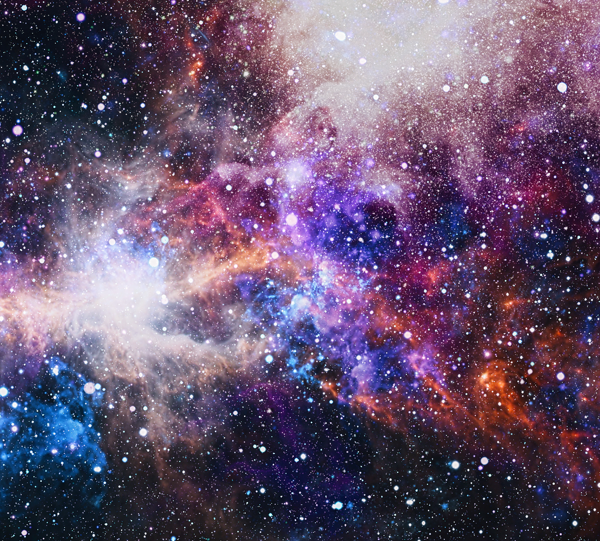
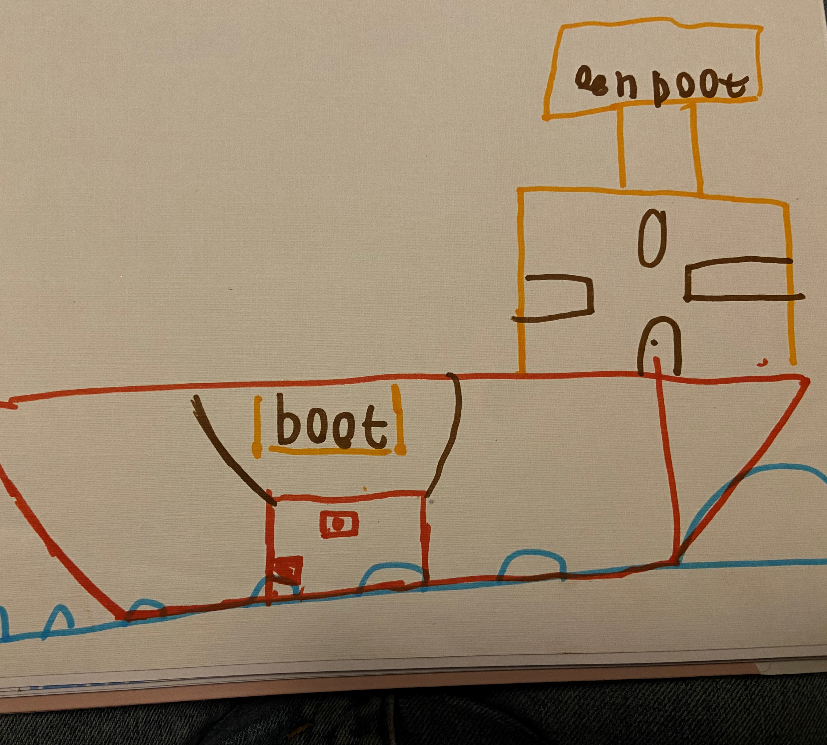
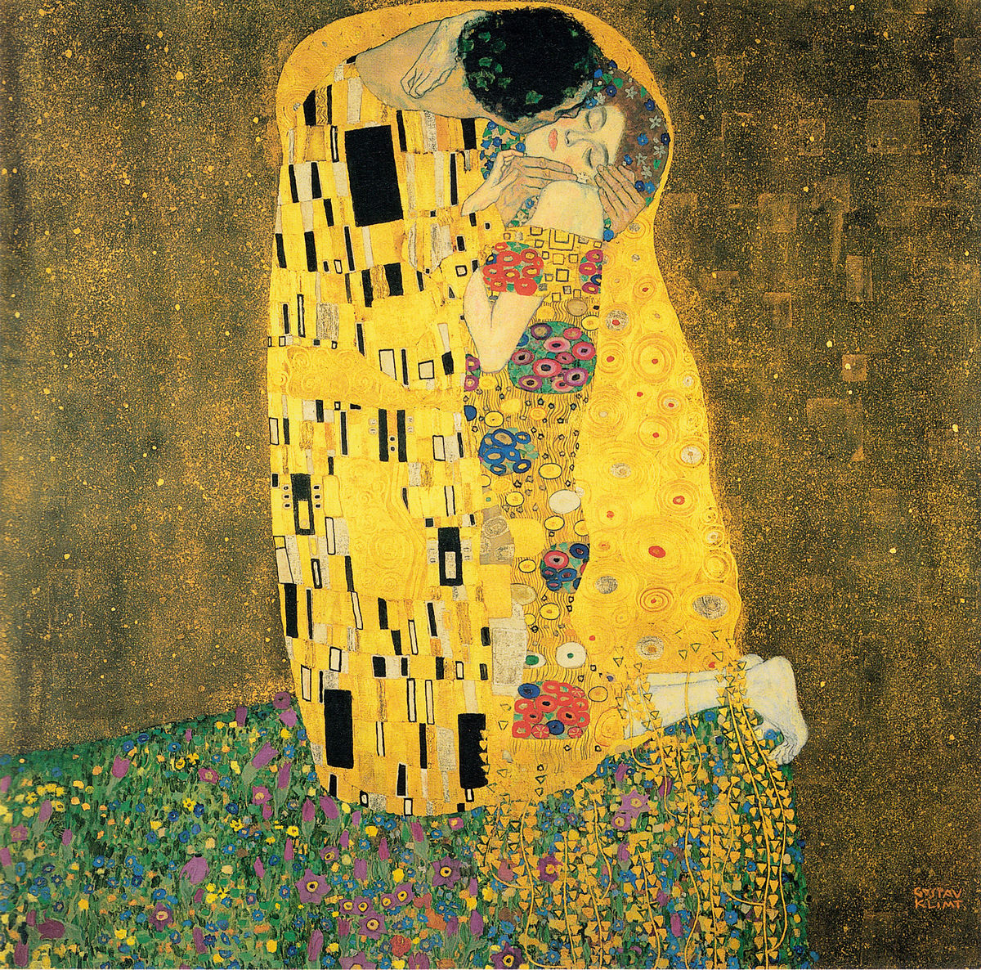
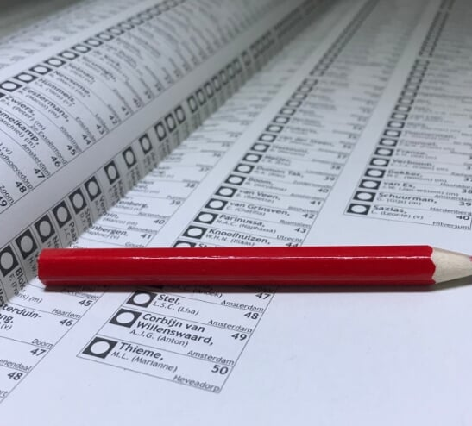
What is philosophy about?
Aesthetics or beauty
Ethics or how to be good
Metaphysics or reality
Nature
Politics

Slide 7
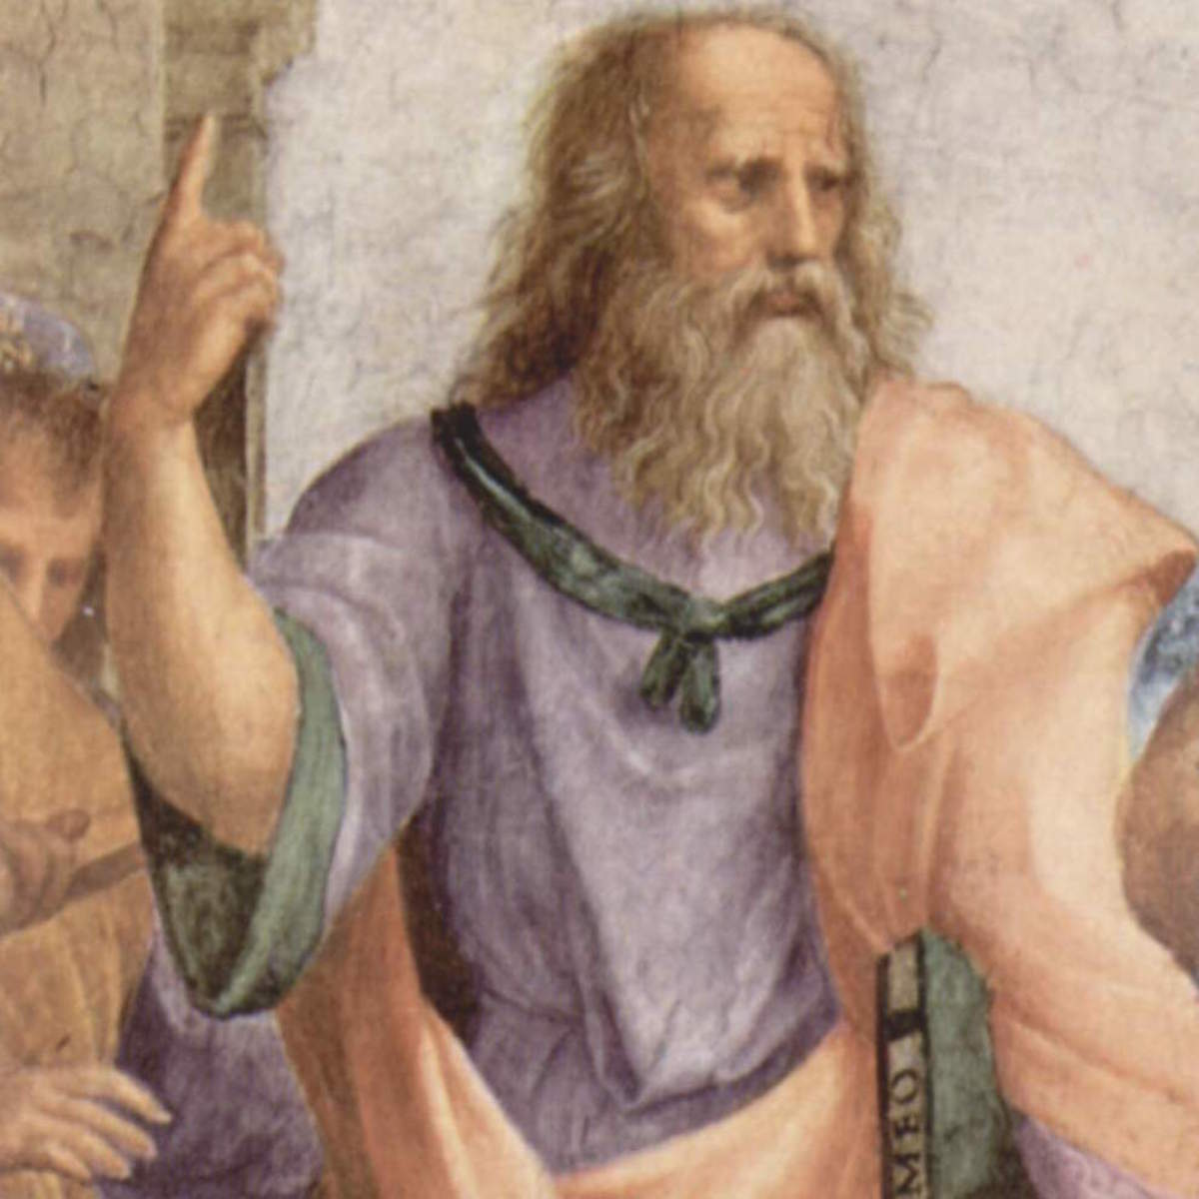
Plato
428 BCE-347 BCE
Athens
Student of Socrates
The Republic

Slide 8
Plato
Appetite or hunger → seek for enjoyment
Spirit or emotions → seek for challenges
Logic or rational thinking → seek for wisdom
Balance!

Slide 9
Plato’s state
Each state had three groups:
Philosopher kings
Workers
Soldiers
No democracy!

Slide 10
Assigment (max 10 minutes)
In pairs and in English
Draw a human body and place appetite, spirit and logic
Match Plato’s groups in the state (philosopher kings, workers and soldiers) to these body parts
Answer questions on the handout

Slide 11
Plato
The three parts of a human
Appetite or hunger → seek for enjoyment
Spirit or emotions → seek for challenges
Logic or rational thinking → seek for wisdom
The three parts of a state
Philosopher kings
Workers
Soldiers

Slide 12
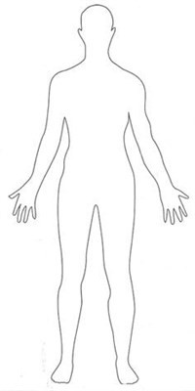
Head = logic & philosopher kings
Heart = spirit & soldiers
Stomach = appetite & workers

Slide 13
Learning goals
At the end of the lesson you can define philosophy
1
At the end of the lesson you can name at least three subjects of philosophy
2
At the end of the lesson you can explain what Plato’s ideal state looked like
3

