Slide 1
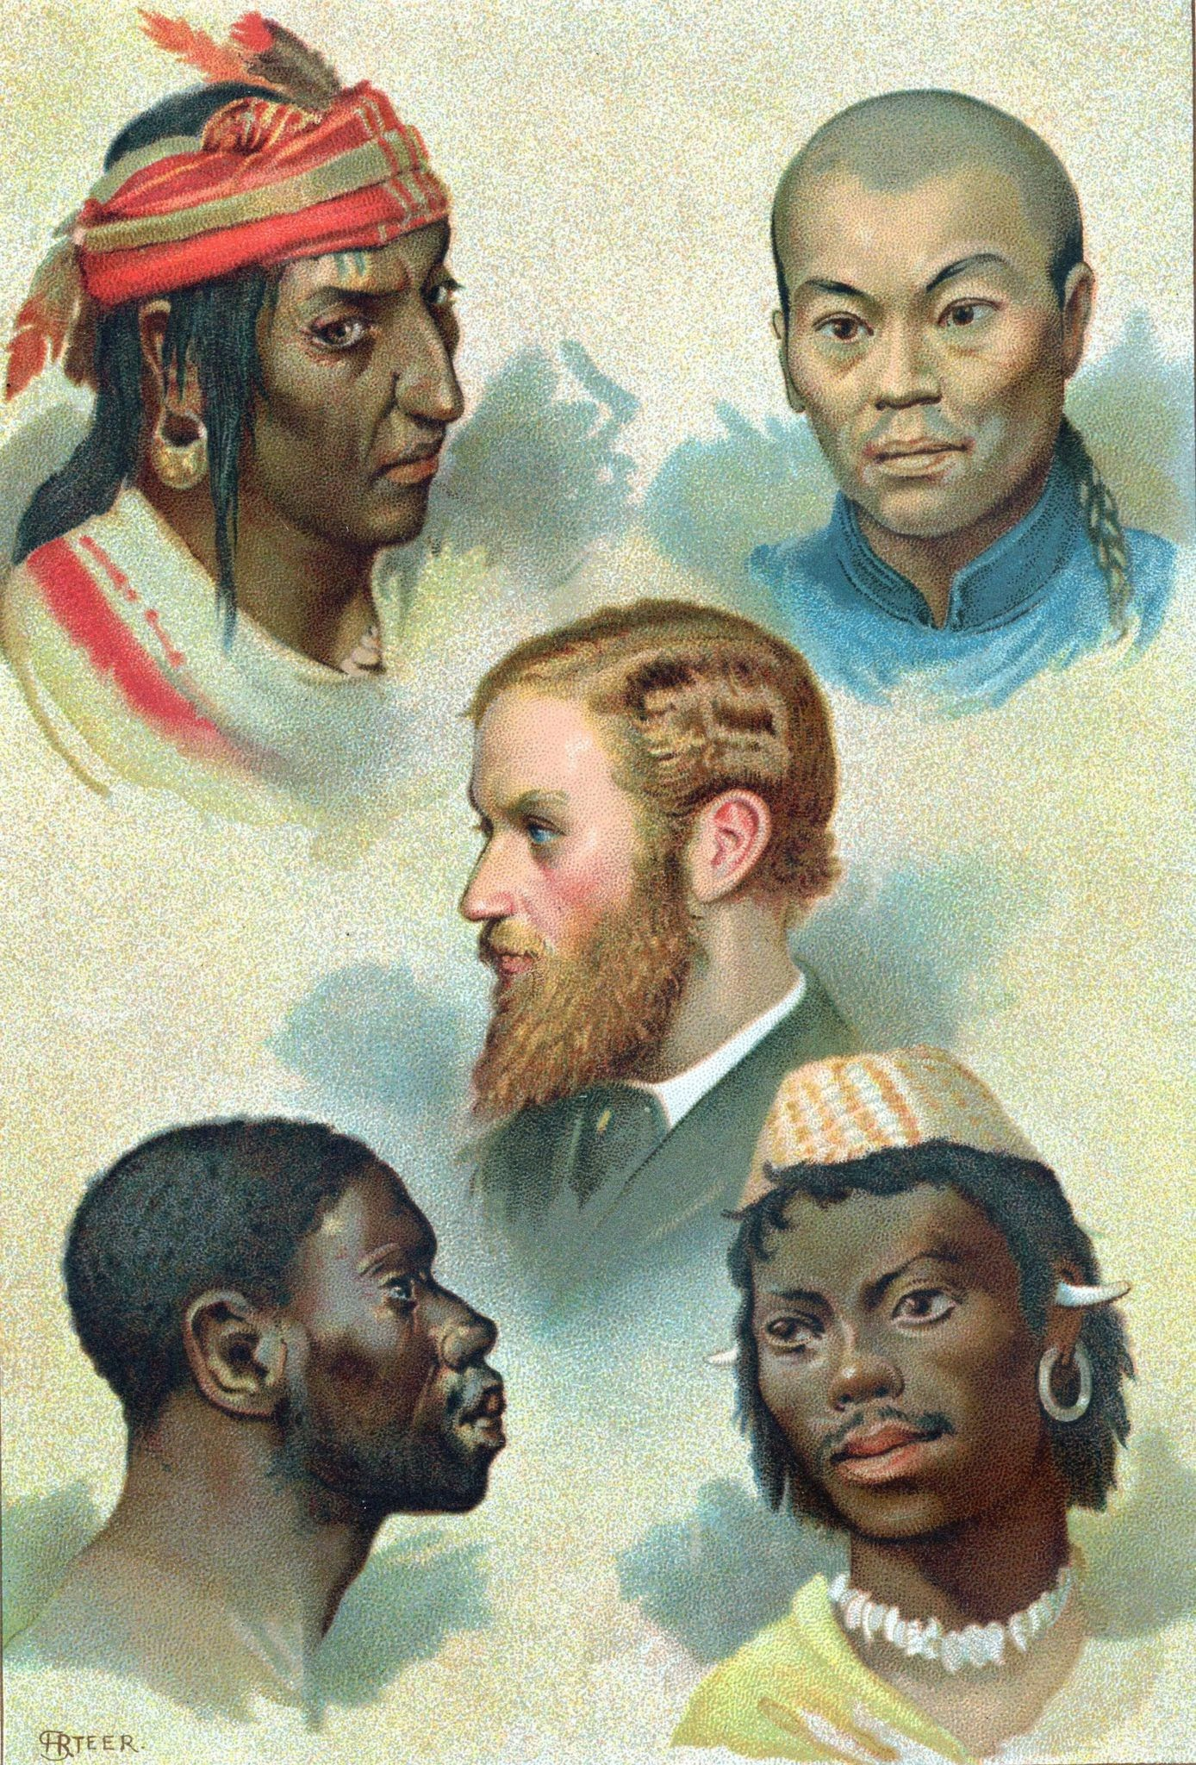
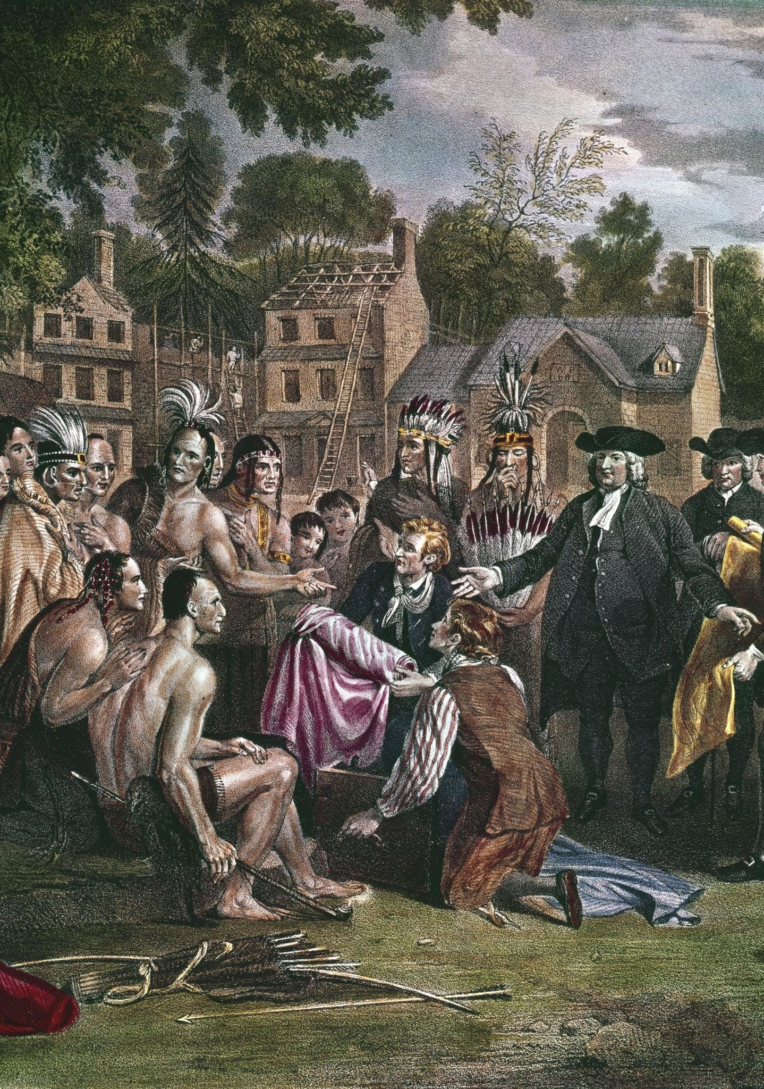
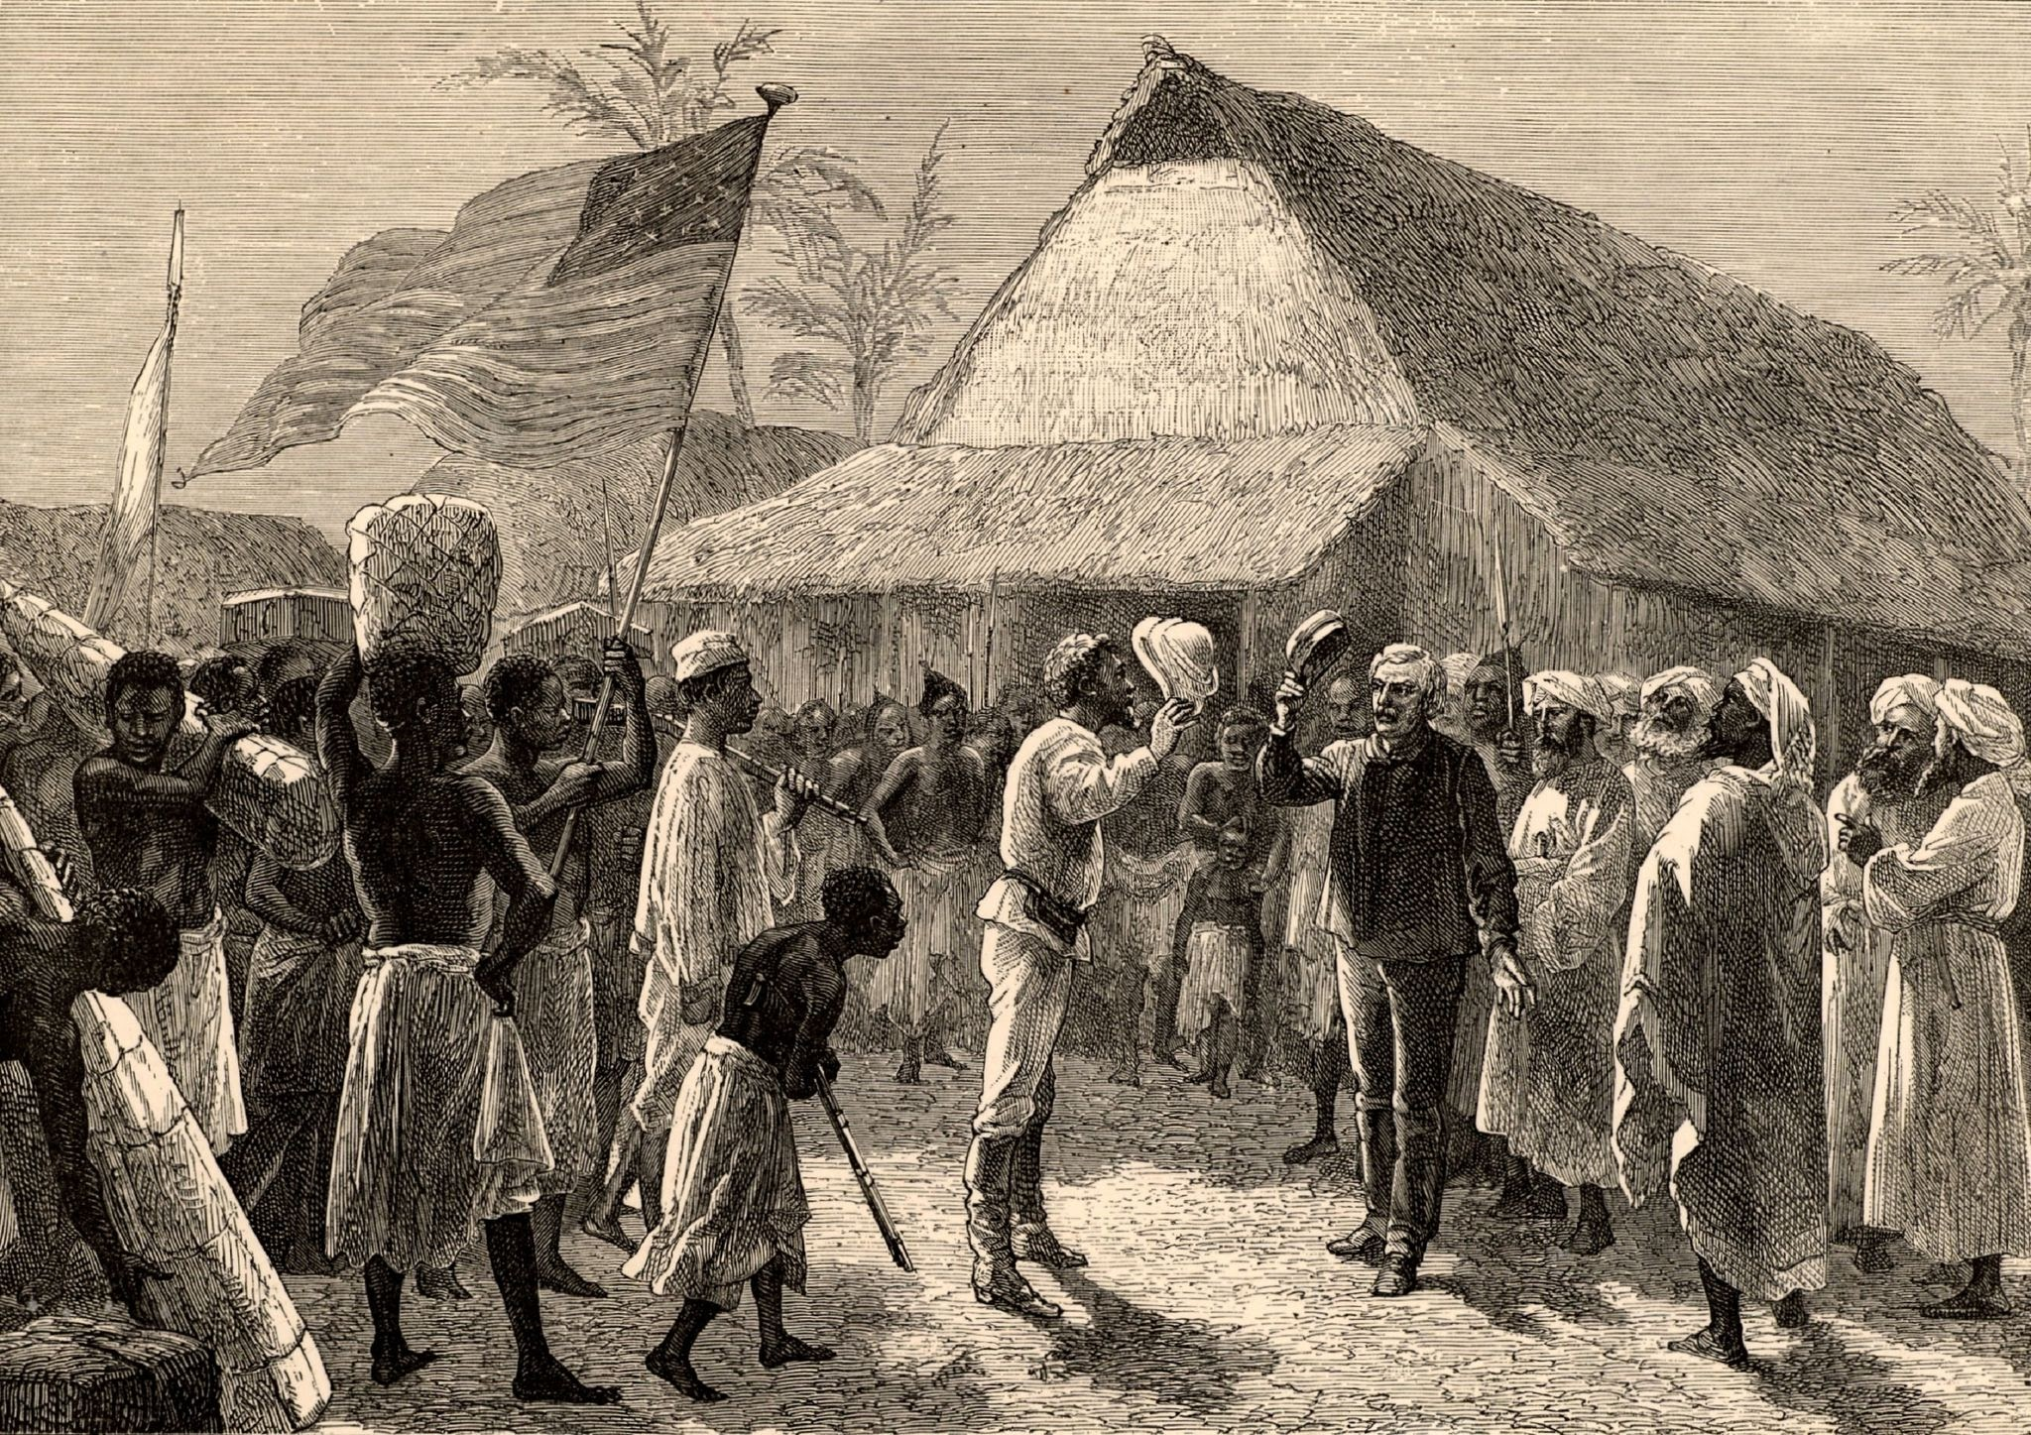
TEACHING COLONIAL HISTORY
Presentation by Lethukukhanya Mbambo, History Educator at Westerford High School

Slide 2
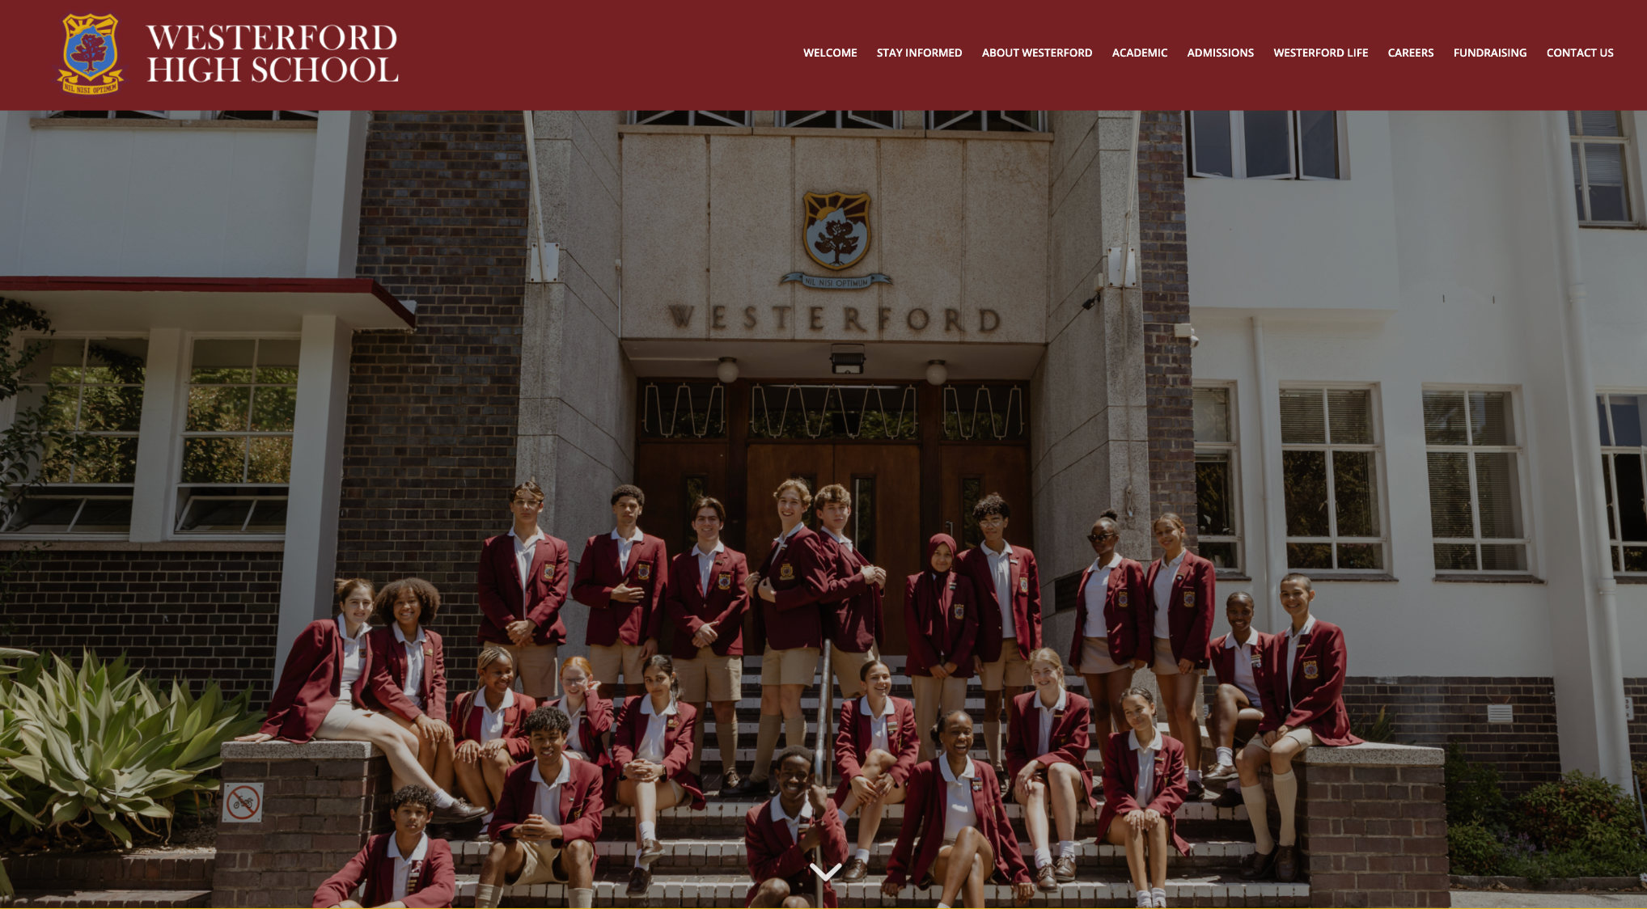

Slide 3
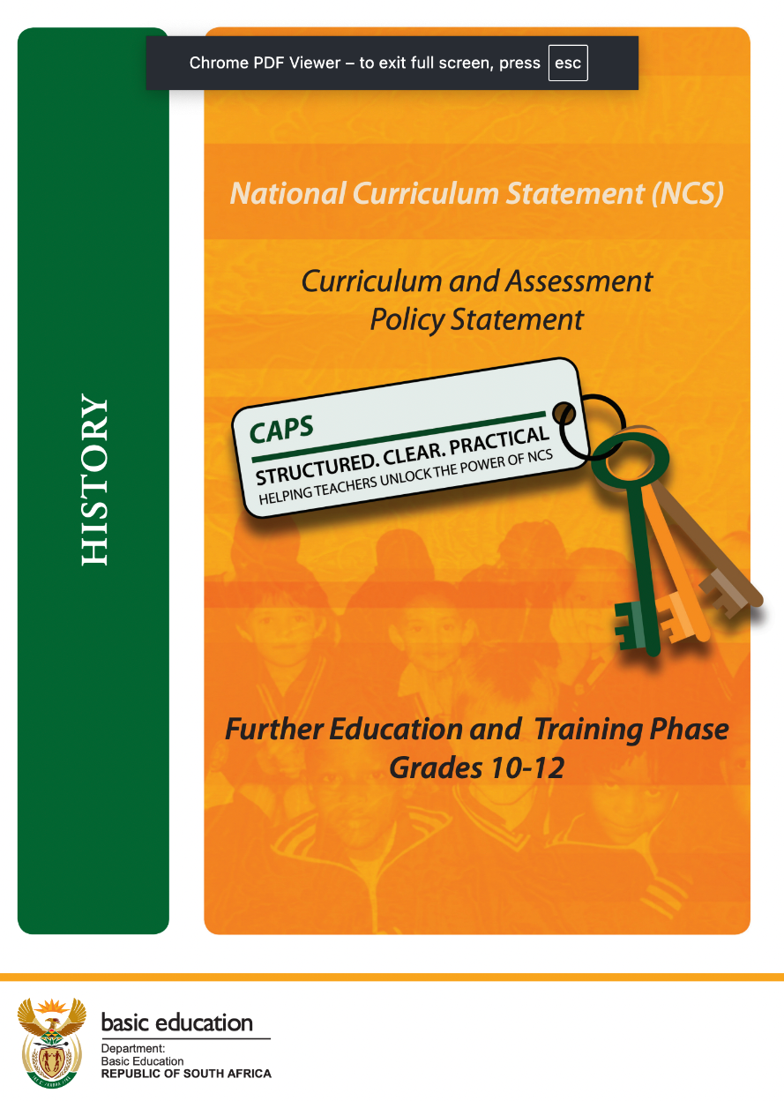
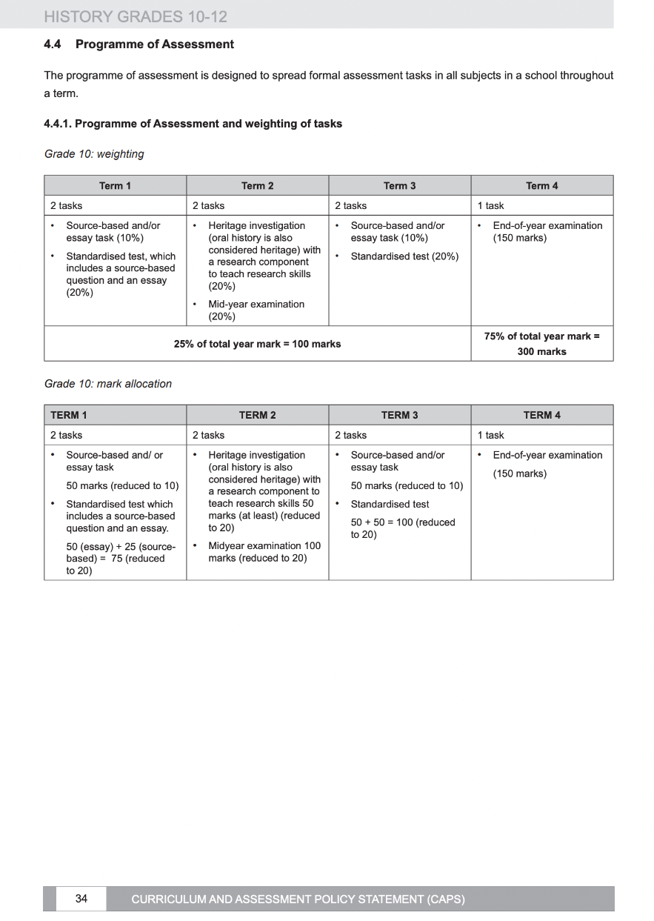
Curriculum and Assessment Policy Statement (CAPS)

Slide 4
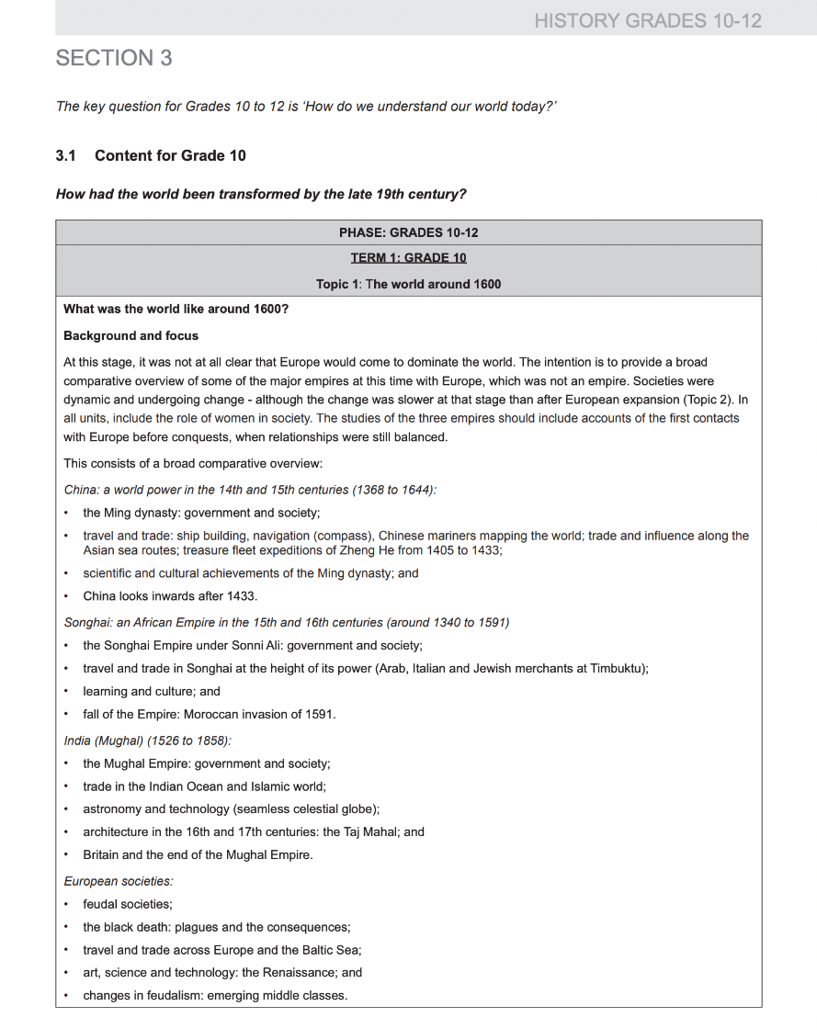
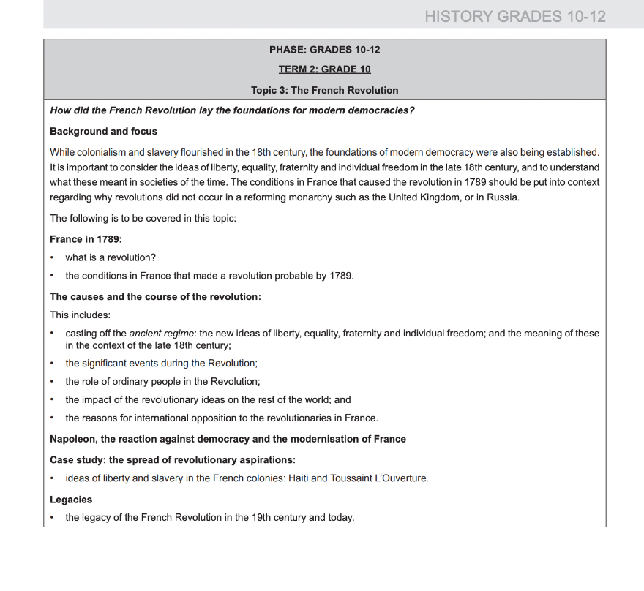
CAPS in Grade 10

Slide 5
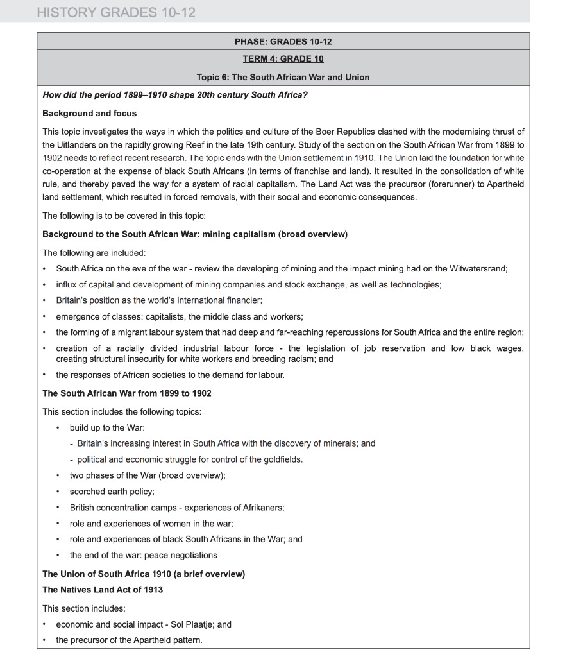
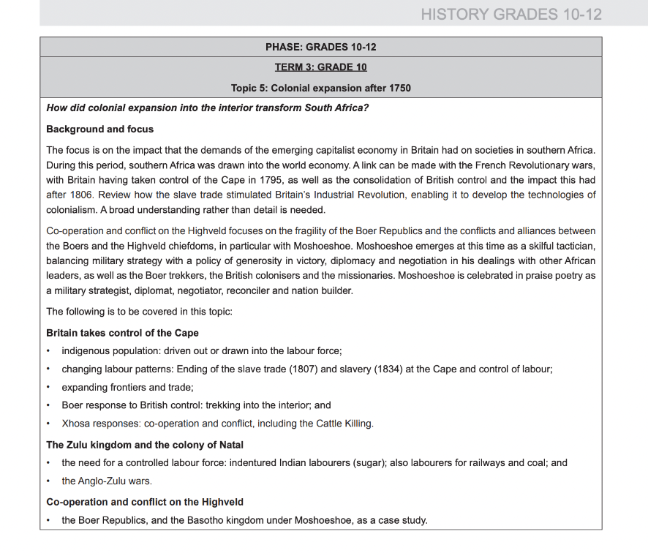
CAPS in Grade 10 (continued)

Slide 6
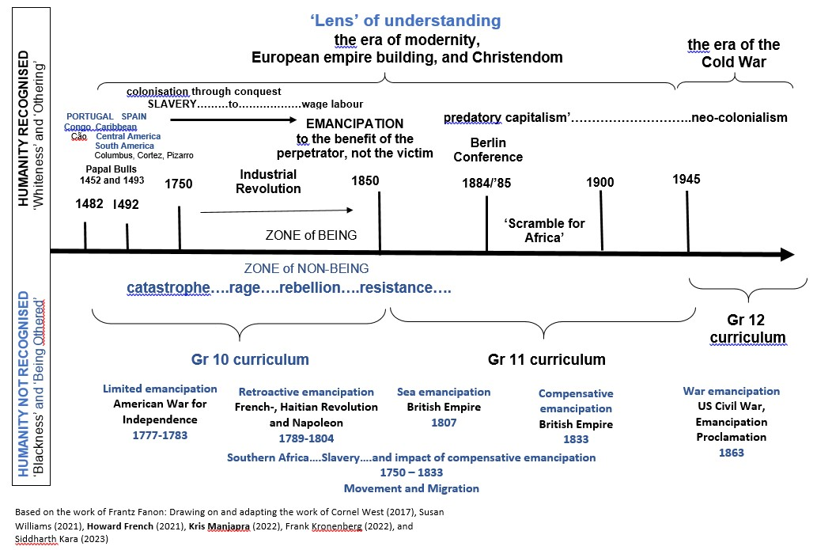

Slide 7
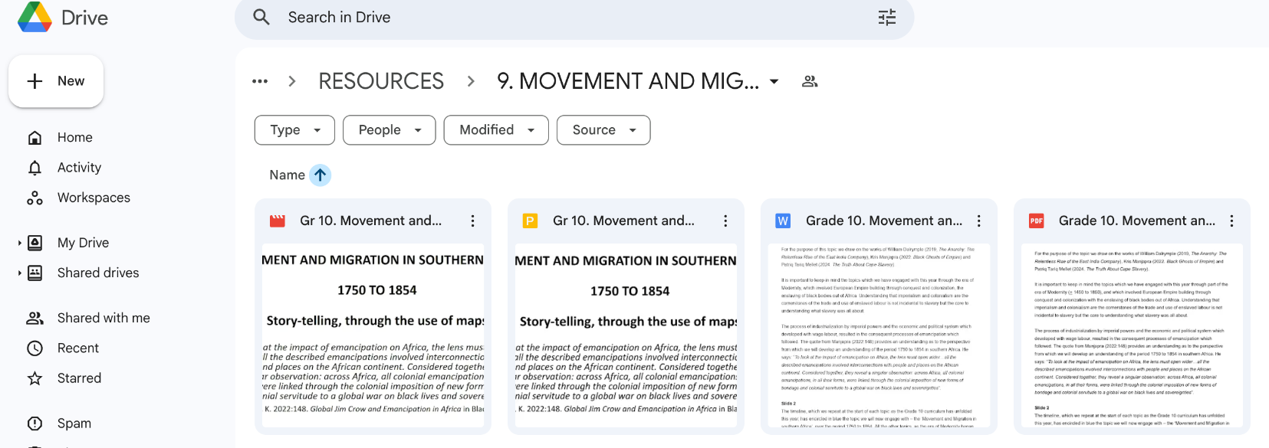
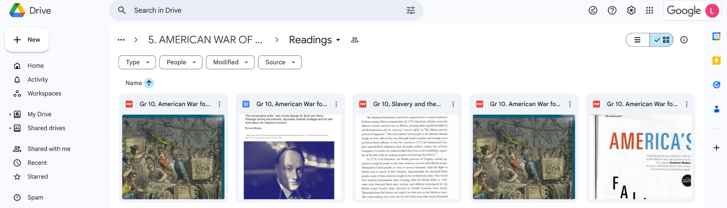
What teaching materials do we use?

Slide 8
Thank you for your attention!
During the second webinar, I will delve deeper into the methodology used to unpack teaching colonial history, share some activities/assessments and highlight the difficulties faced with teaching this colonial history at Westerford..

