Slide 1
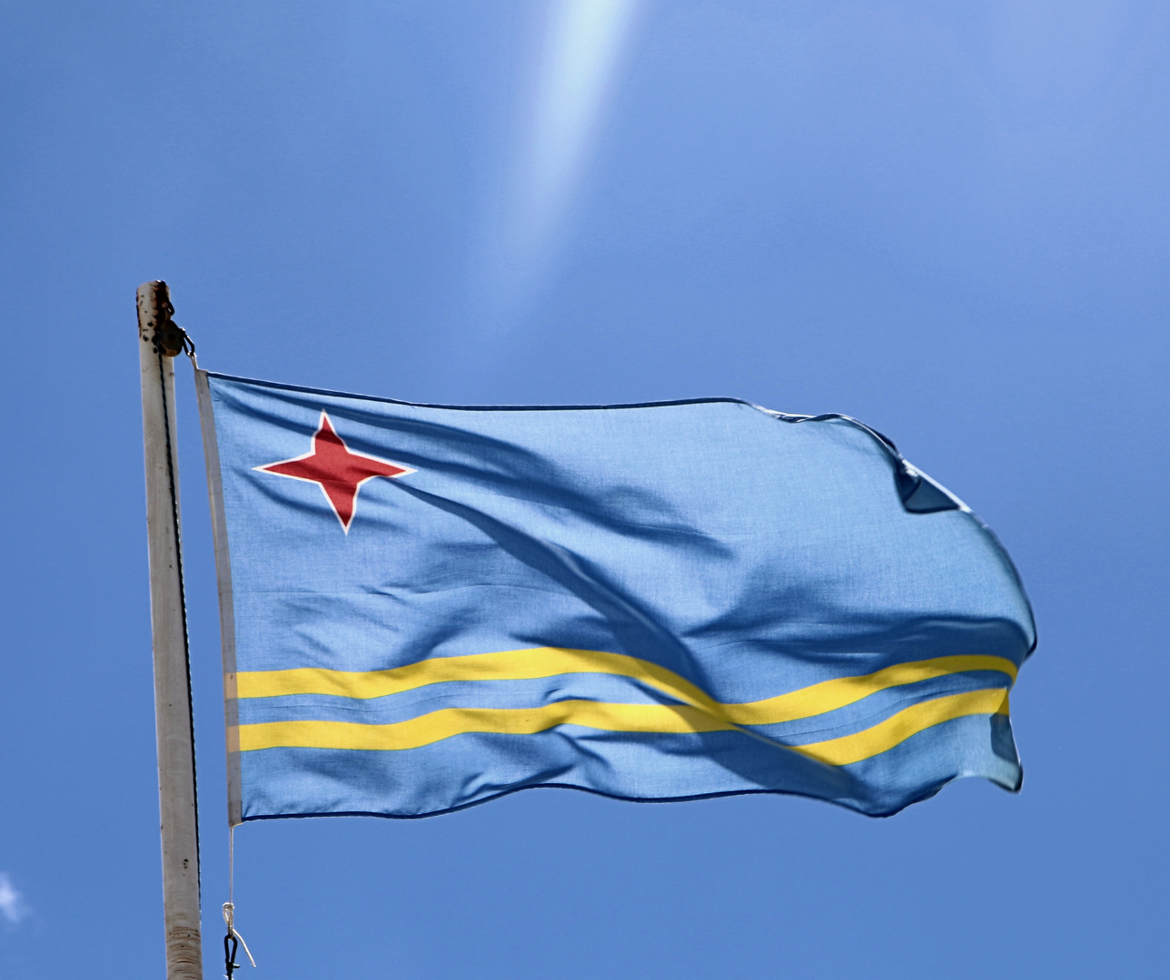
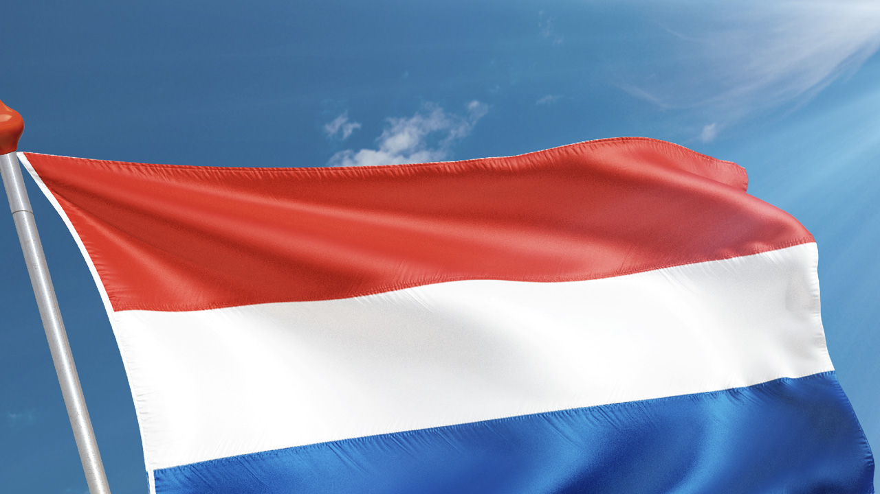


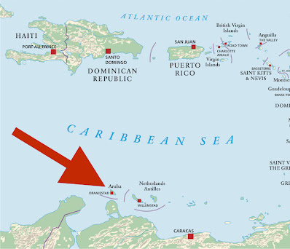
History & Civics
Colegio Arubano, High school for Havo/VWO
Aruba

Slide 2
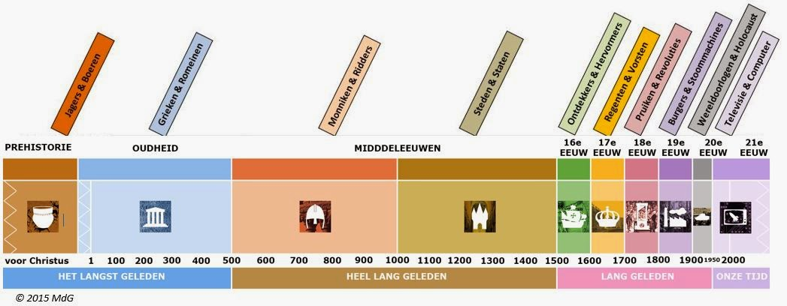
Aruban history programme aims
Mavo-Havo-VWO
A. Historical skills: source and question formulation, fact and objectivity, cause and effect, change and continuity, historical empathy, Historical interpretation, historical investigation, historical research
B. Historical awareness: placing historical events in historical epochs
C. world history 3000 BC- 1500 AD
world history 1500 AD-1750 AD
World History 1750-today
D. History of Aruba, the CAribbean and Latin-America
E. Civics (staatsinrichting) of Aruba

Slide 3
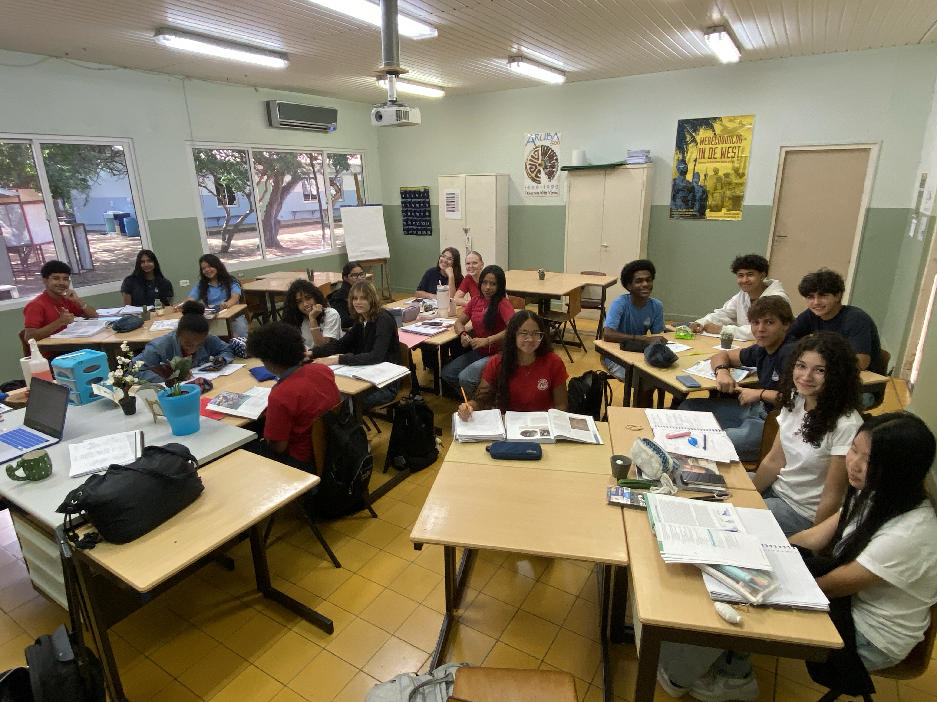
Our Students in Aruba
In Aruba we teach students with different backgrounds: ancestors from Latin-America, Africa, Europe, Asia, etcetera
We have a ‘melting pot’ of different cultures together on one happy Island

Slide 4


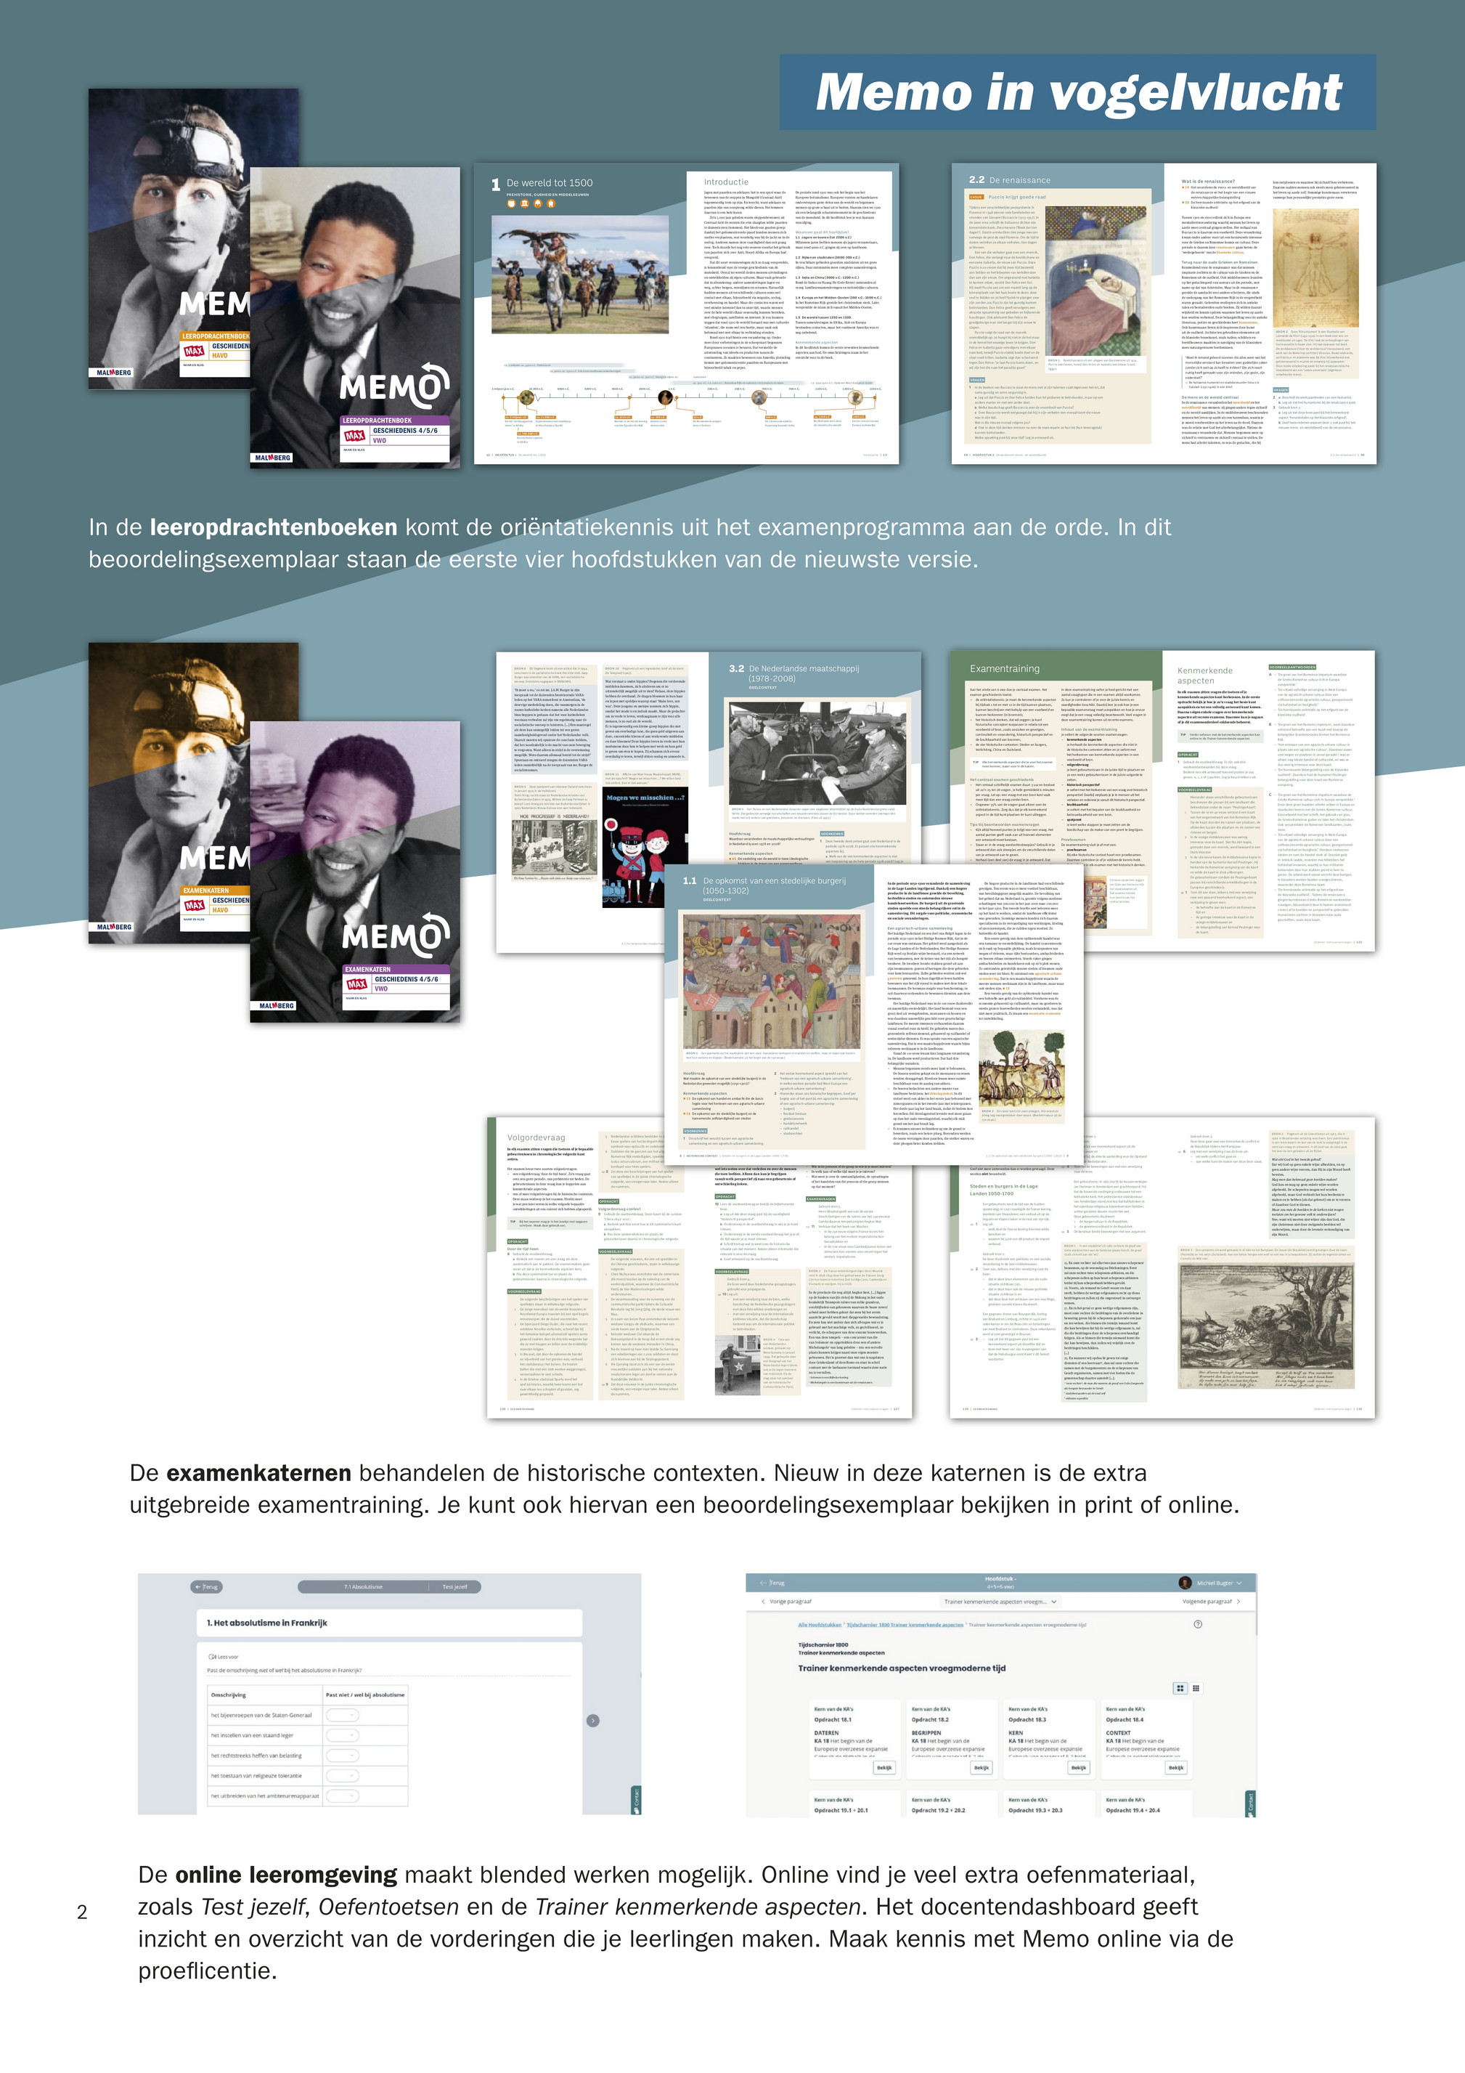
Teaching Material history & civics
Memo: world history
Feniks: Latin-America and the western world
Burgerschap en bestuur op Aruba (civics)

Slide 5
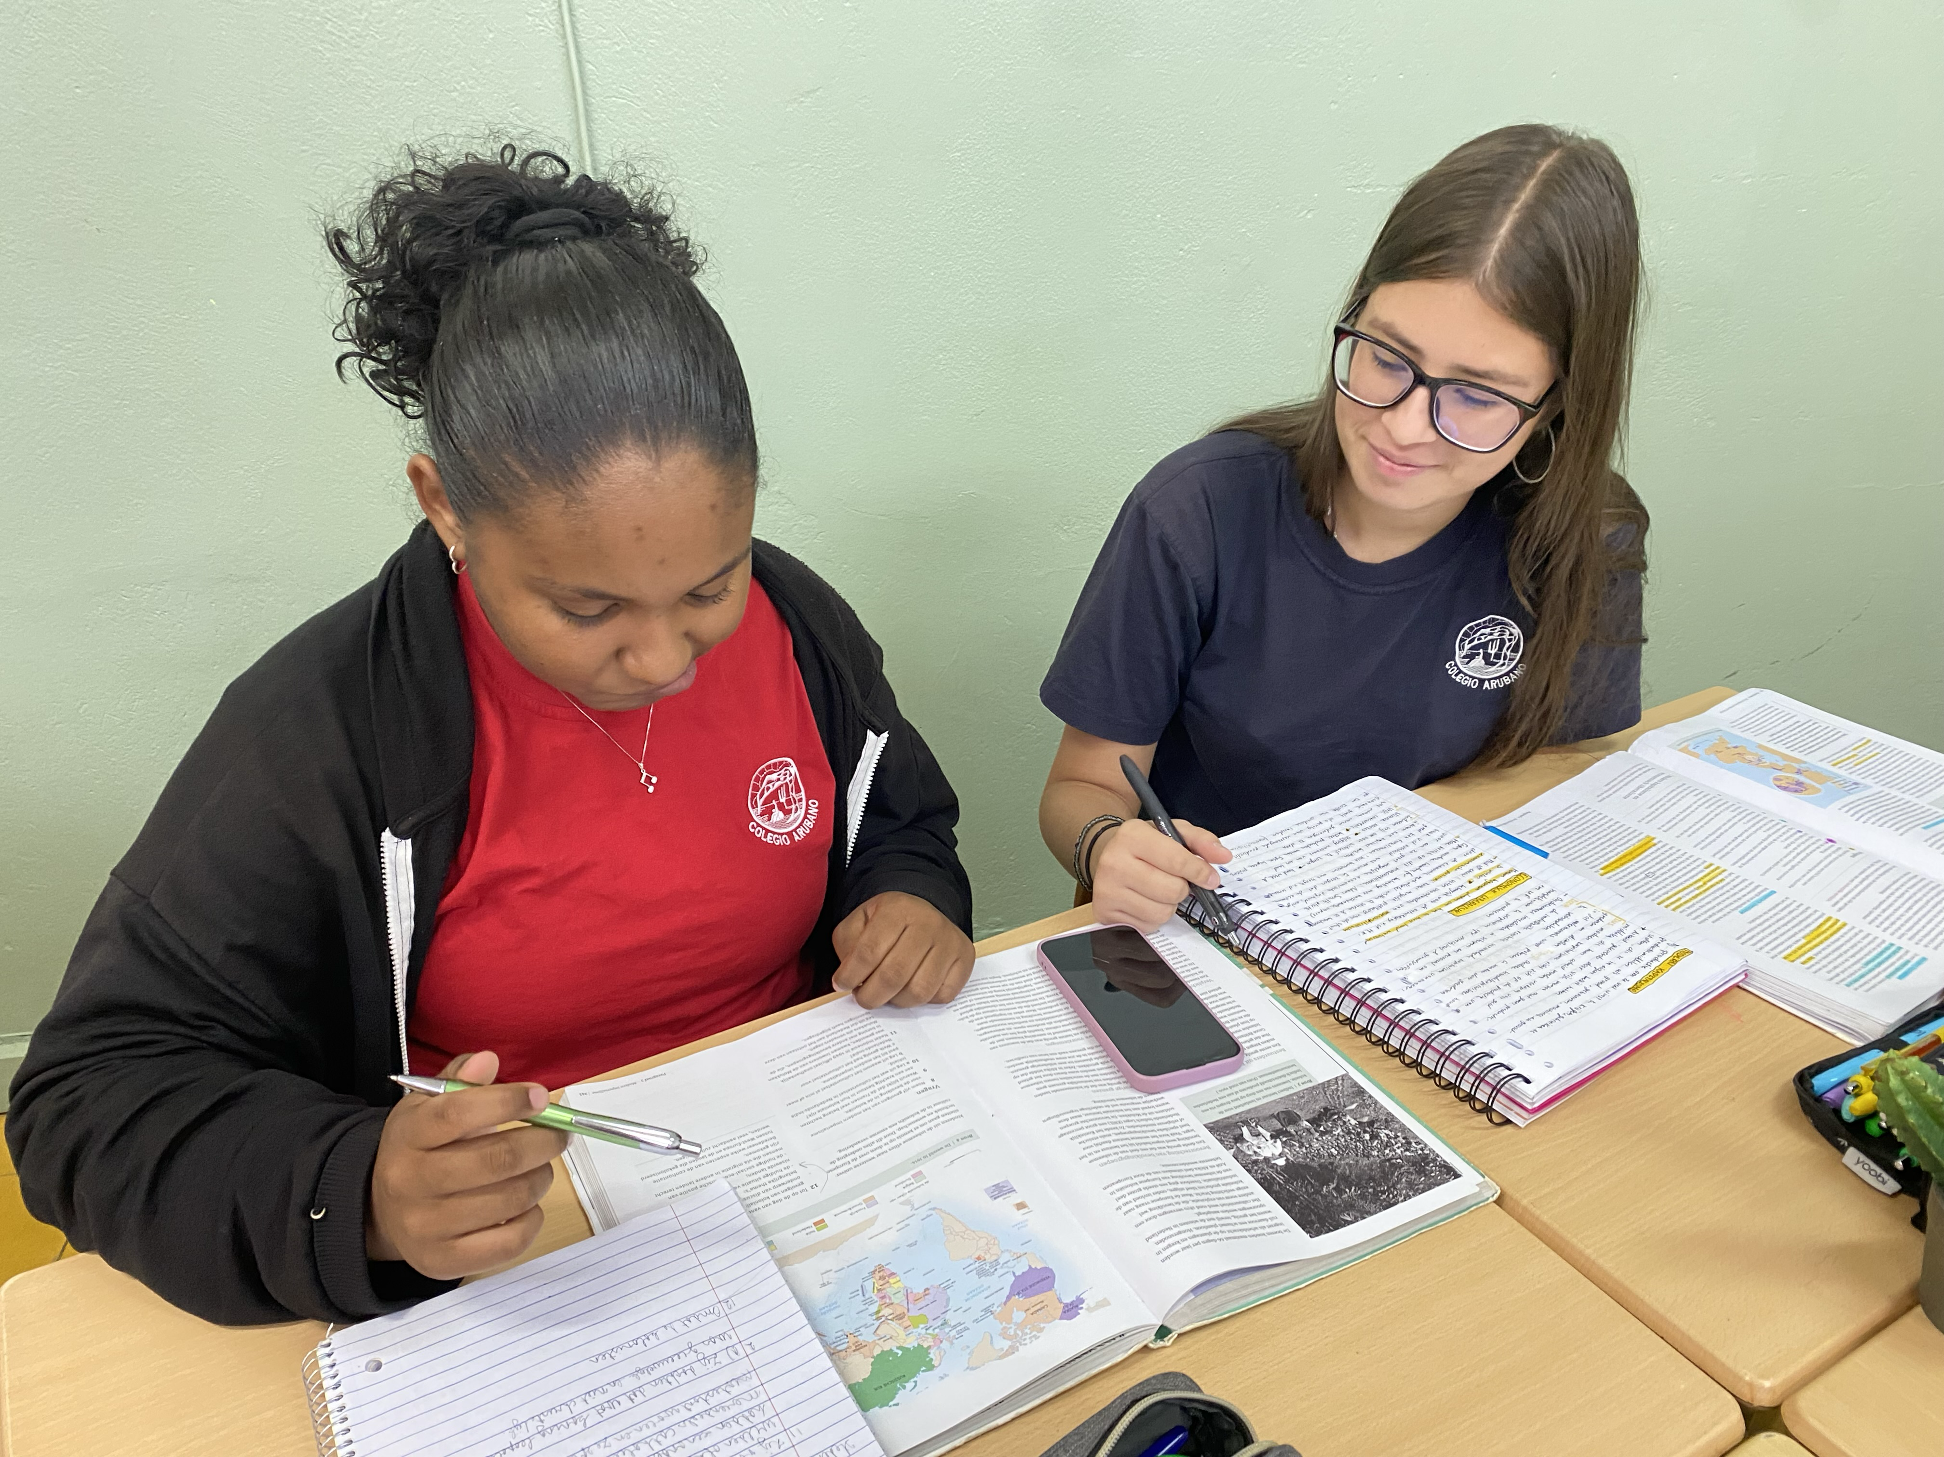
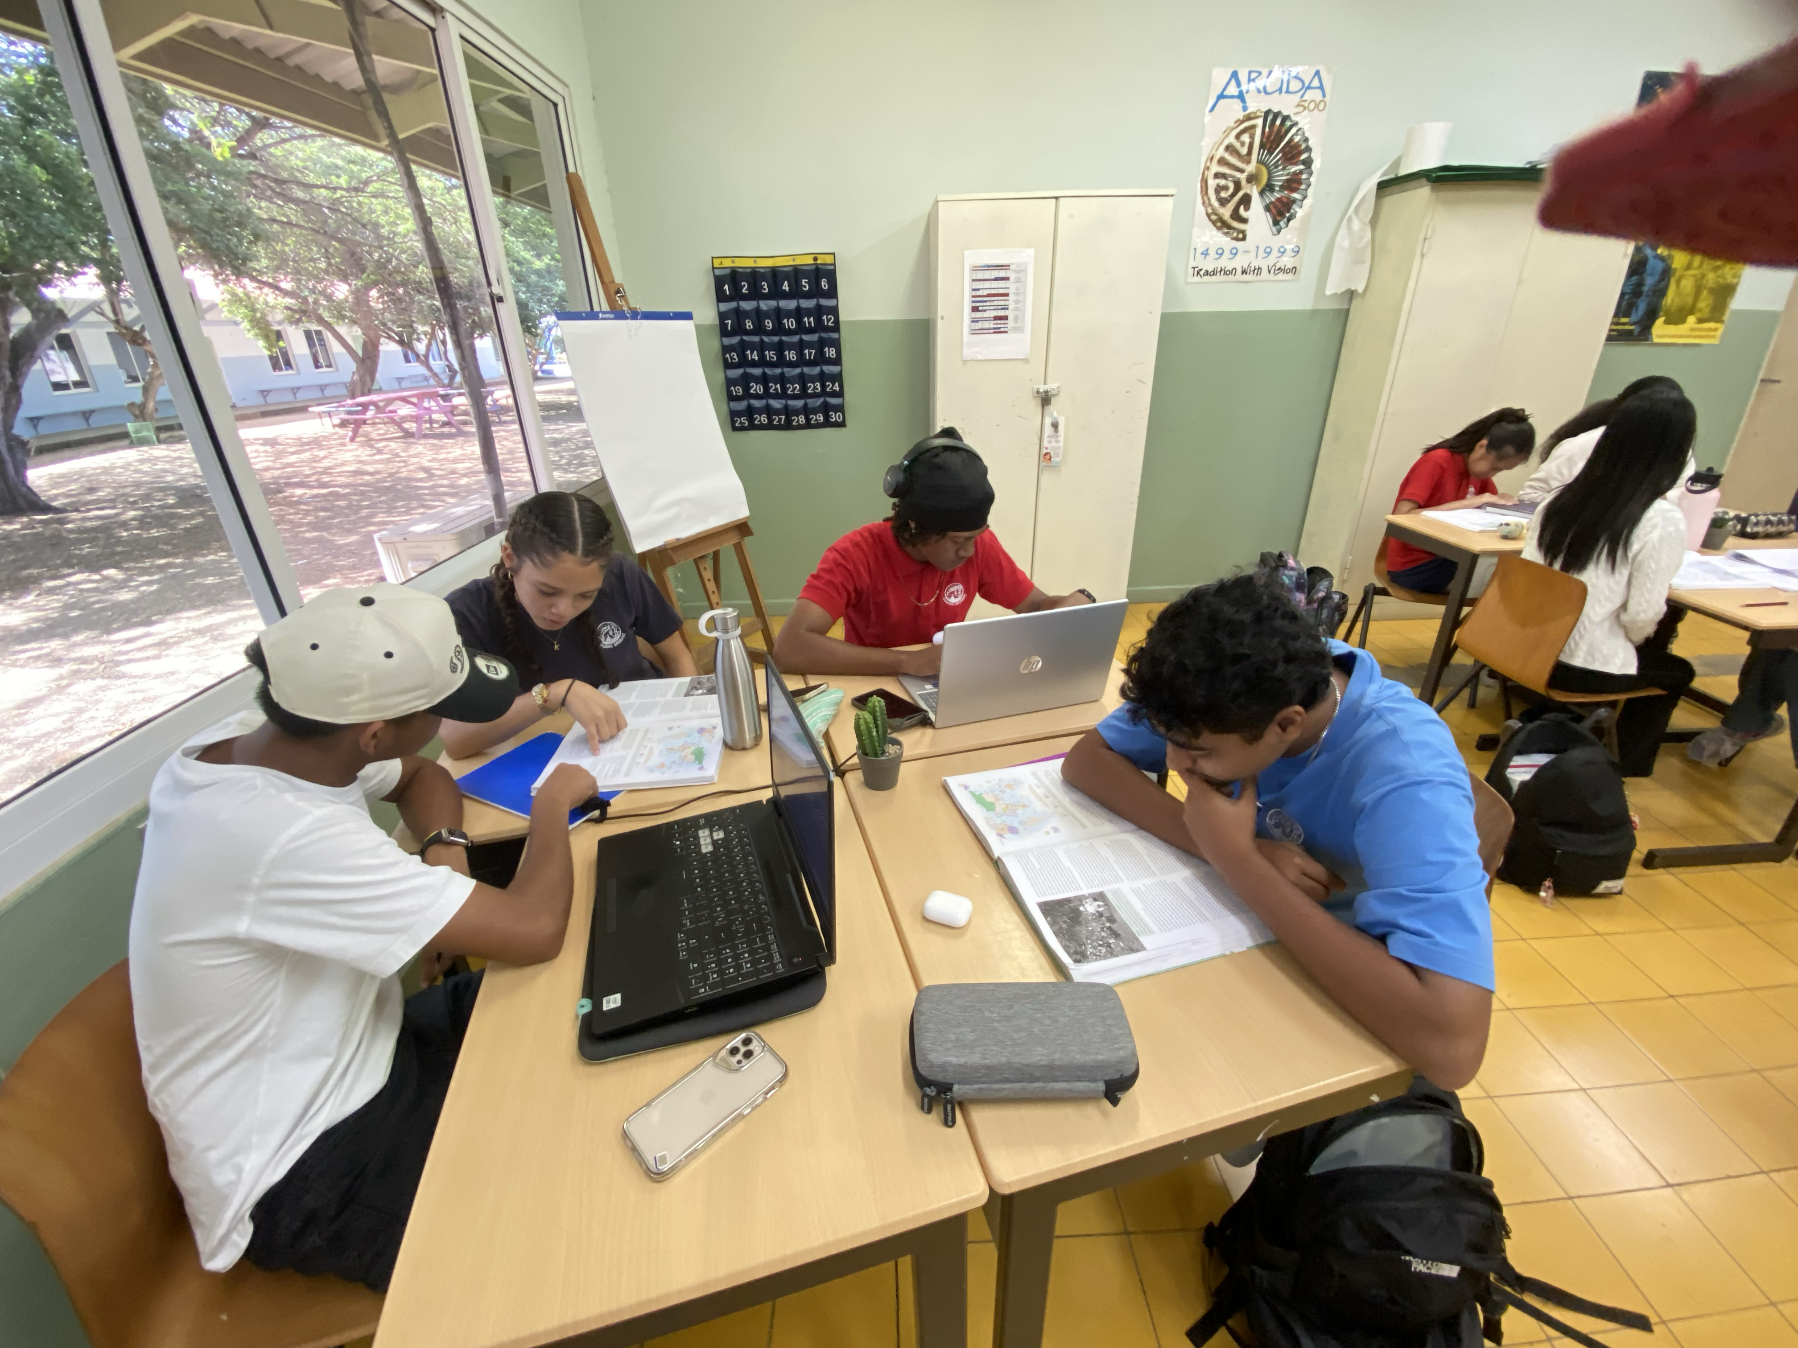
Difficulties when teaching colonial history
When teaching we try to teach from the point of view of the different countries within the Kingdom of the Netherlands (Aruba, Curaçao, St. Martin, The Netherlands), but also from the point of view of independent ex-colonies like Surinam/Latin AMerica and Indonesia
Constantly translanguaging, but the books are in Dutch
difficult topics: Indian slavery, African slavery, (de-)colonization, or debating Civics (staatsinrichting) within the kingdom of the Netherlands

Slide 6
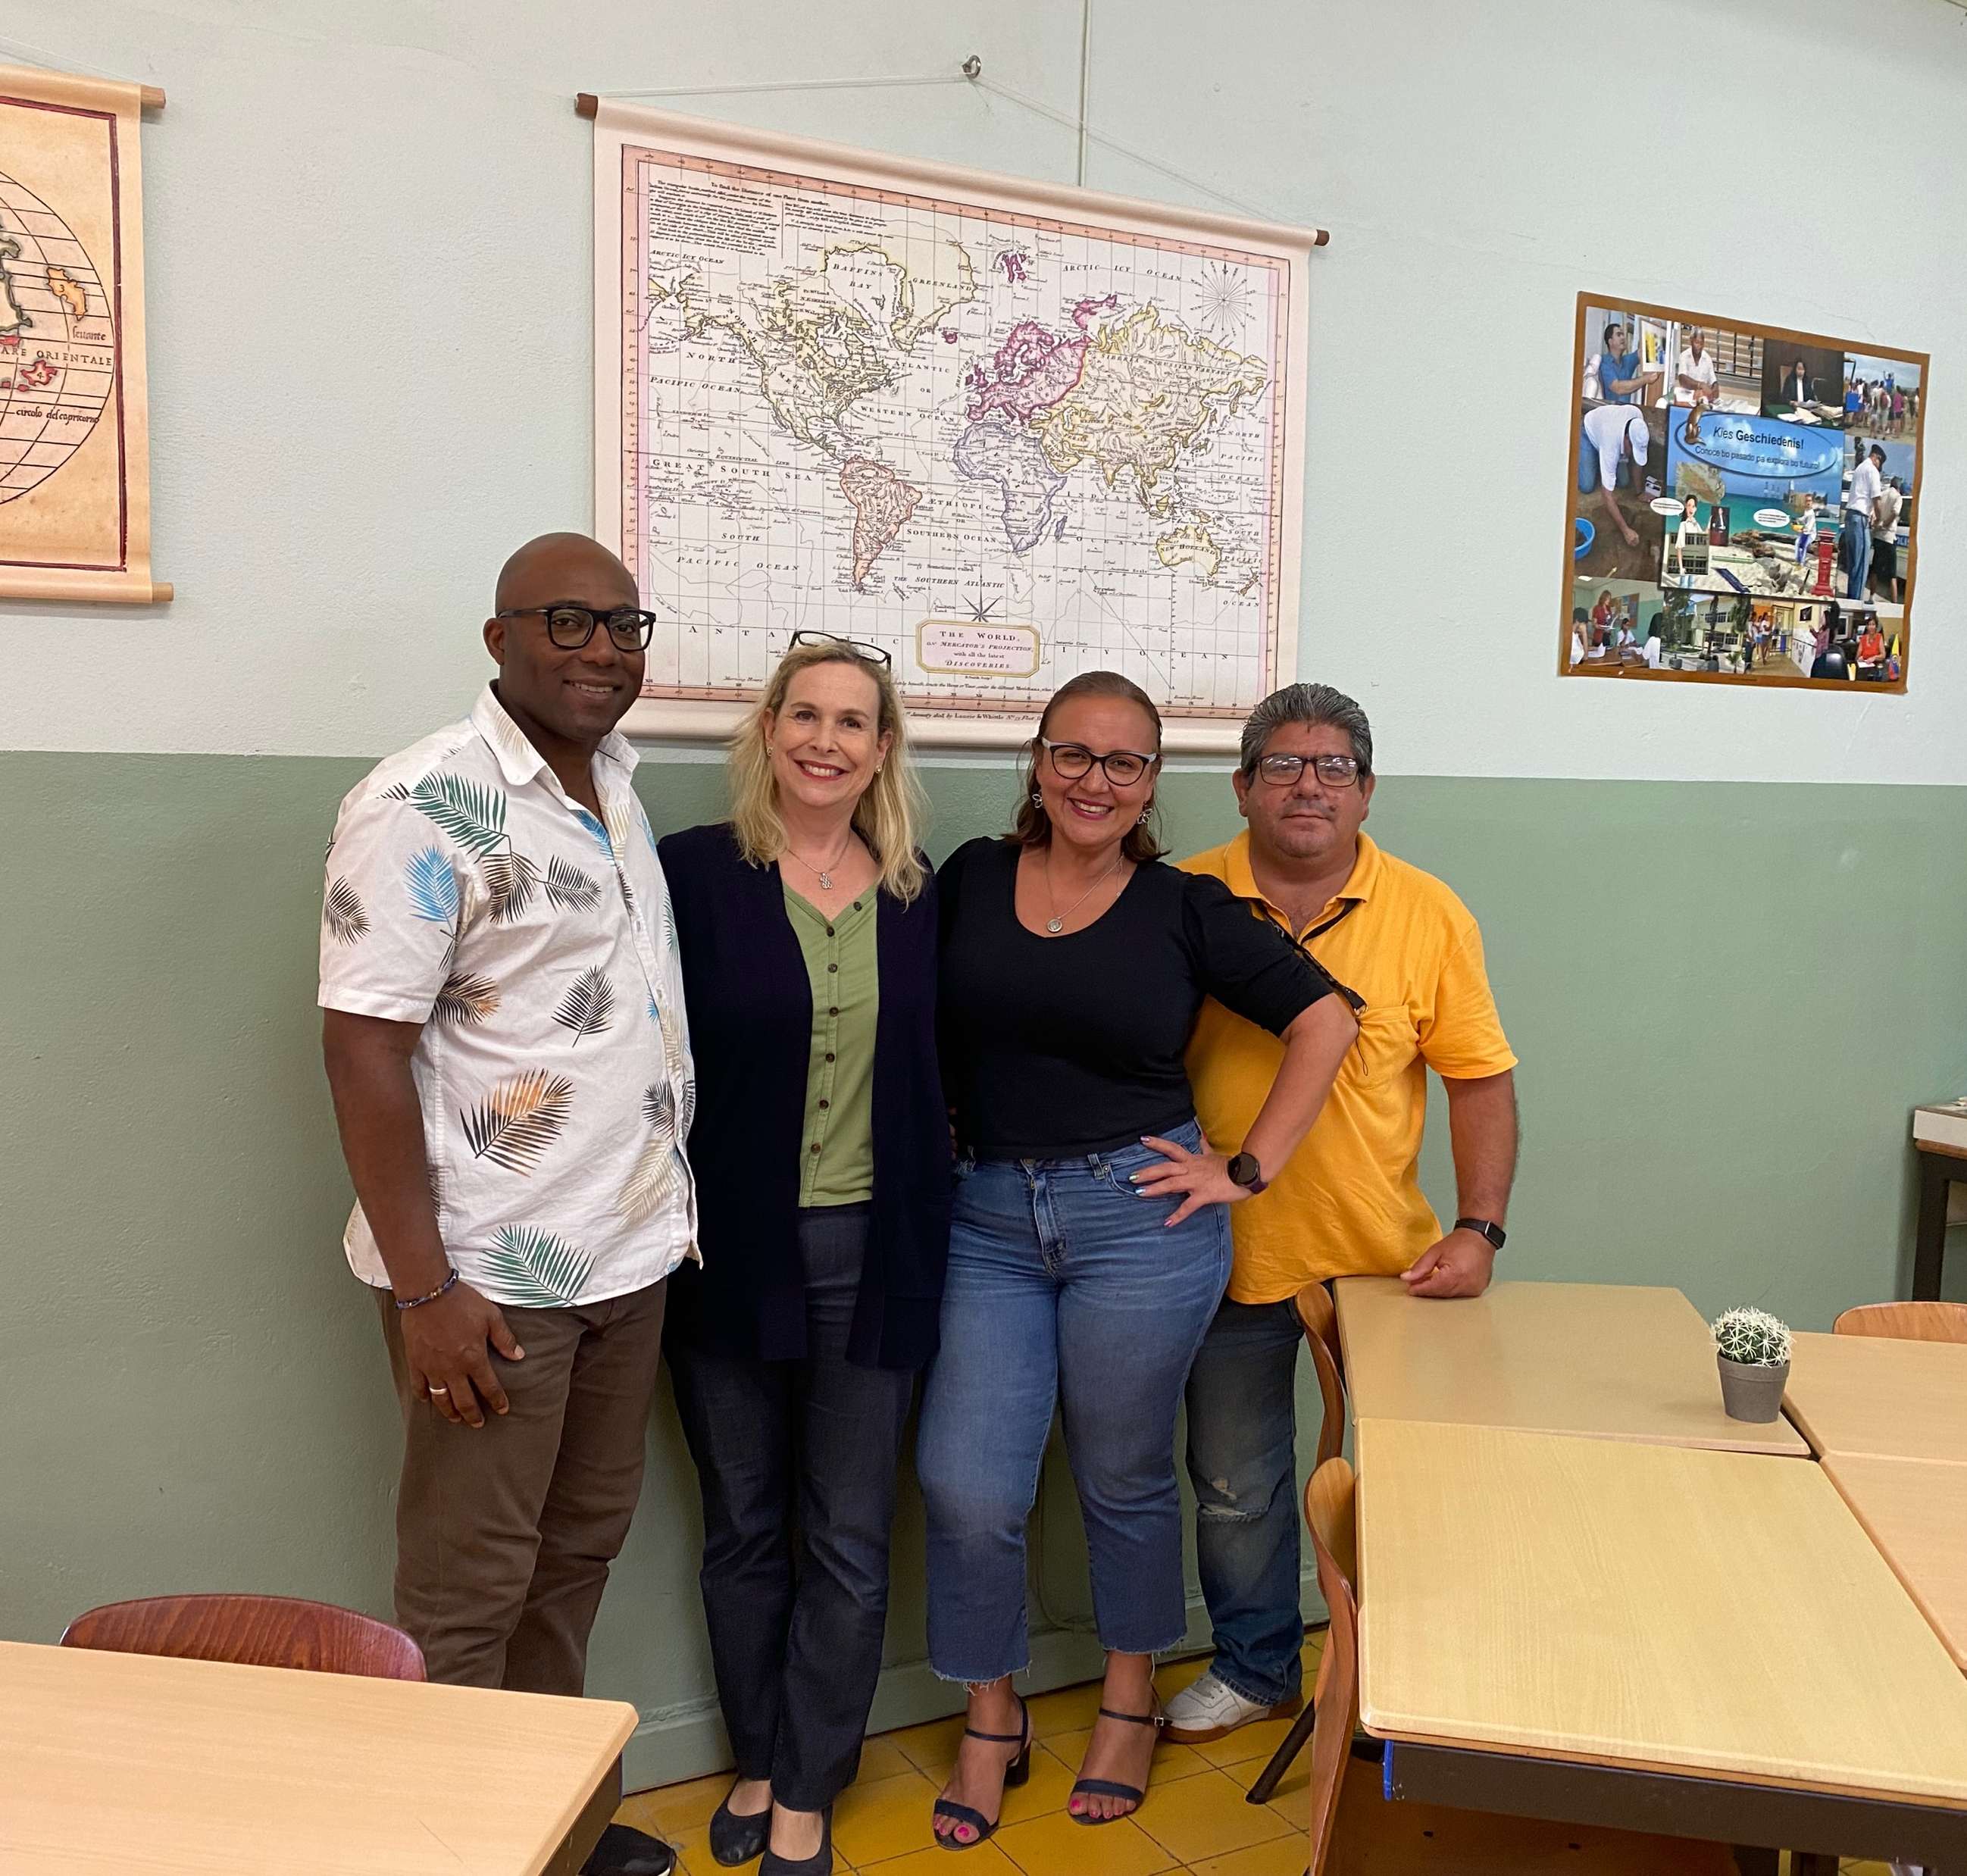
FAR AND AWAY THE
BEST PRIZE THAT
LIFE
OFFERs IS THE
CHANCE
TO WORK HARD AT
WORK WORTH
DOING.
- THEODORE ROOSEVELT
History Department of Colegio Arubano (high school in Aruba, with Havo and Vwo):
Mr. Kenny Meyers, Mrs. Anne Cameron,
Mrs. Suyenne Tromp and Mr. Ivan Yarzagaray

Slide 7

Thank you for your attention
On to the next webinar, when we will delve more deeply into the difficulties when teaching Colonial history in Aruba

