Slide 1
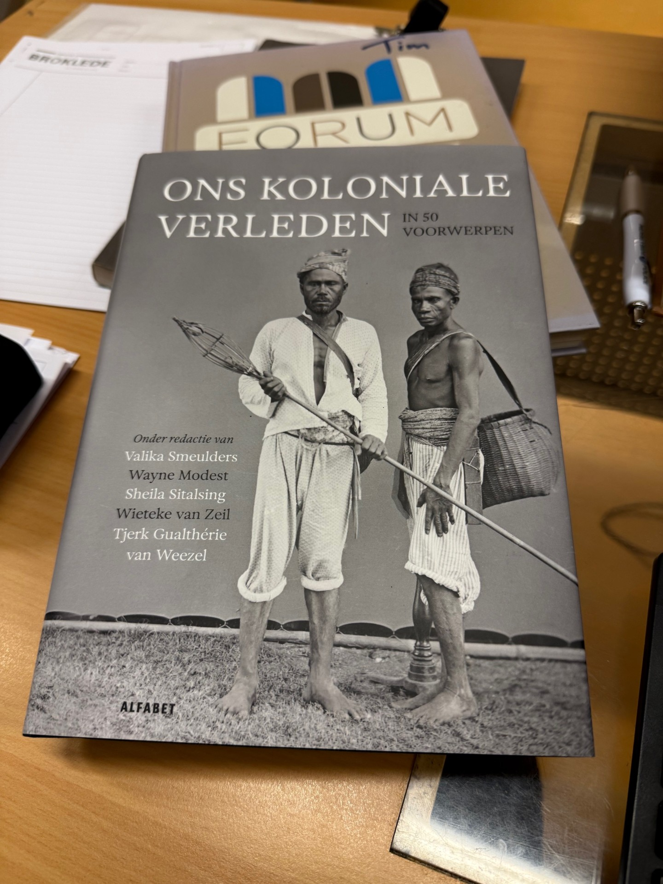
Colonial History
(De)Colonization, Migration, enslaved people and the consequences of these histories for the present
Tim Koetsier
History Teacher

Slide 2
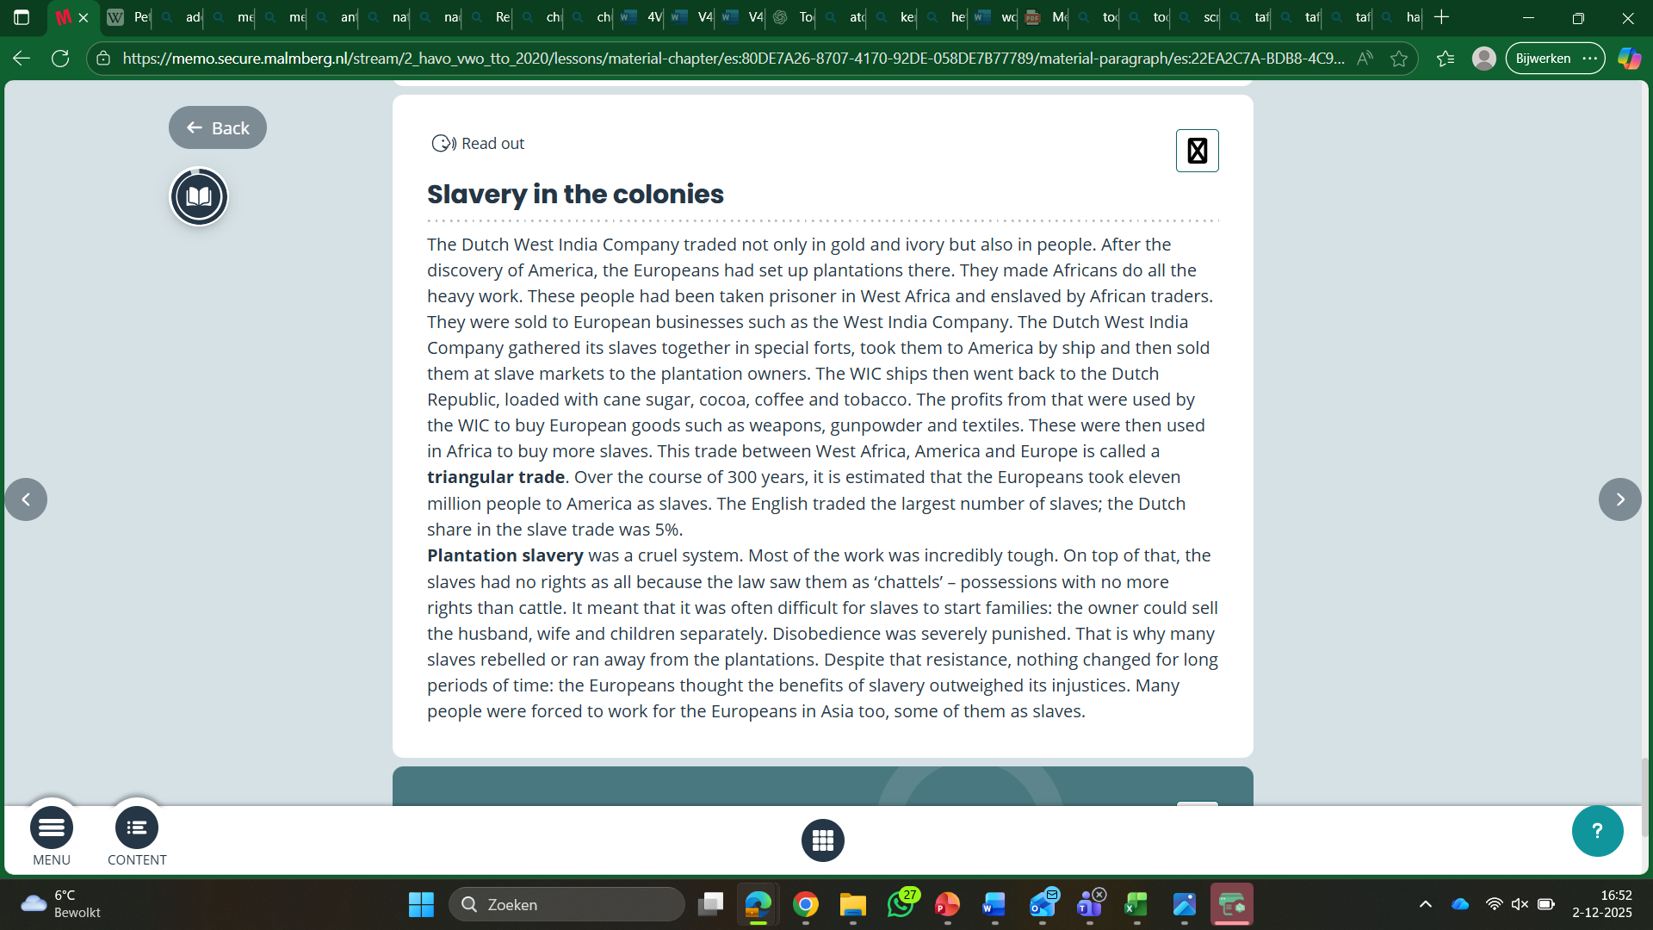
History curriculum
HAVO/VWO
First three years of secondary education
  HAVO = senior general education
  VWO = pre university education
  All students have history
Students develop historical awareness and knowledge
  Colonization and decolonization
  Slavery and abolitionism
  Migration
Students can explain the meaning of these topics for the present
Students develop historical skills
Source: SLO and Memo schoolbook

Slide 3
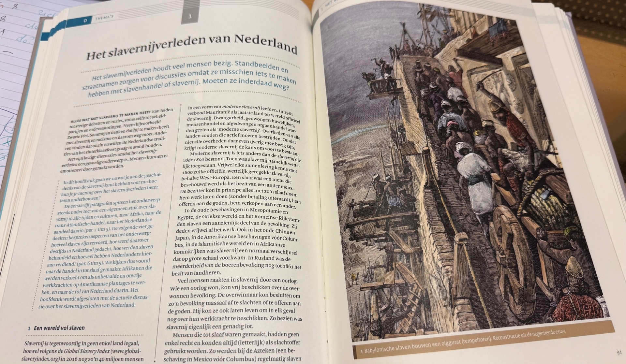
History curriculum
HAVO / VWO
Final two (HAVO) or three (VWO) years
  Not every student has History anymore
A new history curriculum is being developed at this moment
  Deepen historical awareness and knowledge
  Focus on more complicated historical skills (multiperspectivity for example)
  Focus on historical problems and how they continue working in the present
  Less eurocentric, more inclusive history
  Source: startnotitie SLO (sept, 2024)
Schoolbook we use about slavery

Slide 4
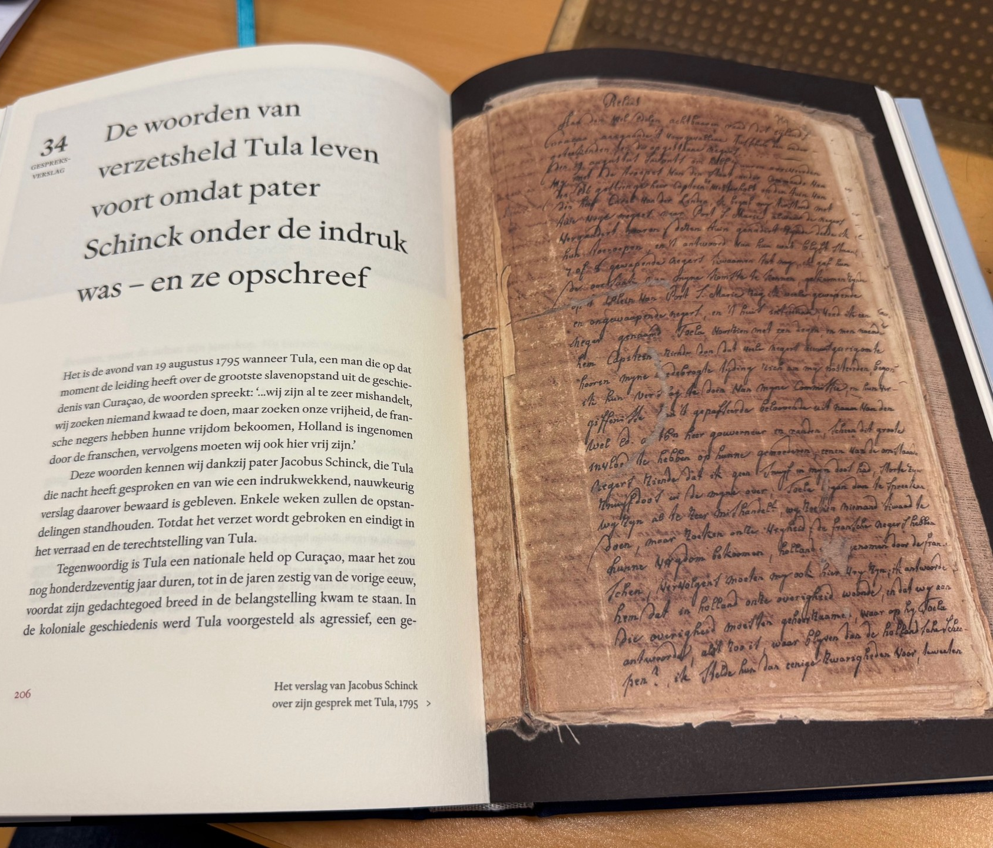
Multiperspectivity and heritage
Students have to think about historical objects from the Dutch colonial past from different perspectives.
They have to find reliable extra sources about the object and finally make a exhibition proposal for a museum.
For example: letters from a Catholic priest with Tula

Slide 5
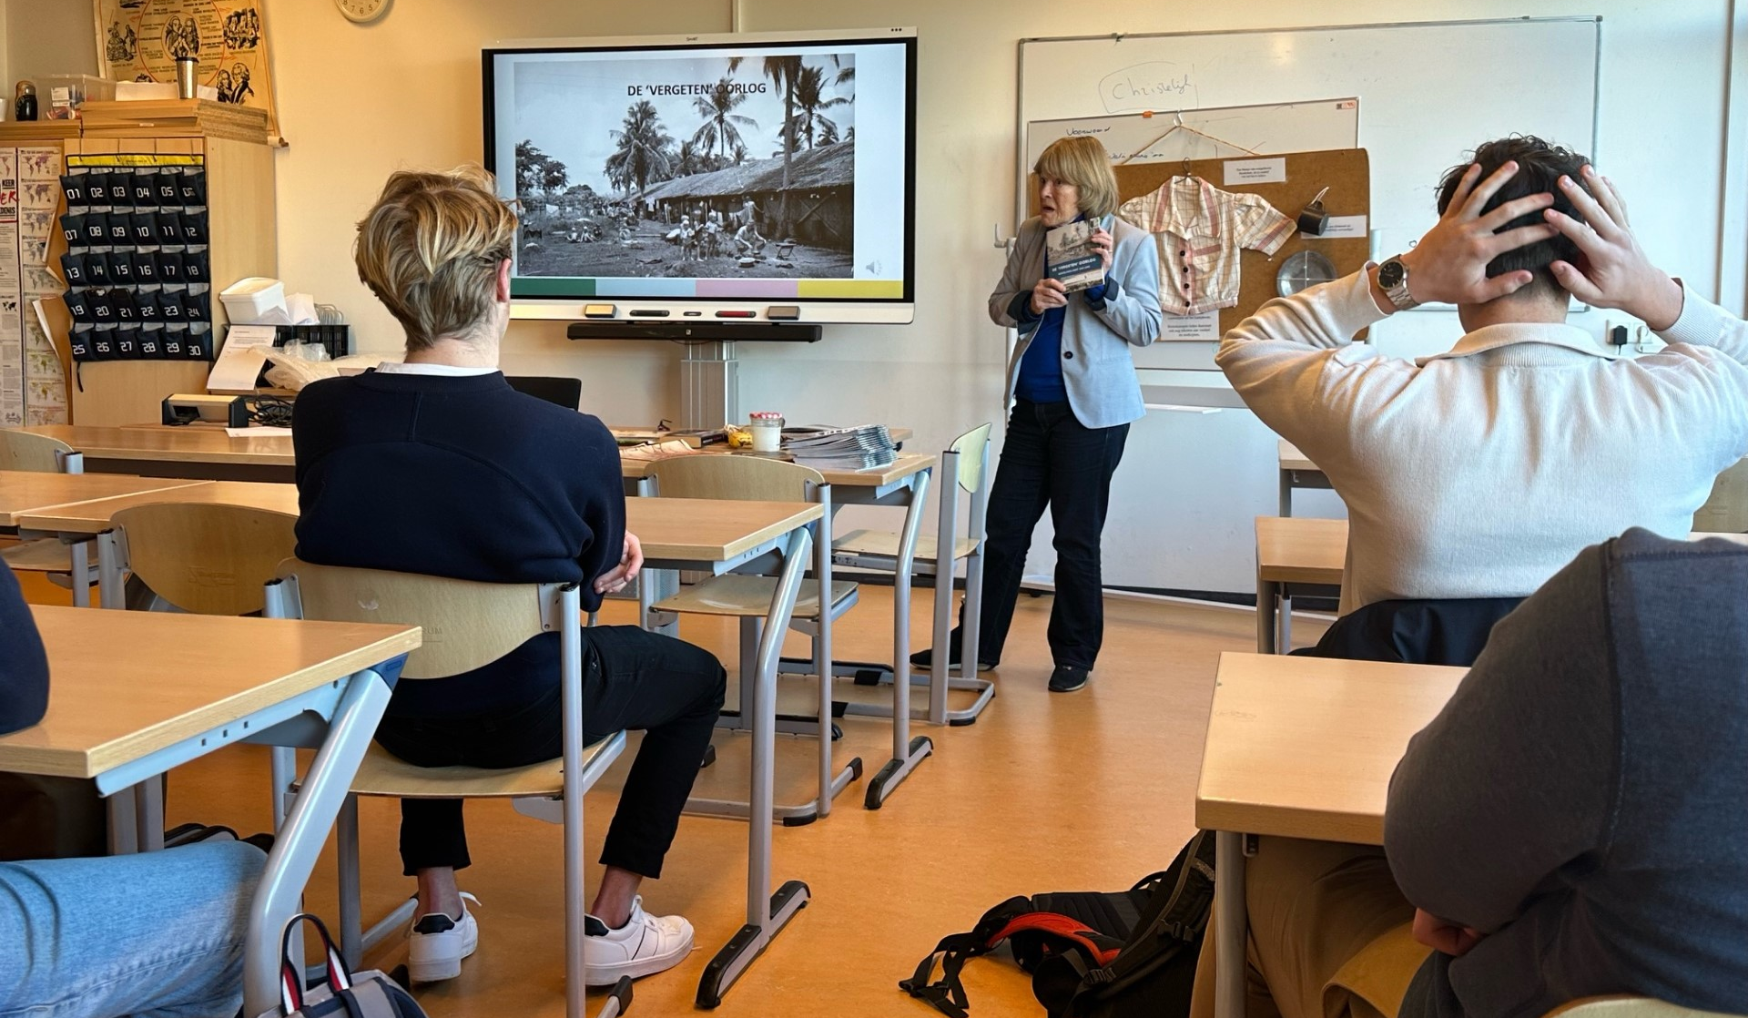
Local history
The Moluccas Islands and Breukelen
The Moluccas Islands and Indonesia
After the decolonization war in Indonesia people from the Moluccas Islands fled to the Netherlands.
Large Moluccan community in Breukelen
Guest lessons from people with Indonesian or Moluccan roots about the decolonization war, WW2 and the history of the Moluccan community in Breukelen.

Slide 6
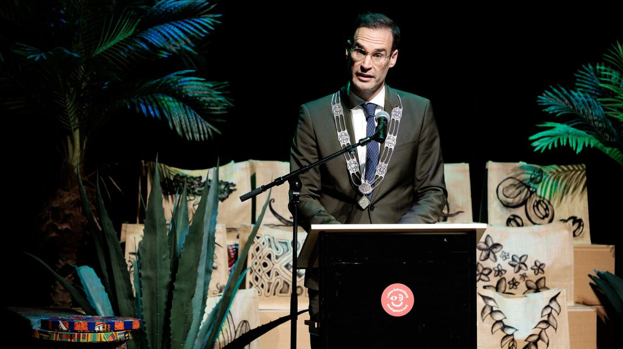
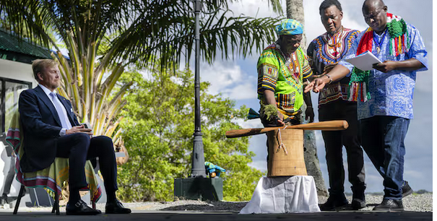
History and the present
Students can reflect on present day events from multiple perspectives and the historical context
Mayor of the city of Leiden apologizing for slavery on behalf of the city counsel
King of the Netherlands in Suriname meets descendants of enslaved people. They accepted the kings apologies for the slavery.

Slide 7
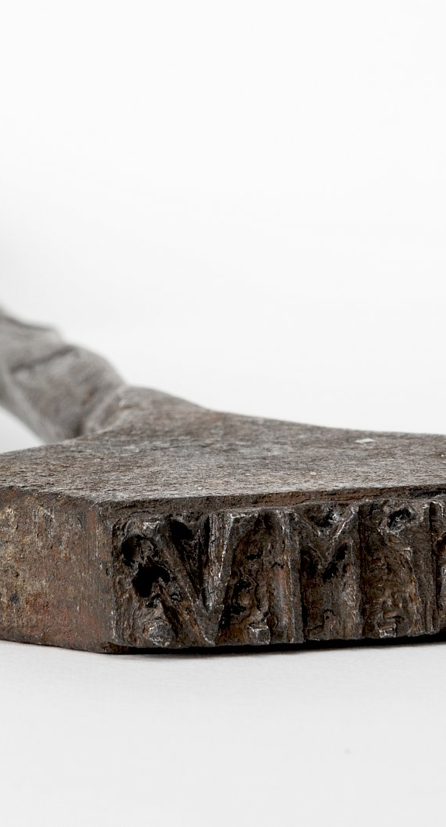
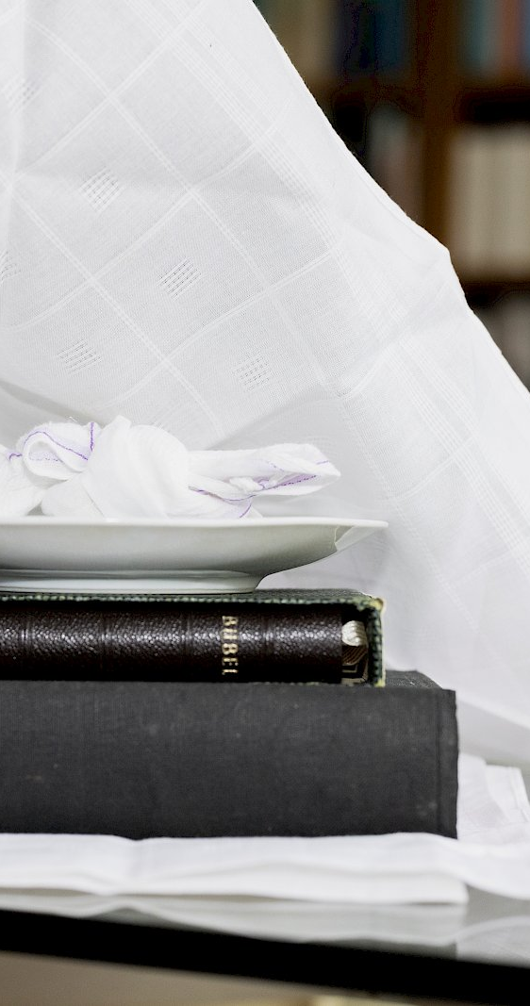
Where two worlds meet
Historical sensation
Piring natzar a Moluccan offering bowl
  Student in 4VWO last year
Descendants of plantation owners
  Student in 6VWO three years ago
  Podcast “the plantation of my ancestors”

Slide 8
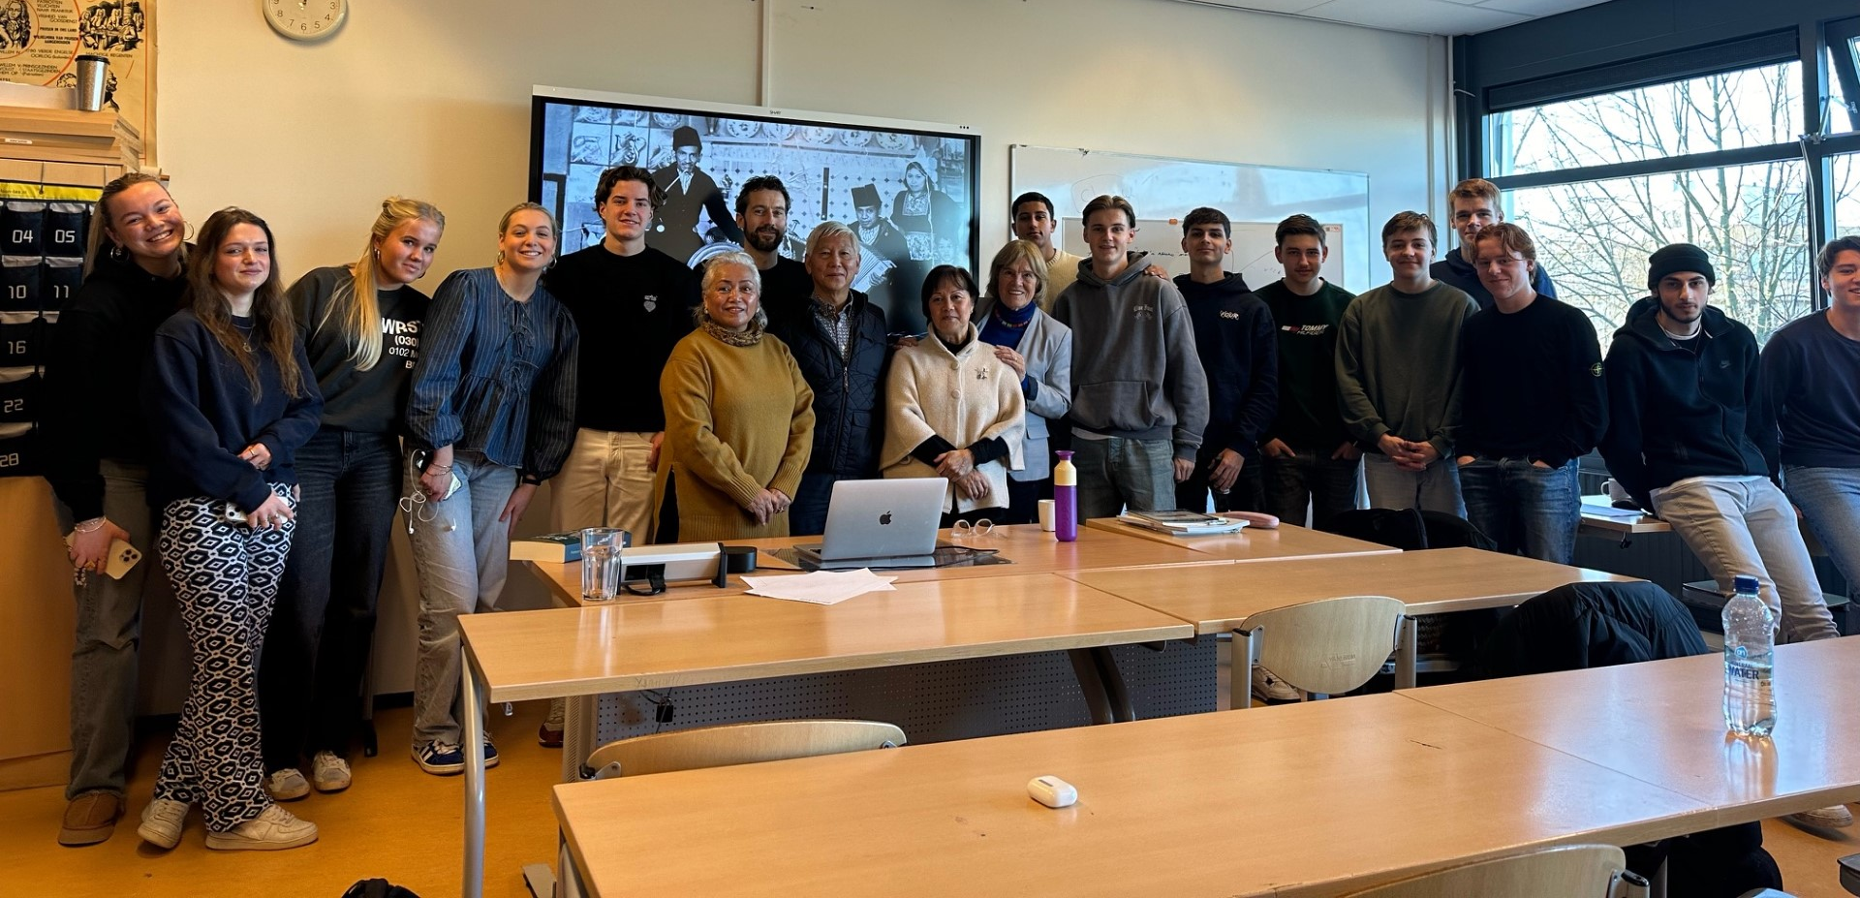
Thank you

