Slide 1
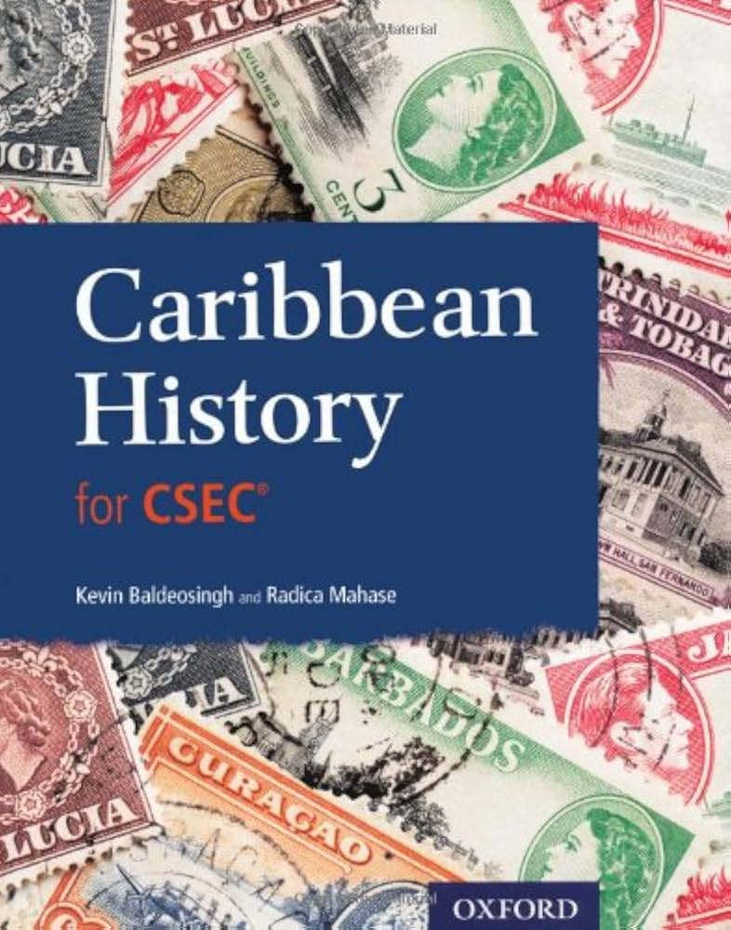
Caribbean History
Combining Caribbean and Dutch Caribbean history
Martin Visser
History Teacher

Slide 2

SKAIH-Pre-University
CXC/SCEC
First two years of secondary education
  CCSLC
Last three years of secondary education
  CSEC
Limited overview of Caribbean History during Social Studies.
Deeper study of Caribbean History until 1985, starting in 3rd year.
Local history of Dutch Caribbean added by teacher.
Notes:
Caribbean Certificate of Secondary Level Competence
Caribbean Secondary Education Certificate

Slide 3
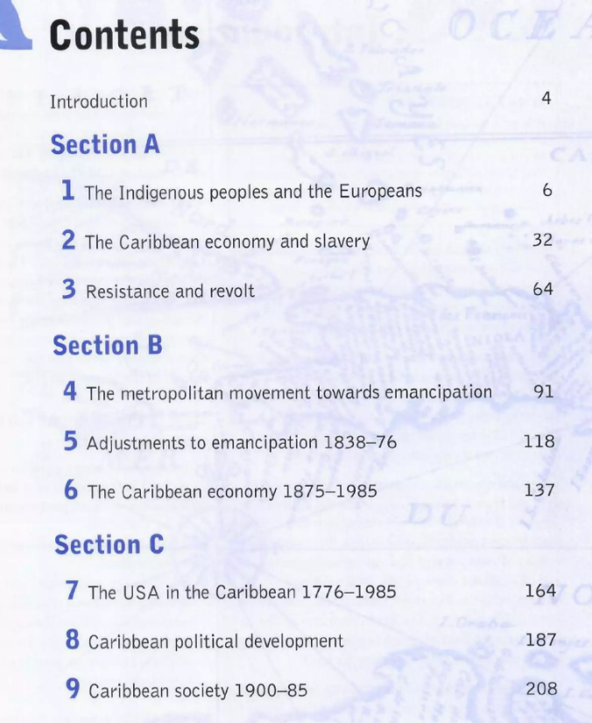
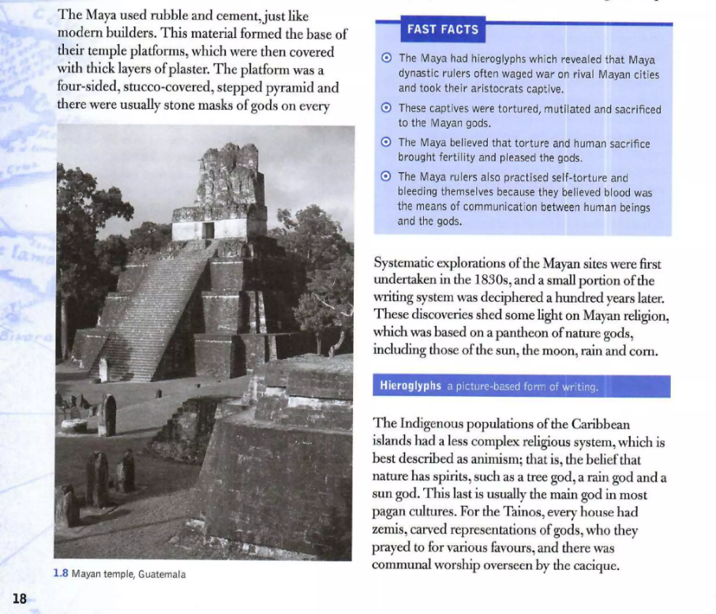
History curriculum
CSEC
Final three years at SKAIH Pre-University
  Embedded in business package.
The Curriculum consists out of nine themes grouped into three main themes.
African part is embedded in theme 2.
Section C is modern, American and political history.
Caribbean history teachers are very active in making YouTube-videos.
Some references to Suriname, more to Berbice.

Slide 4
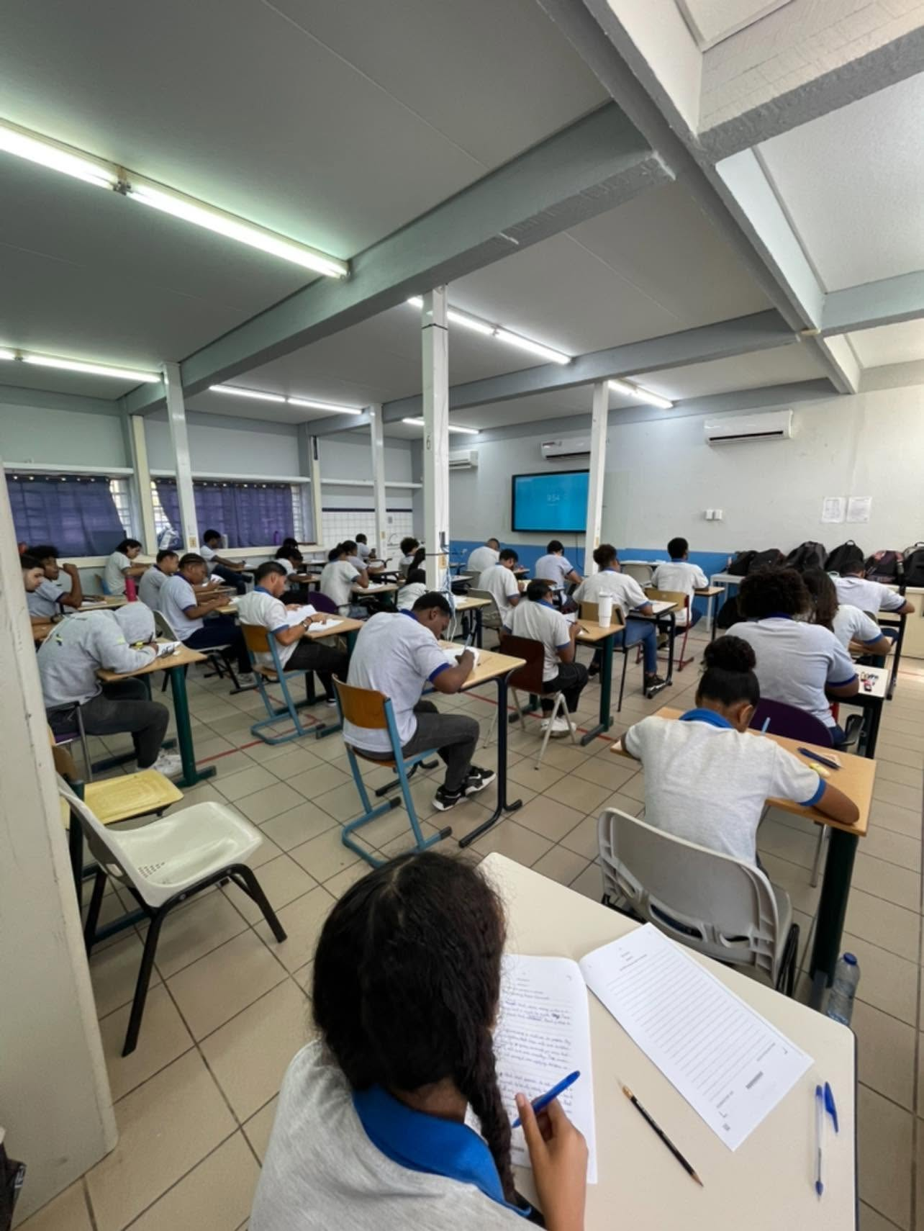
Examination
CSEC
Paper 1
    60 Multiple Choice Questions
Paper 2
    9 question items
    3 Items per section (A,B,C)
    1 Item per section to be chosen
    3 items in total obligatory
SBA
    School-Based Assessment
    Research
    Connected to Caribbean History Sections
    Local History
    Until 1985

Slide 5
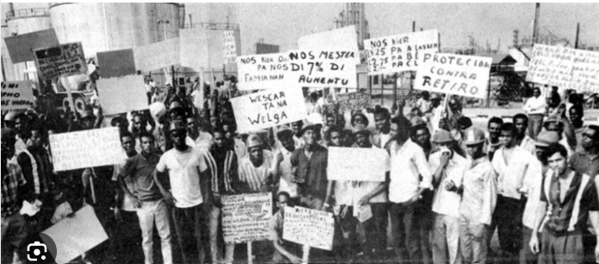
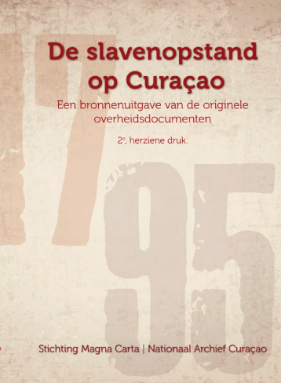
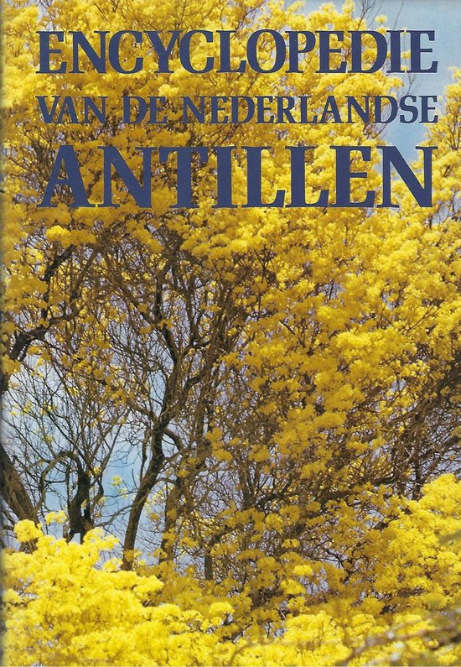
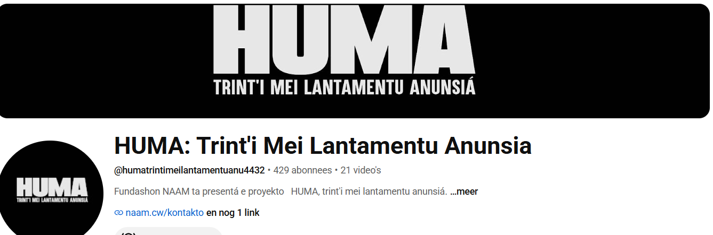
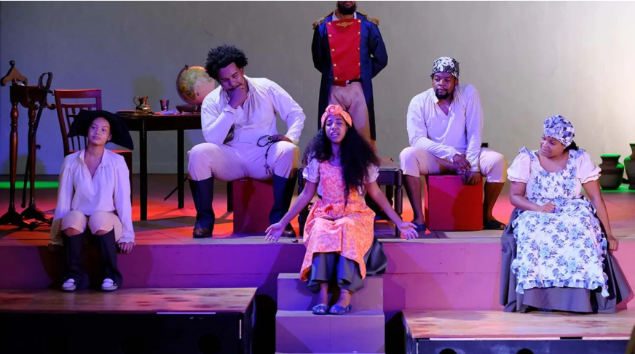
Pre-Slavery, Slavery and Post-Emancipation.
Caquetio and Dutch Caribbean colonial history.
Governance and the Kingdom of the Netherlands.
Haven’t paid enough attention to Latin-America.

Slide 6
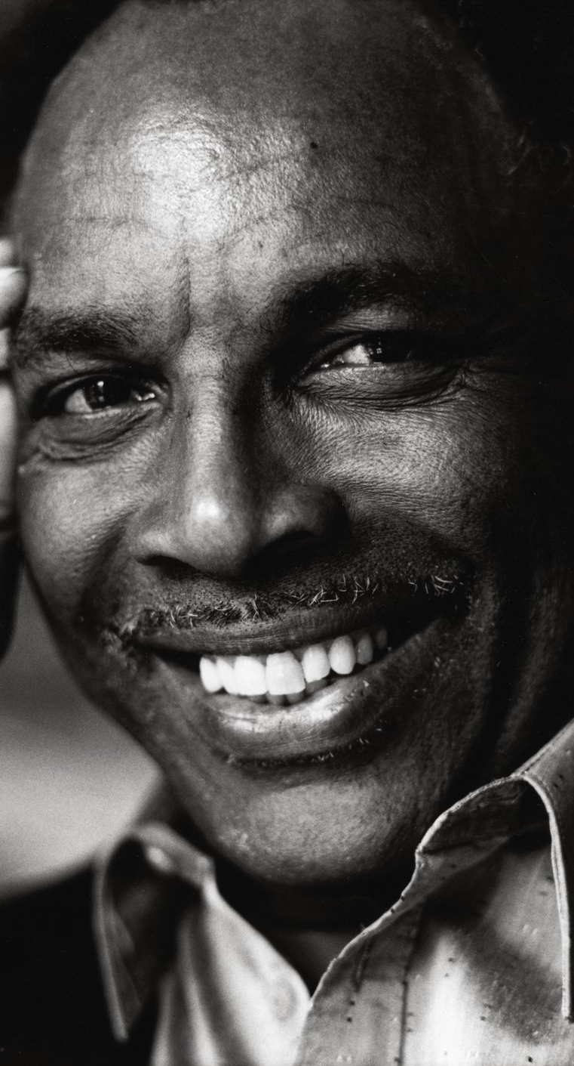
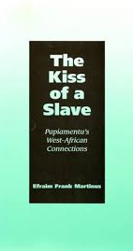
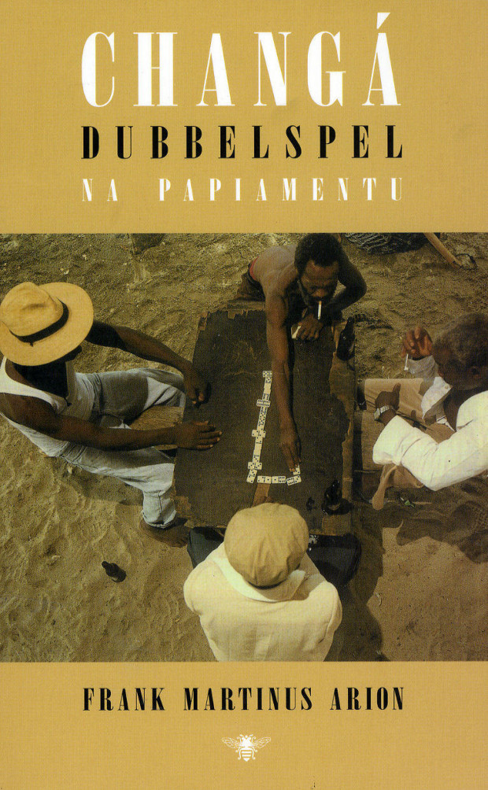
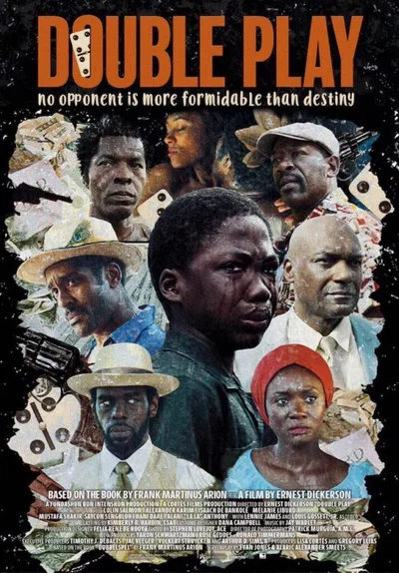
FSHP
School Board
Only educational board with Papiamentu as main language of instruction.
Established by Frank Martinus Arion in the mid-eighties.
After 2010 also the SKAIH Pre-University, which is also English based.
Dutch local obligation to pass the exam.

Slide 7
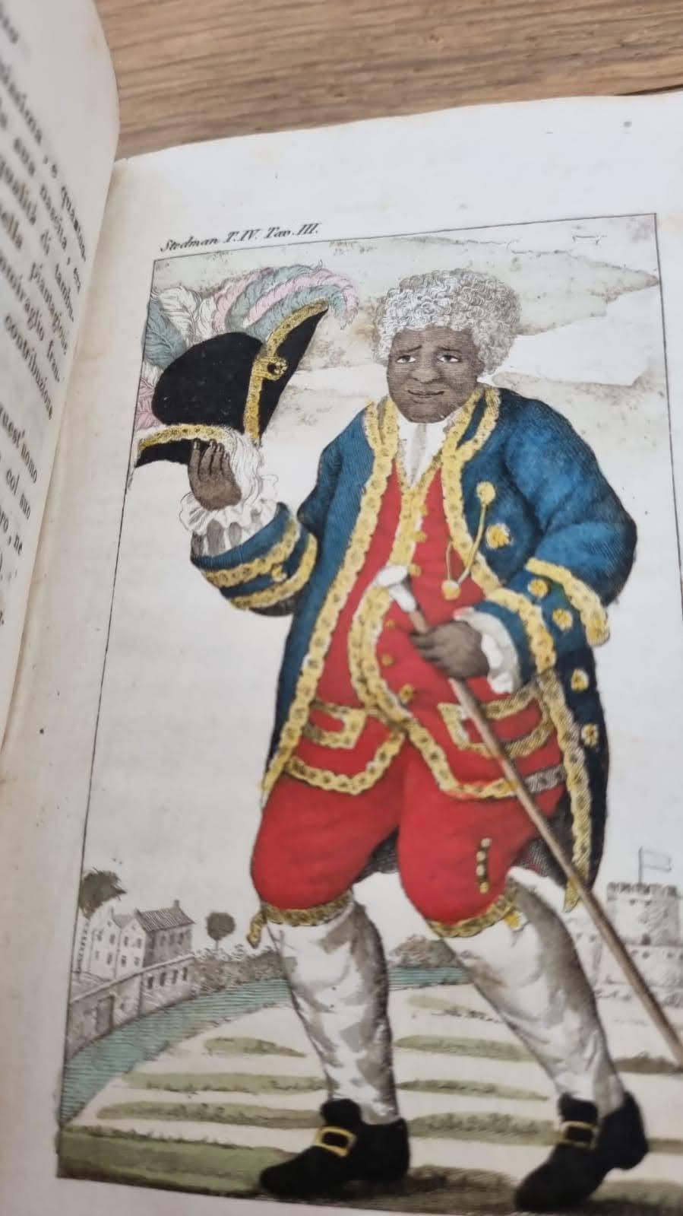
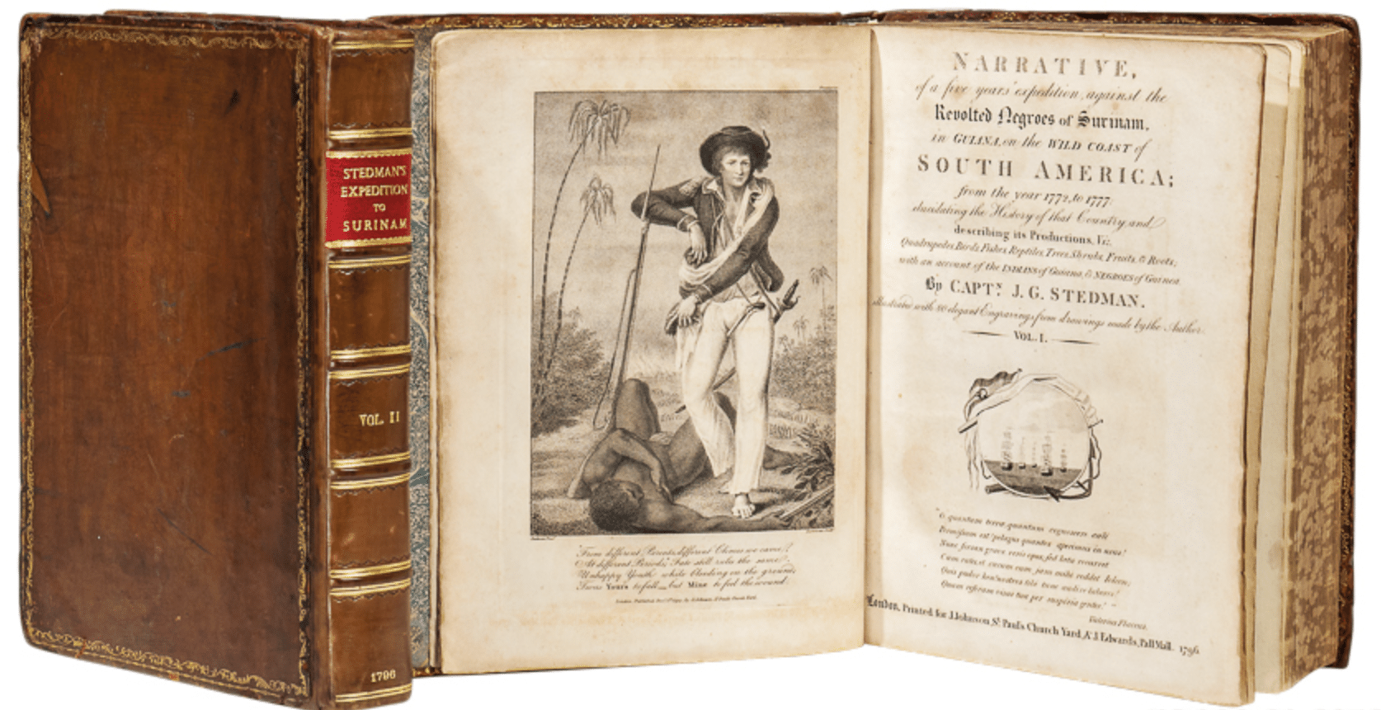
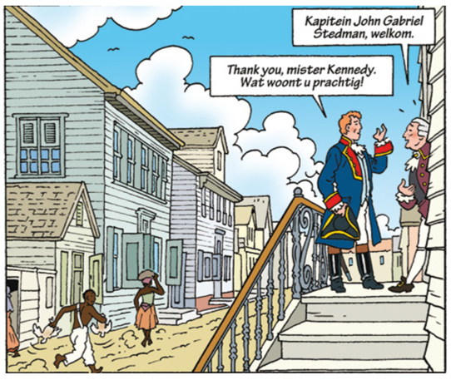
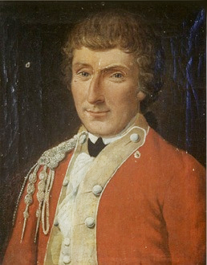
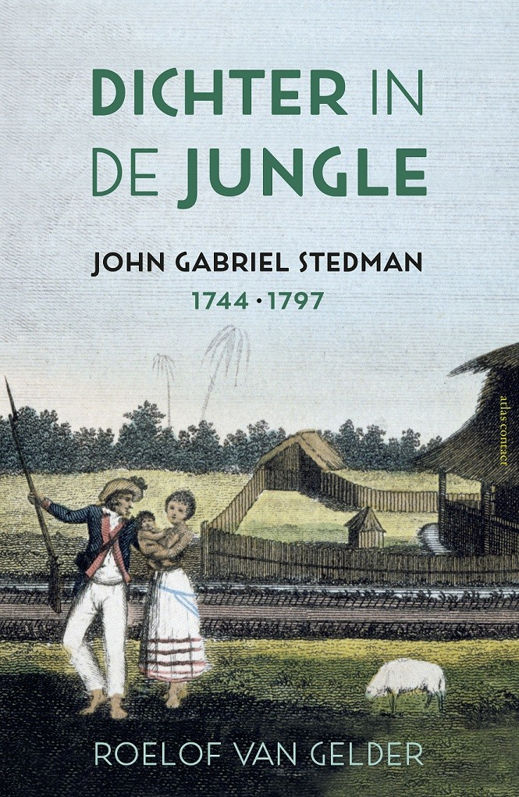
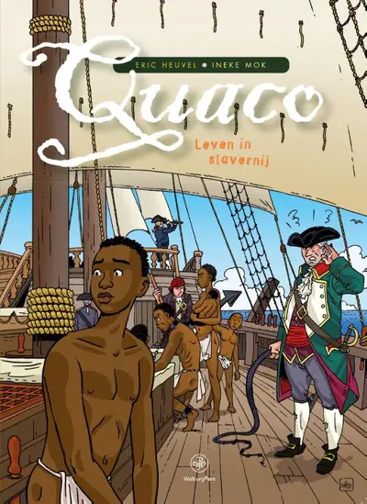
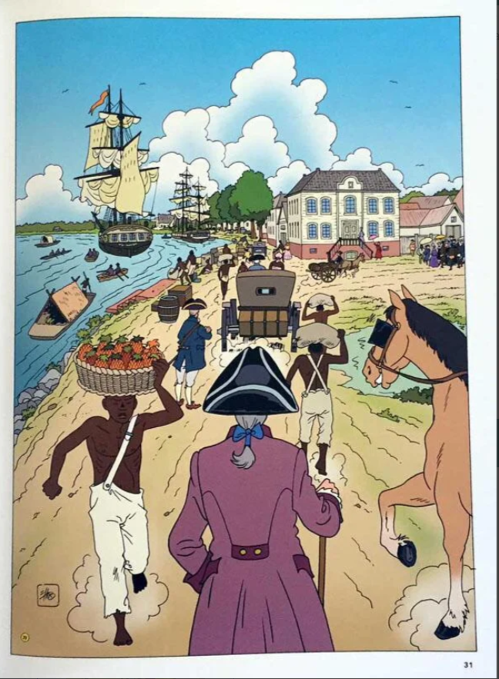
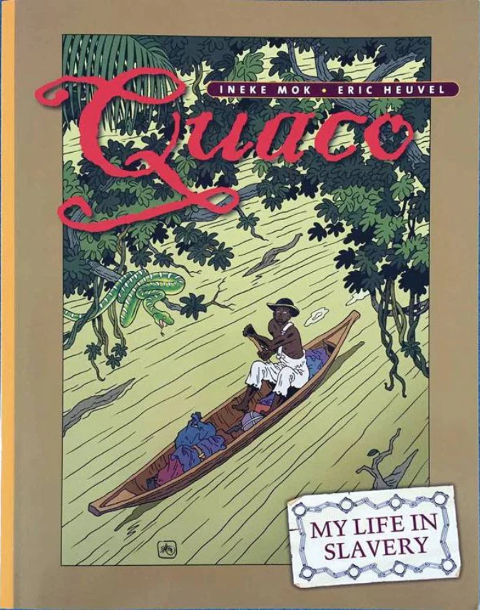
Educational materials
Graphic Novels and Written Sources
Booklet with relevant historical questions. Student must read the graphic novel.
Students watch clips from Dutch TV about Surinam, John Stedman and Dutch abolitionism. (Subtitles)
Group assignments about the drawings of John Stedman. Are they objective? Which of them are referred to the graphic novel? Do they show Stedman’s view on slavery?
Cooperation with art class to make their own drawings in the style of John Stedman or that of their own.
Notes:
The character of Jacob Kòrsou.
Katibu ta galiña
Mama
Katibu ta galinja hm
Curacao uprising of 1750 at Hato plantation.

