Slide 1


Jorrit van Houts
History teacher
Jorrit.vanhouts@svobeschools.sx

Slide 2
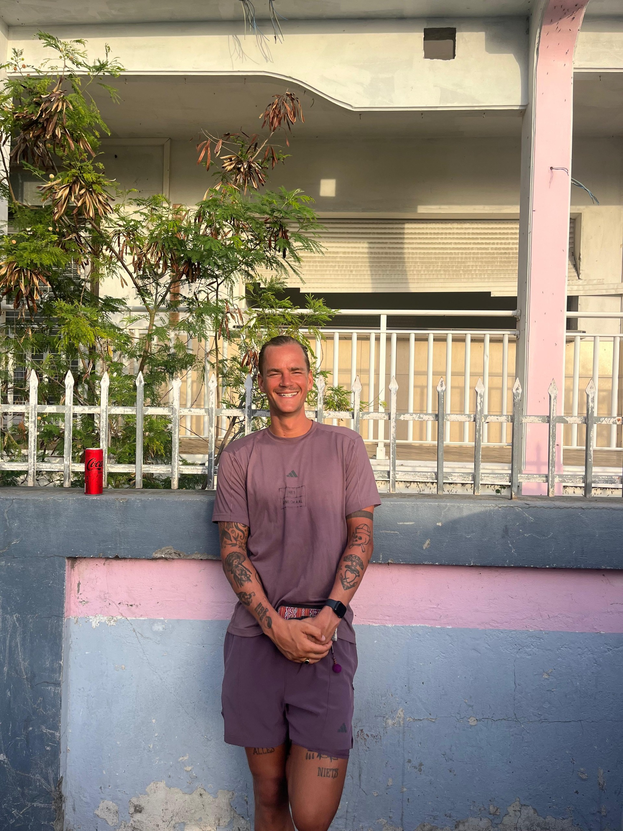
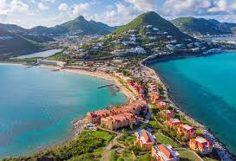
1993
100% cheese
Psychology
History
Island boy all along
Notes:
Oorzaak gevolg verbanden

Slide 3
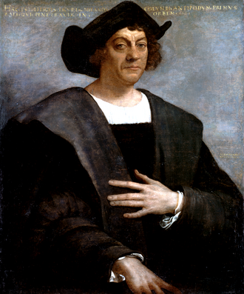


Sint -Maarten

Slide 4
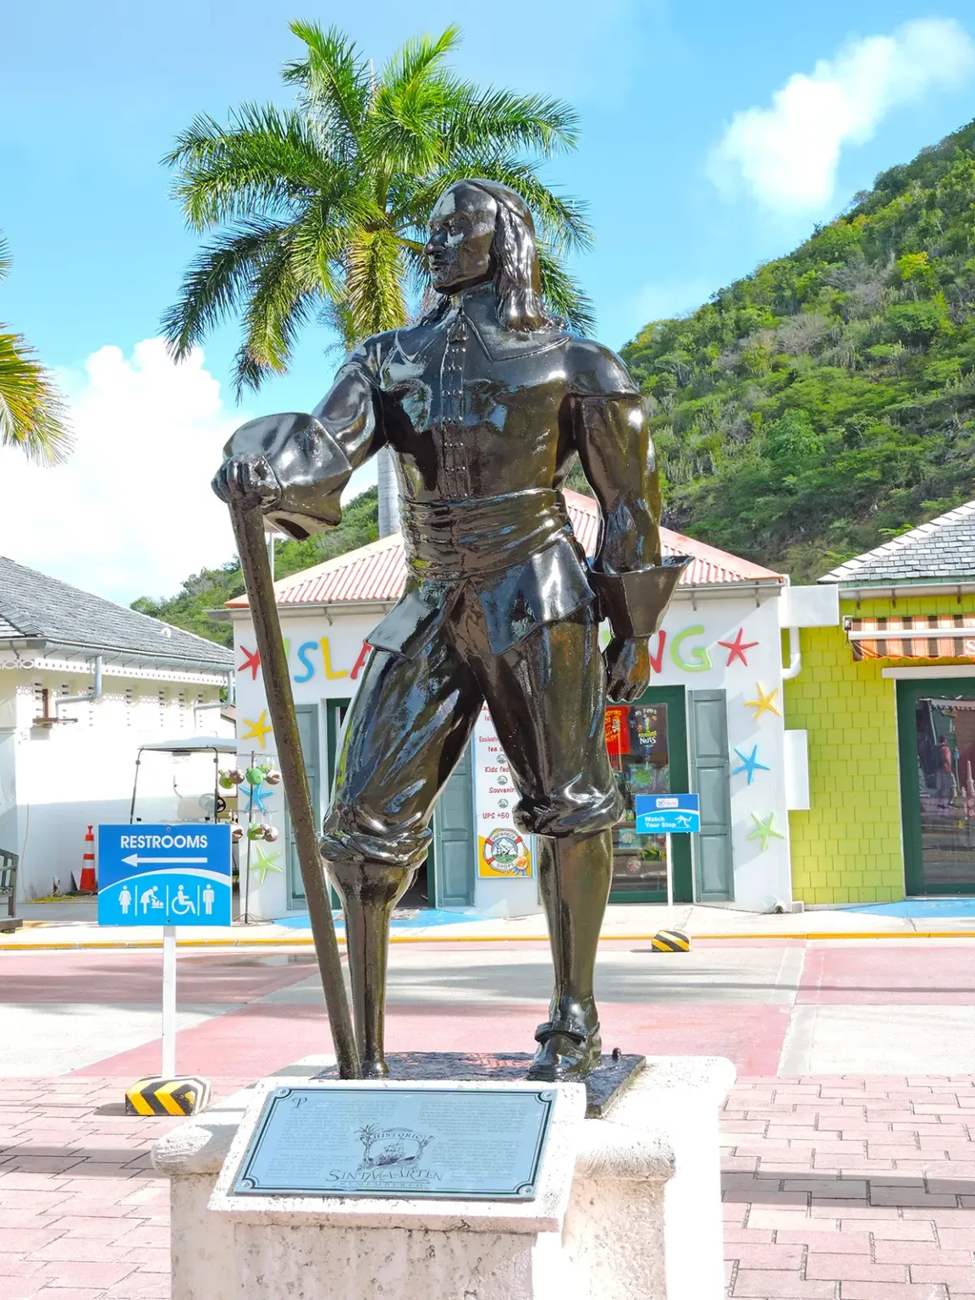
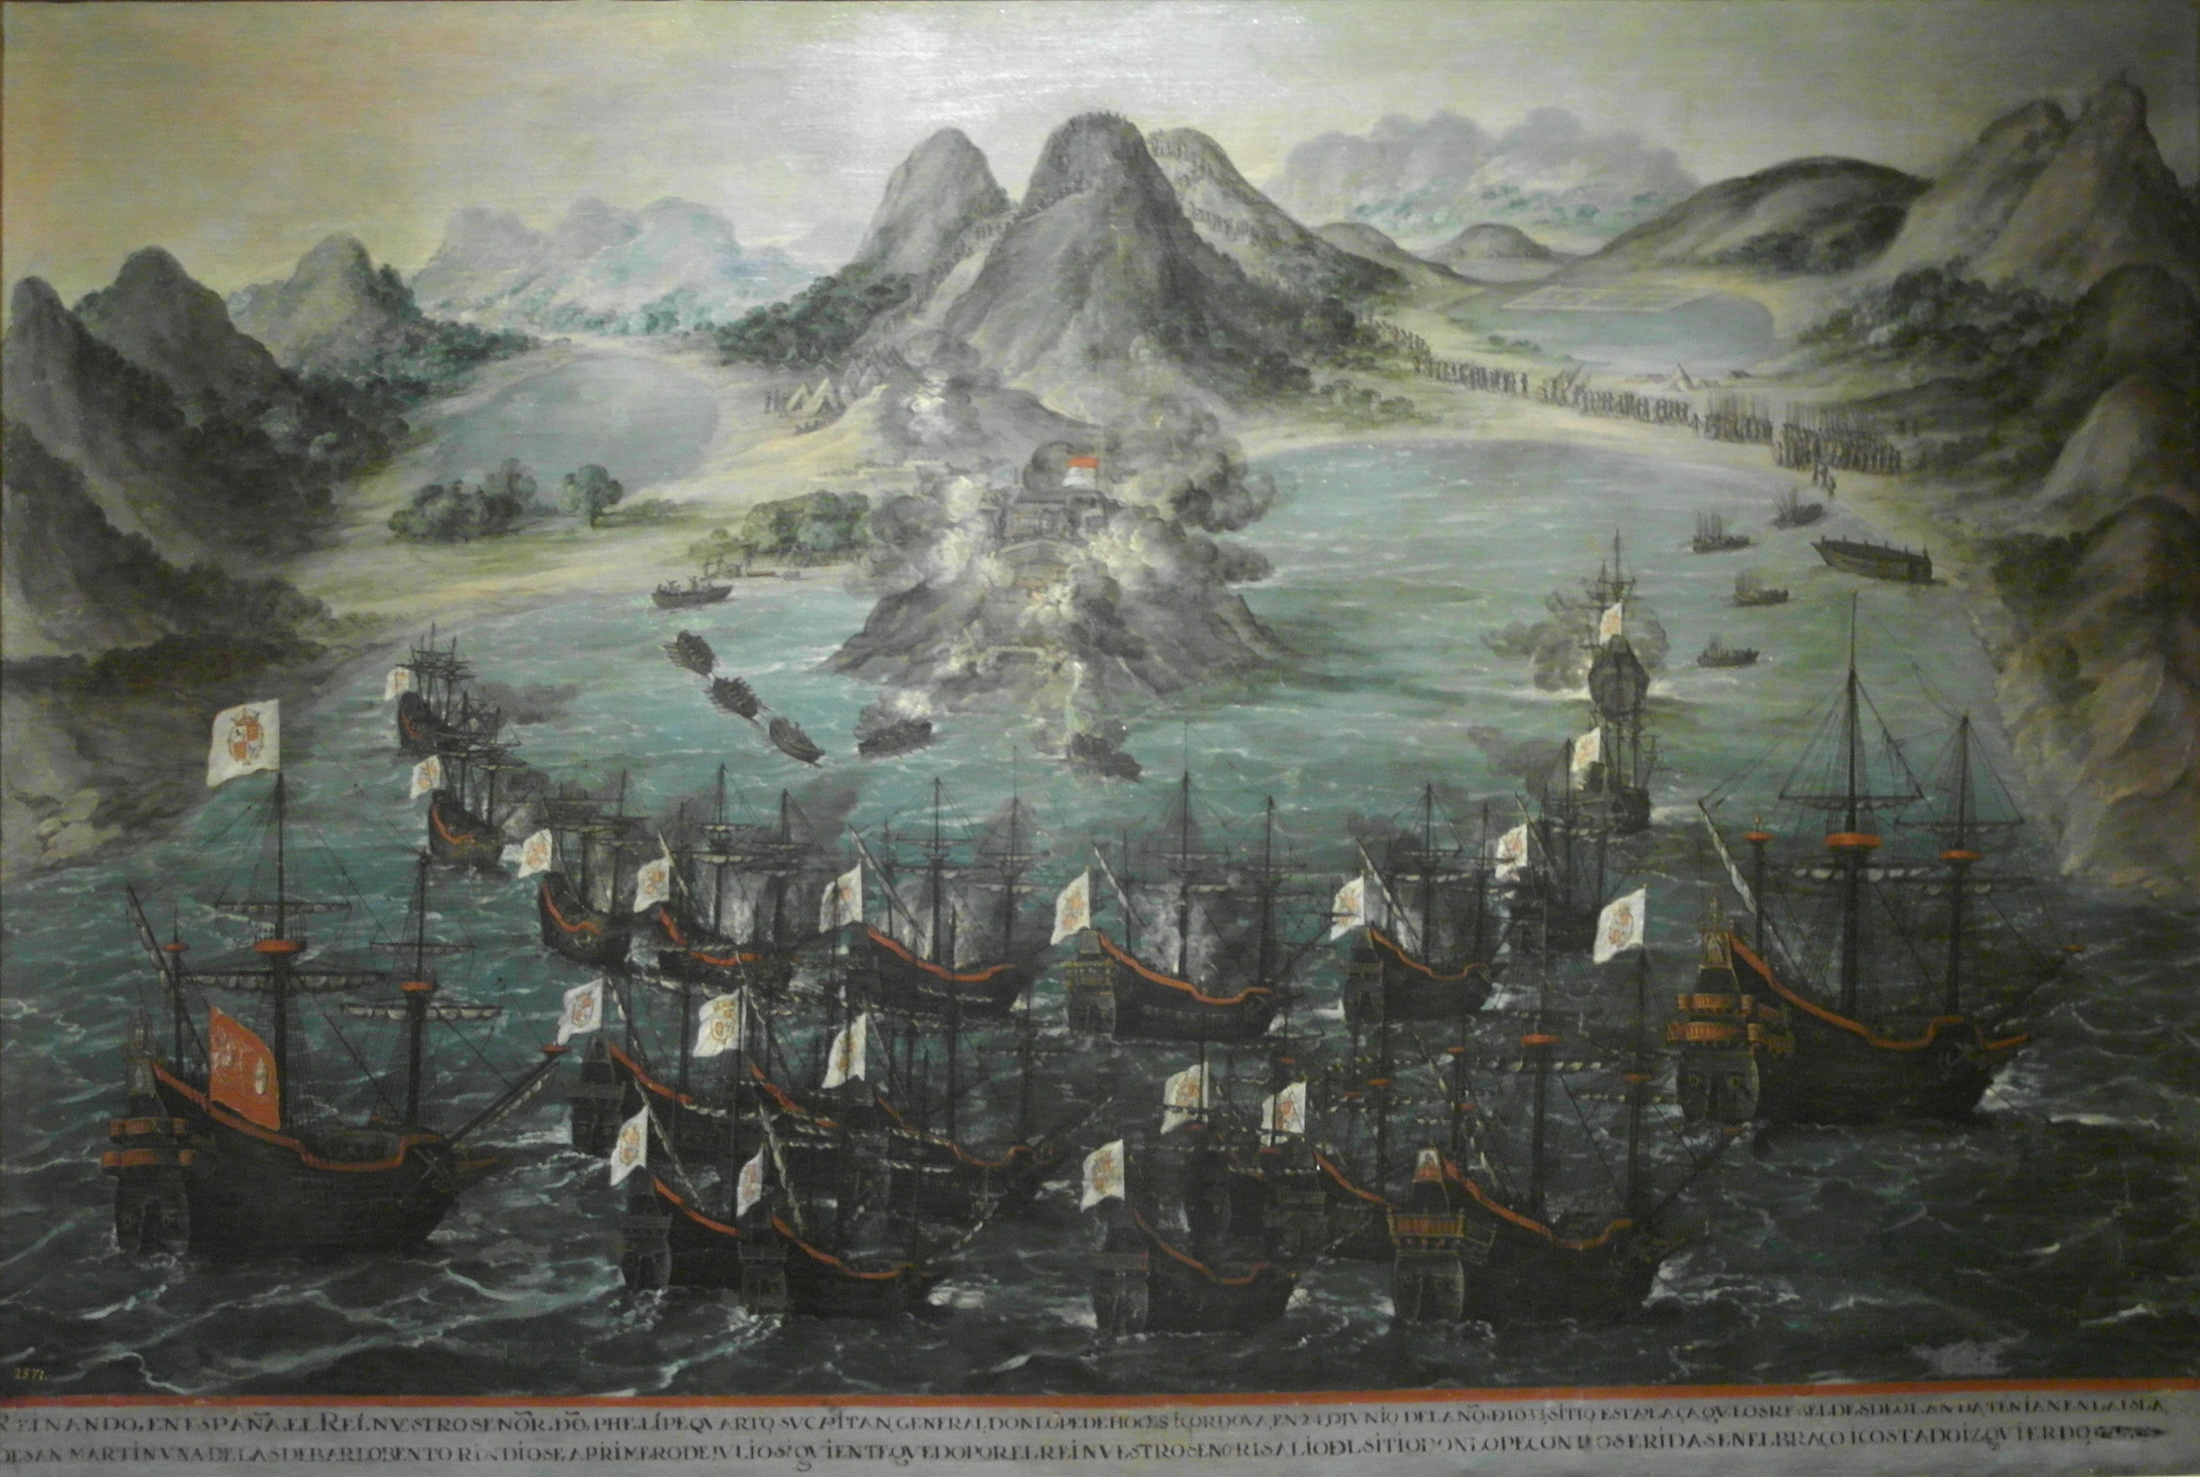
Peg Leg Pete

Slide 5
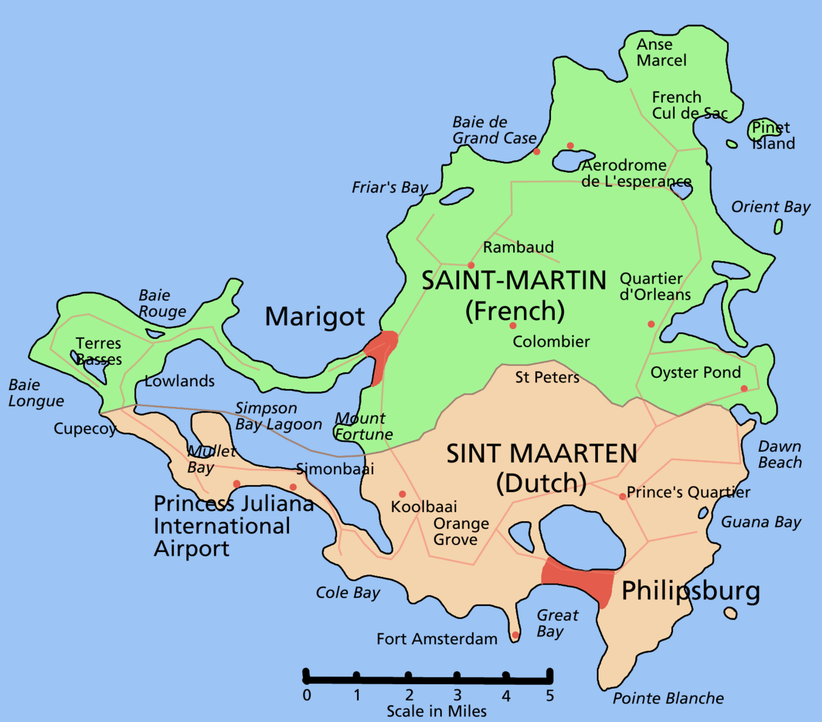
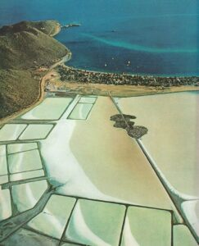
Treaty of concordia 1648

Slide 6
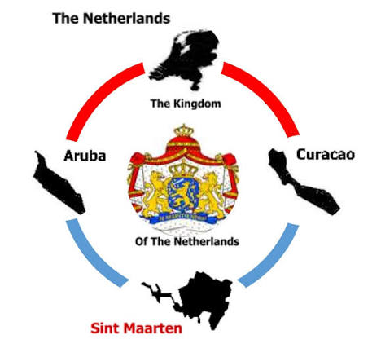
Colonial – history - education
Milton Peters College (MPC)
Dutch public high school
Gateway to Europe
Language barriere
History books from Europe (lacunes)
Exam from Curacao (perspective)
One foot int the kingdom
One foot in the Carribean

Slide 7
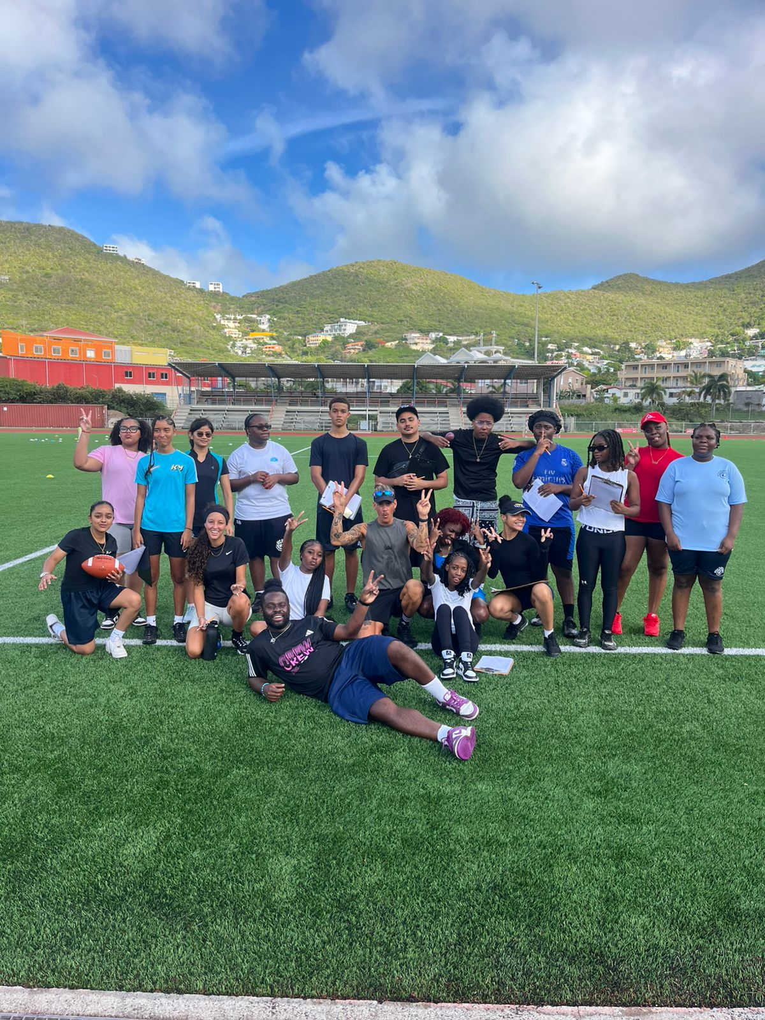
Classroom context
Islanders
Expats
20 students

Slide 8
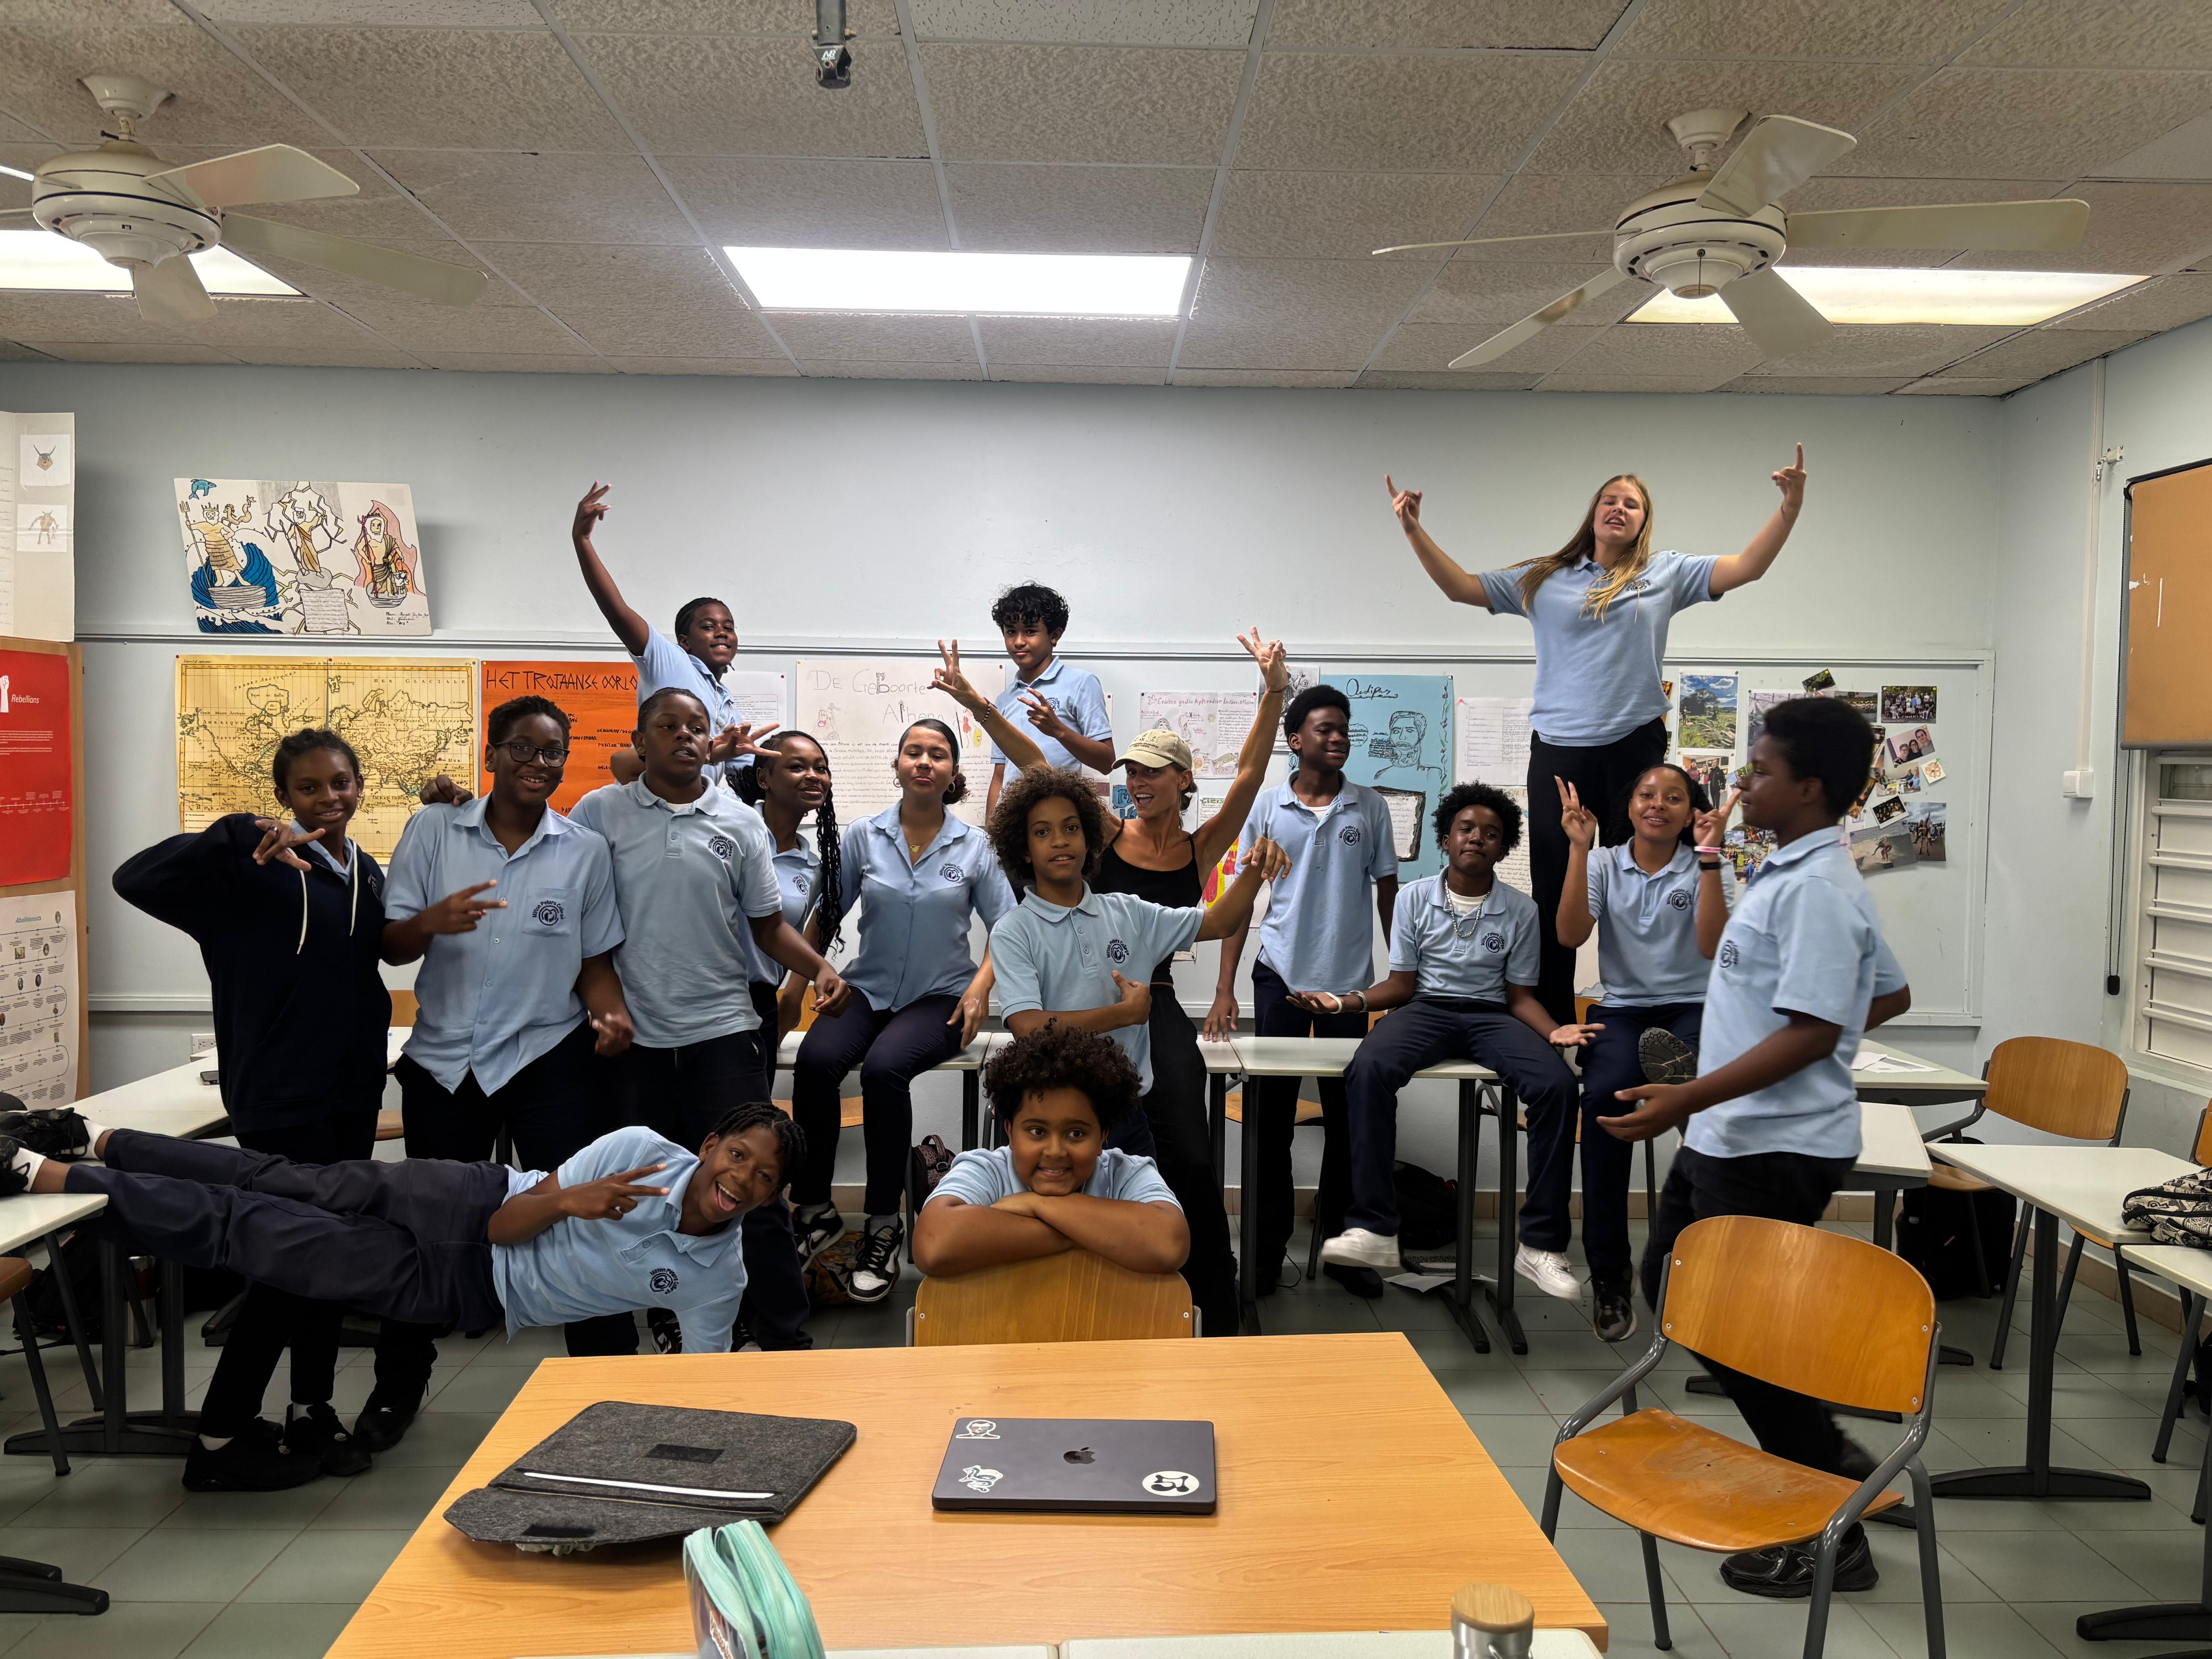
Classroom context
Islanders
Expats
20 students

Slide 9

Classroom context

Slide 10
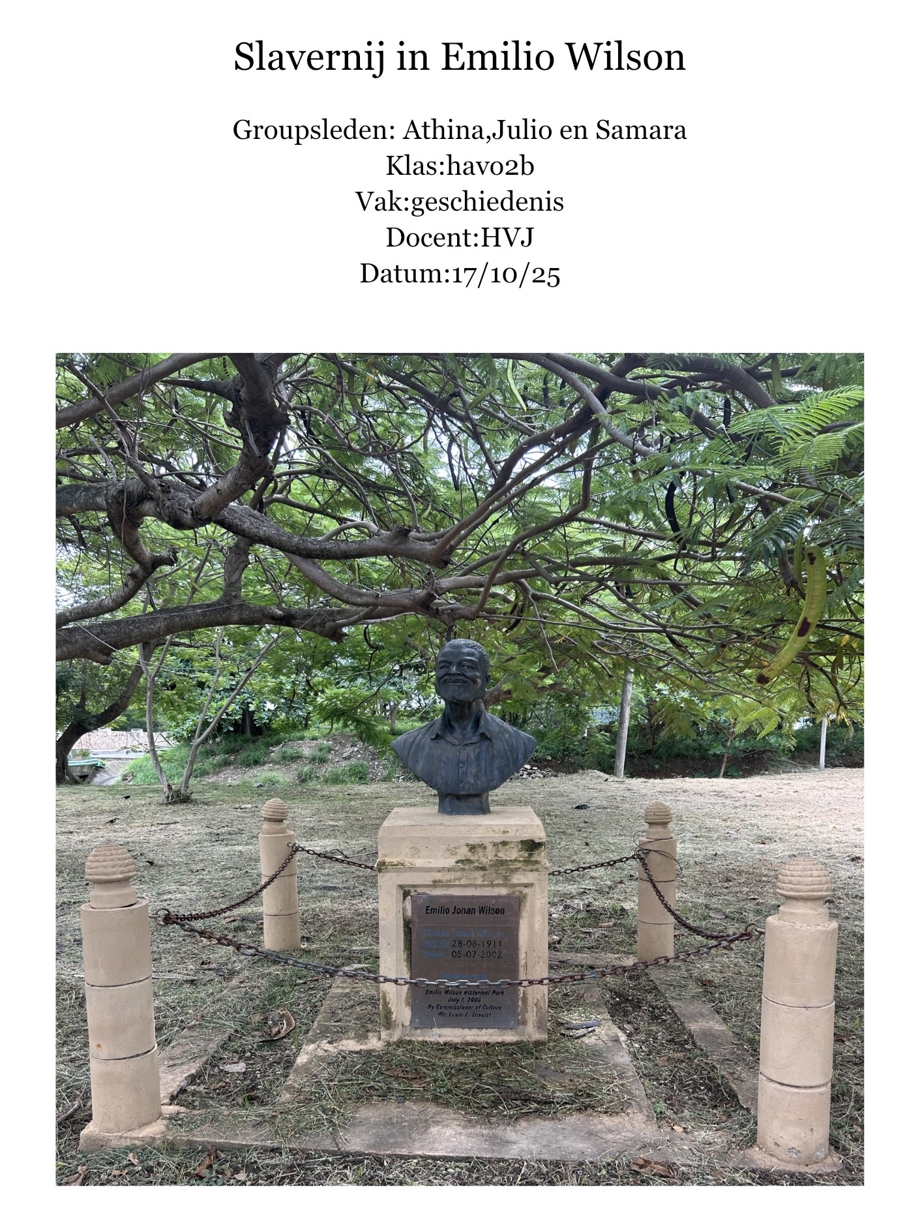
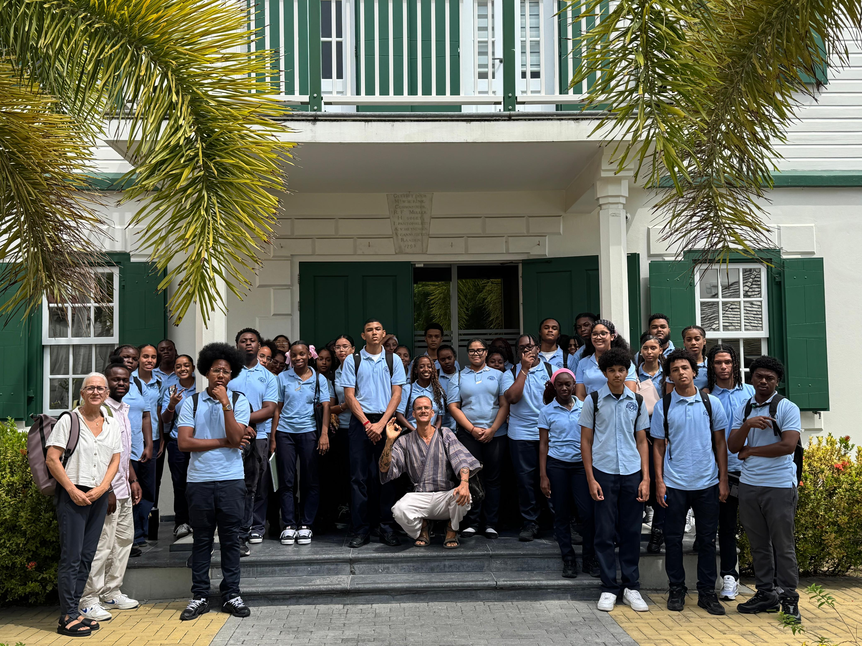
Examples

Slide 11
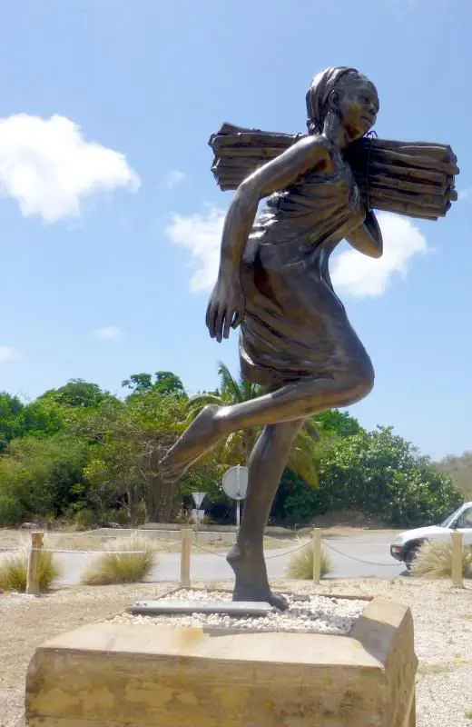
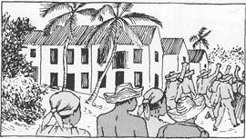
Examples

Slide 12
FREE RESOURCE PAGE

