Slide 1
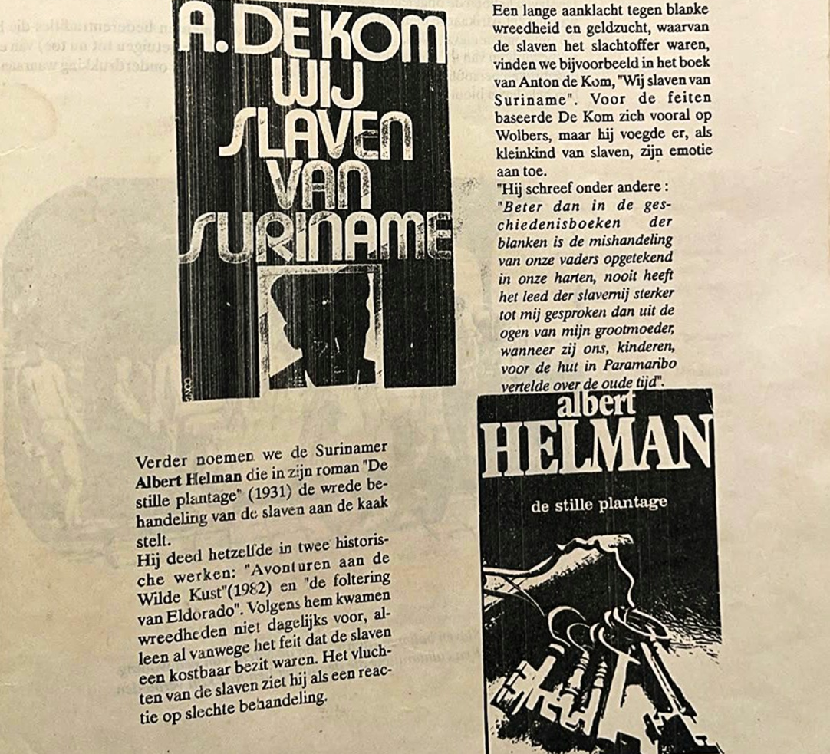
History and civics in Suriname
S. Kavita Jiawan
Suriname
Mr. Dr. J.C. de Miranda Lyceum/NOS Ad Fontes Lyceum
30th of june, 2026
Webinar: ‘Beyond the empire’: Dialogues on teaching Colonial histories

Slide 2
History Teaching Across Educational Levels in Suriname
Primary schools
(8 years)
Voortgezet Onderwijs Junioren
(5 years)
Voortgezet Onderwijs Senioren (VOS)
HAVO/VWO/ Kweekschool
2-4 years
Where is history taught?
History is taught at the primary and junior secondary levels. At the senior secondary level, history is mainly offered in VWO and HAVO, where students follow a broader academic curriculum. Students in the S-streams of VWO (Science streams) receive history only in the first year; after that, history is no longer part of their curriculum.
Civics (Staatsinrichting) is taught in the first year of HAVO and second year of VWO

Slide 3
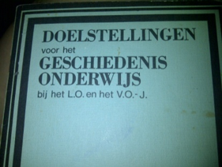
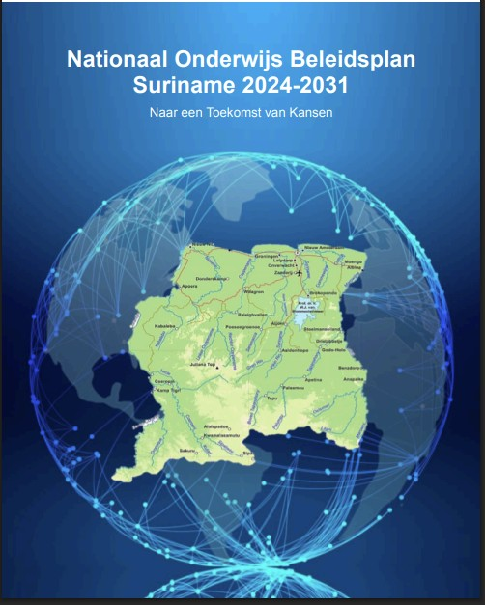
Context
Suriname is a former Dutch colony in South America that became independent in 1975.
History education was reformed after 1975 to support nation-building and emancipation. The curriculum emphasizes a Surinamese perspective rather than a predominantly European one.
Curriculum Development
Before 1975: some authors attempted to incorporate Surinamese elements into history education.
Shortly after the independence the ‘Doelstellingen voor het geschiedenisonderwijs het Lager Onderwijs en Voortgezet Onderwijs Junioren’ was formulated and published.
Unlike primary education, history education at the VWO and HAVO levels has not undergone a comprehensive curriculum reform in recent decades. As a result, much of the curriculum still reflects reforms and initiatives developed in the 1980’s and 1990’s.

Slide 4
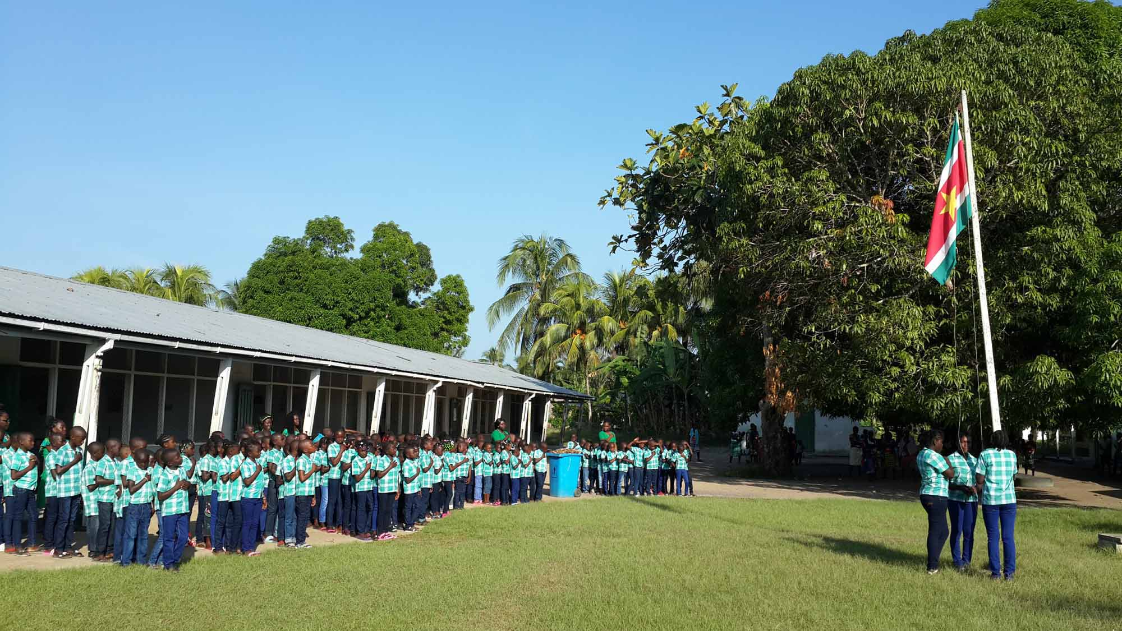
Curriculum
Primary schools
National history (slavery, migration).
VOJ
National history in more depth.
Development for one’s own identity.
Introduction to Suriname’s multicultural society.
World history (Capitalism, Socialism, World wars, Imperialism, Arabic-Israelic conflict, Cold war)
Politics and governance of Suriname: democracy, elections, constitution and institutions.

Slide 5
Curriculum vwo
Leerjaar 1/ Class 4
What is history?
Leerjaar 2/ Class 5
Capitalism
Leerjaar 3/ Class 6
Revision: Class 5
Imperialism
Slavery in the past and present; slavery in Suriname
Indentured labor in Suriname (Asians)
Nationalism in Suriname
CARICOM
History of the republic Suriname
Socialism
Interbellum
World Wars
Cold War
Arab-Israeli Conflict
League of Nations/ UNO
Research & writing: a paper on Surinamese topic
HAVO is more or less the same, but in a more compact form.

Slide 6
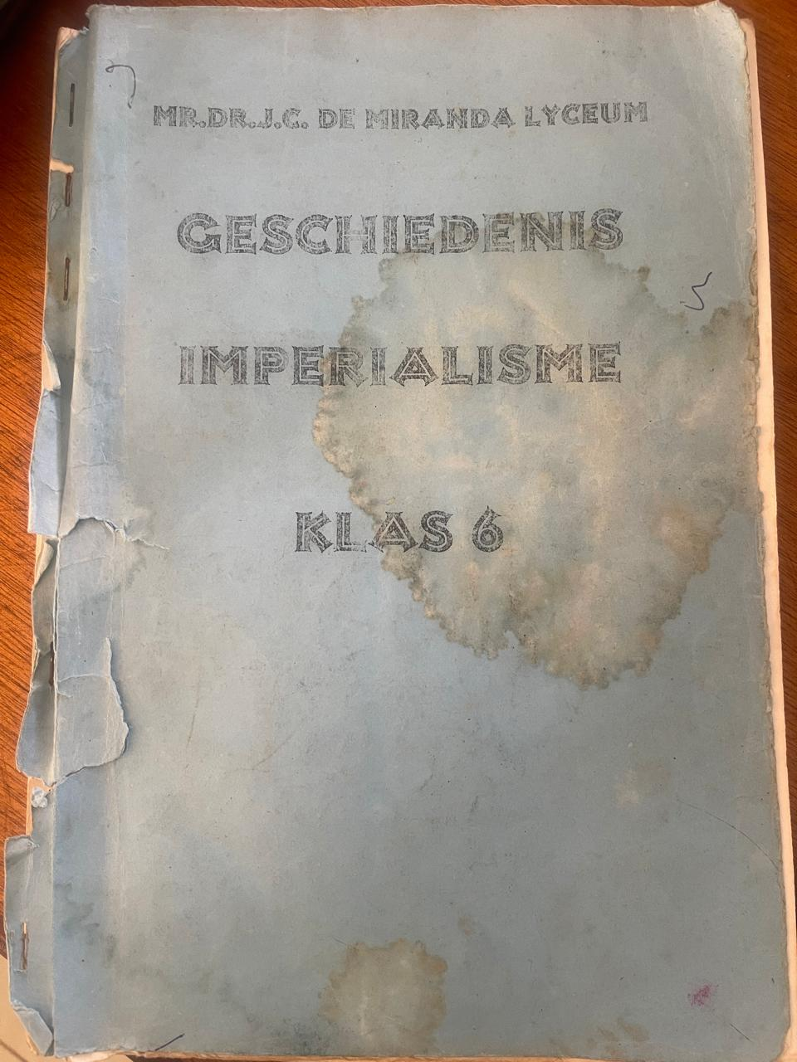
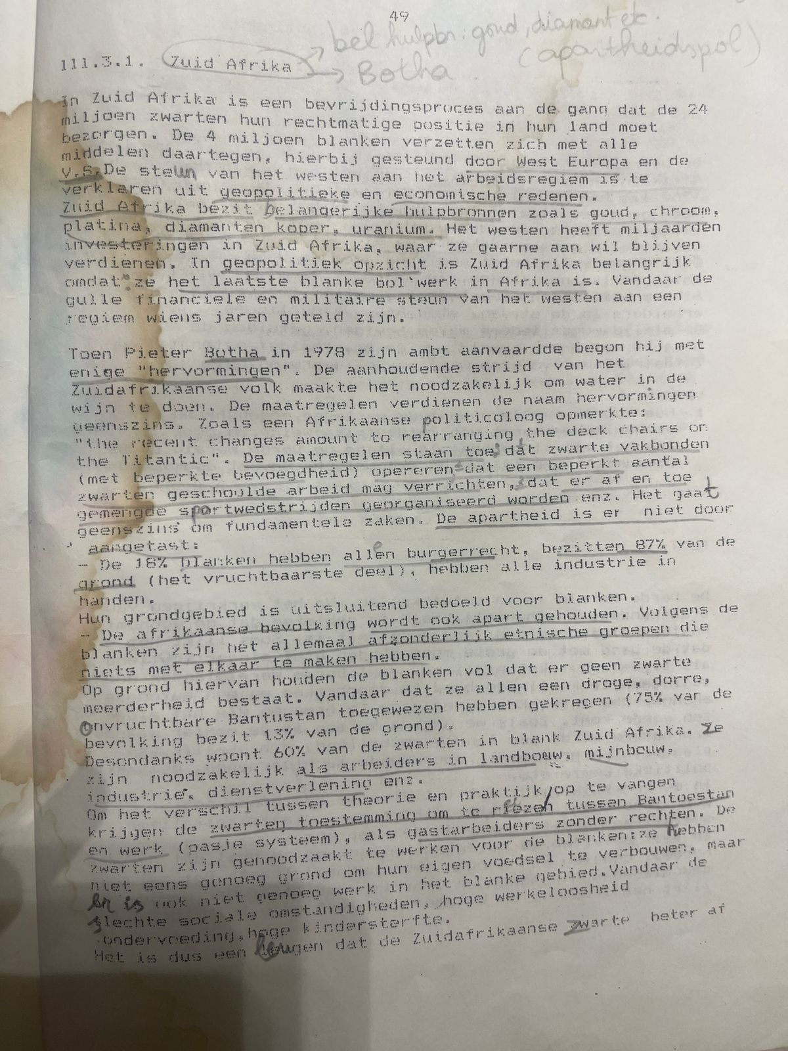
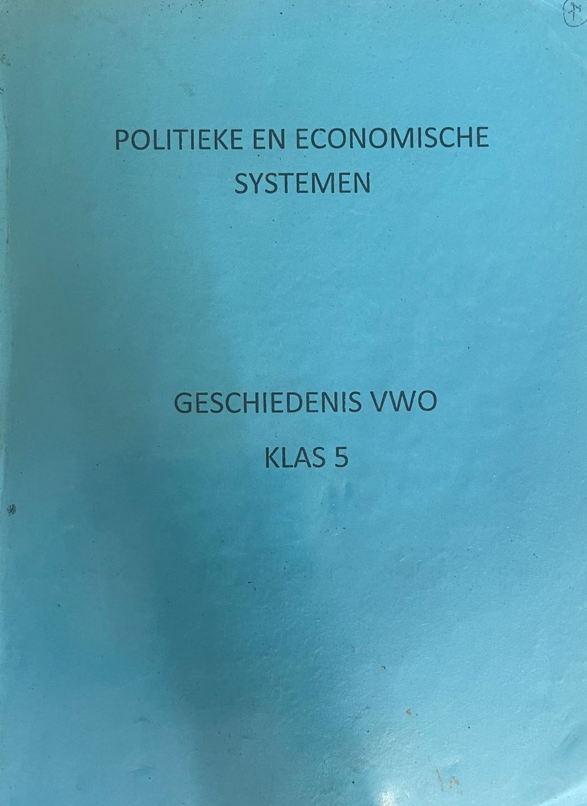
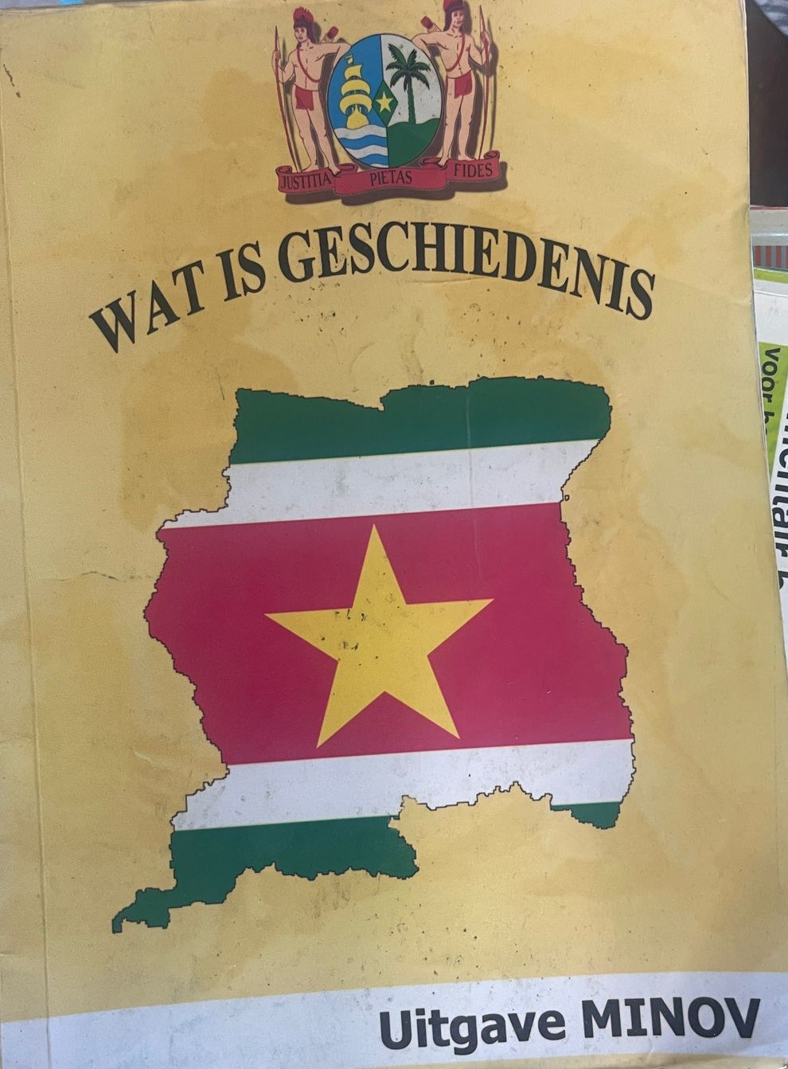
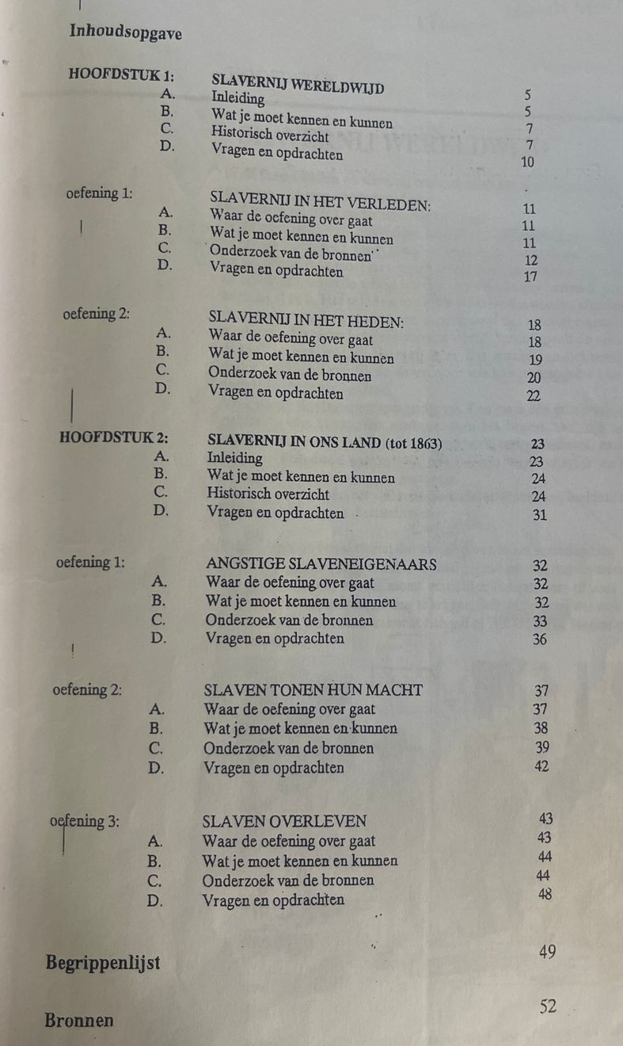
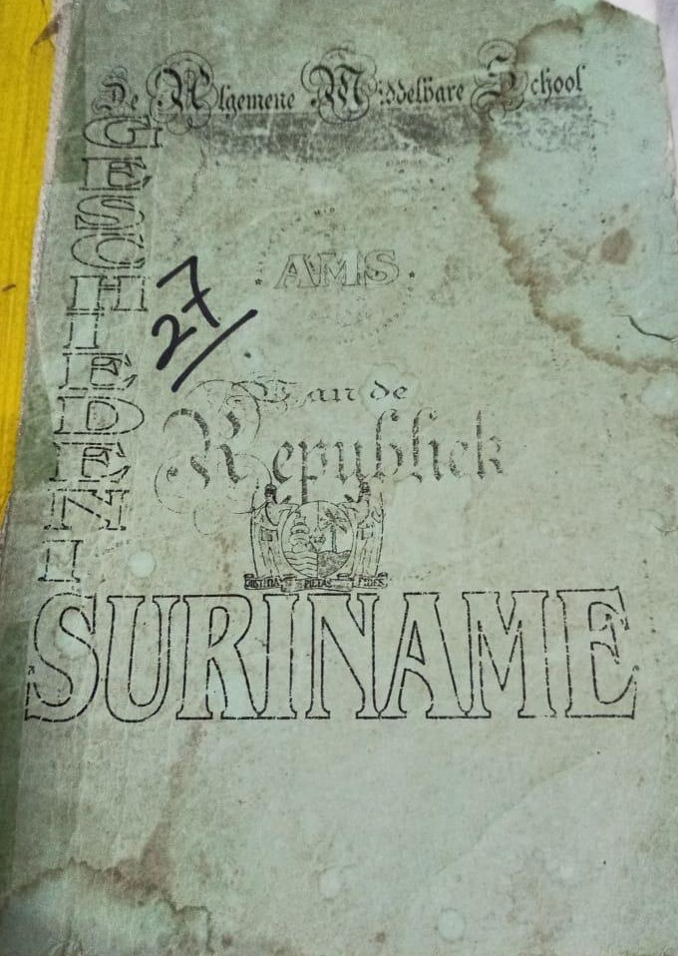
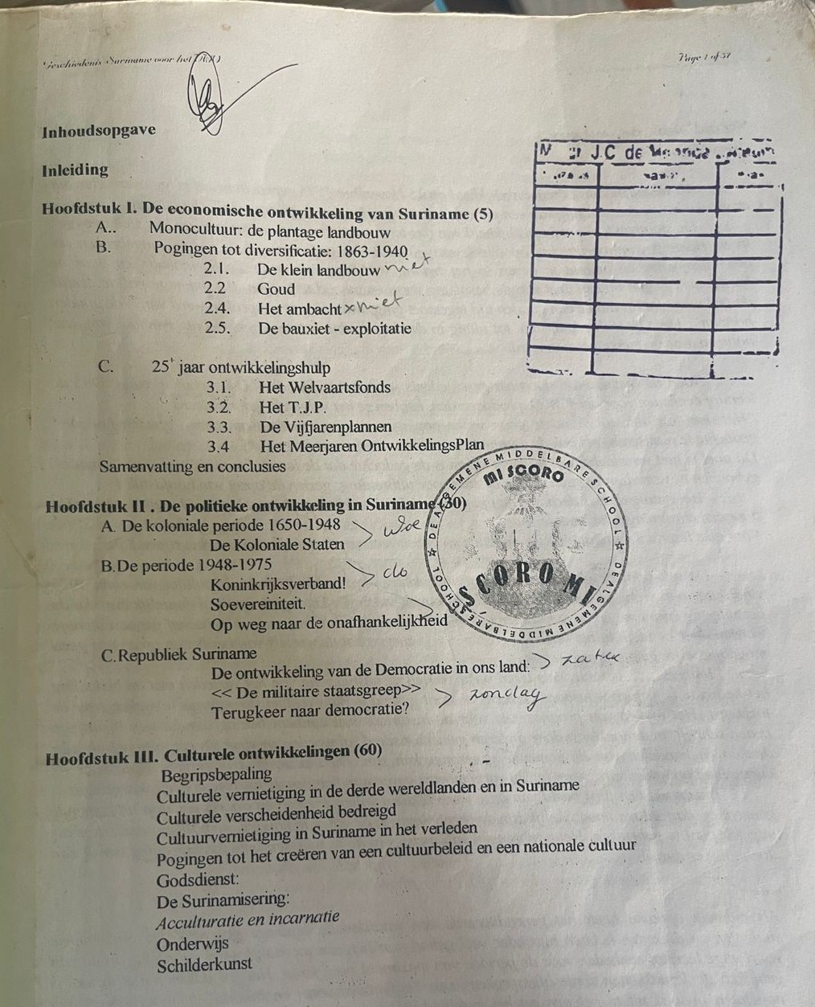
Our teaching material

Slide 7
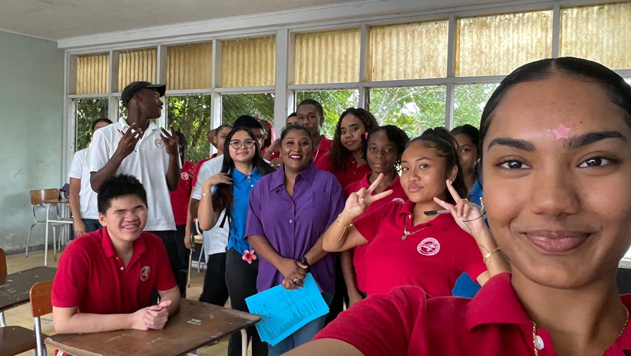
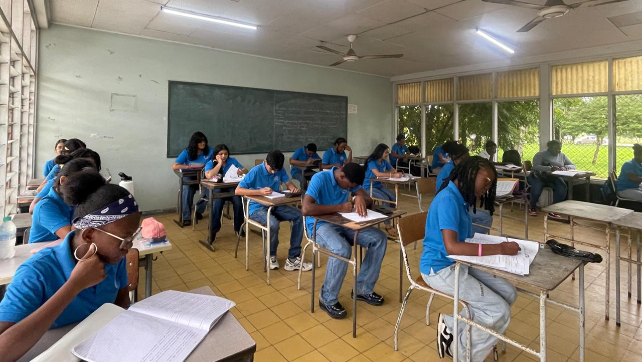
Classroom
Suriname is a multi-ethnic and multicultural society
Students come from diverse backgrounds: African, Indigenous, Indian, Javanese, Maroon, Brazilian, and Chinese heritage
Education takes into account each student’s starting situation
Instruction is mainly in Dutch, with strong influence of English. There’s room for multilingual practice.
Teaching is adapted to different cultural groups to ensure inclusive education for all

Slide 8
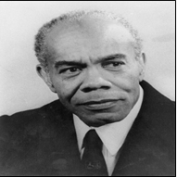
Example of a lesson(year 1)
Assignment questions:
Explain what Trefossa aimed for.
What was the poet’s opinion about other cultures?
Explain the concept of the poet’s positionality (standplaatsgebondenheid).
Name two contributions Trefossa made to nation-building in Suriname.
Do you think Suriname today sufficiently preserves its own culture?
How can young people contribute to Surinamese culture?
Topic: Nationalism (cultural nationalism)
Henny Frans de Ziel (Trefossa) opposed Dutch culture and advocated for a distinct Surinamese culture. In 1957 he wrote:
“Suriname is moving towards its own culture. However, this will not be possible if local interpretation is insufficient. Thinking and acting like others will not give us our own culture. At best, this will only give us a similar form without real living content. Imported culture can be enriching, but it is the creation and development of something of our own that makes culture truly ours. We may, and even must, be open to foreign literature; we can gain information, inspiration, and recreation from it. But if we want our own culture, we must never be tempted into blind imitation”.

Slide 9
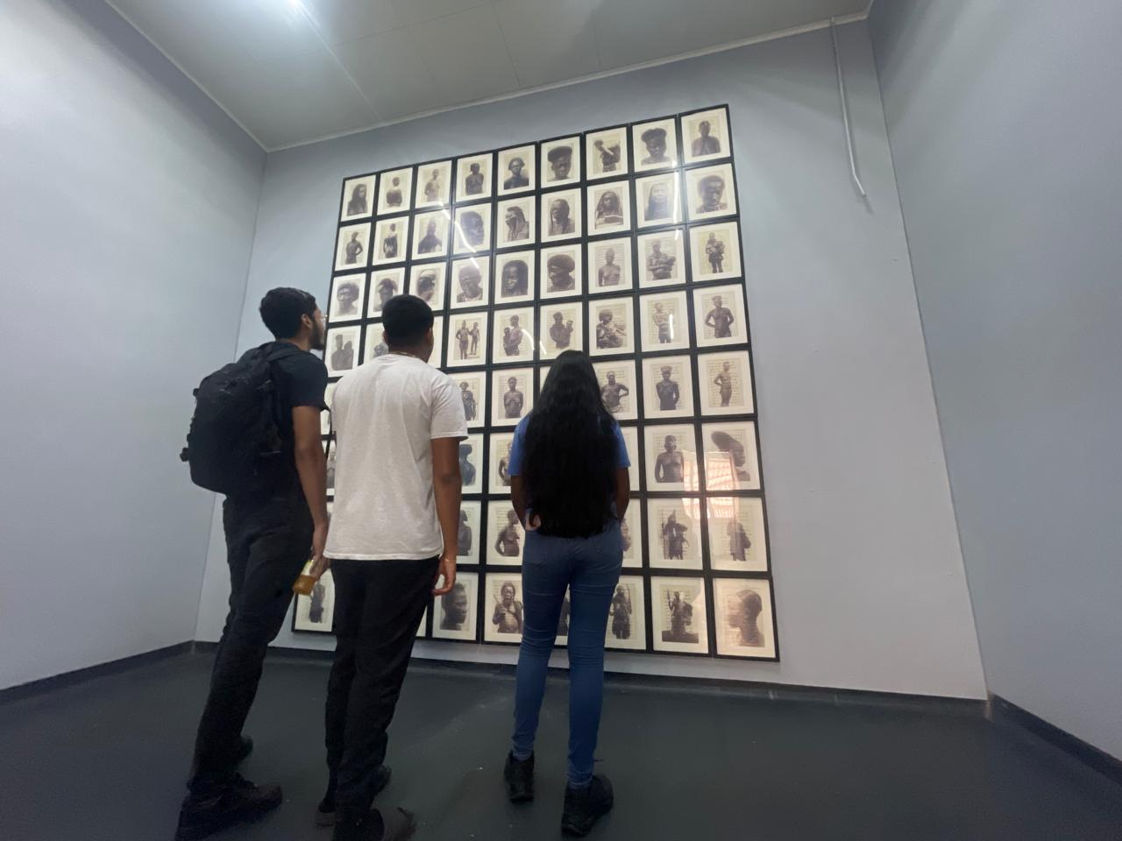
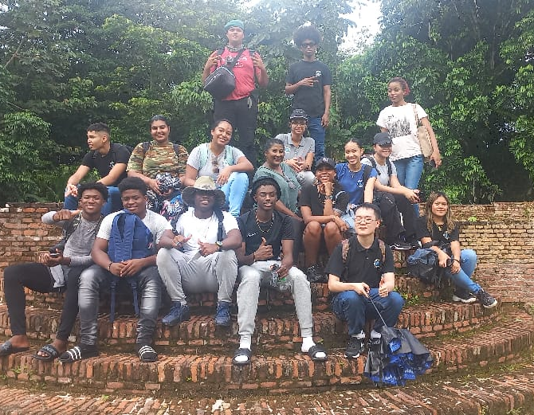
Challenges and reflections teaching history
Limited teaching time (3–4 weeks, 90 minutes per week and the use of more modern technology
Curriculum pressure requires focusing mainly on exam content.
Sensitivity in classroom discussions about culture, norms, and religion: differing religious perspectives (e.g., Christianity, Hinduism, Winti traditions).
Surinamese history is strongly represented, but culture and heritage could be more emphasized.
Material is too descriptive, with little to no visual material and no room for creative assignments, because the focus is on covering the content within 3–4 weeks before the assessment moments.
Some facts are already outdated. It needs renewal.
World history needs adjustment (less focus on political/economical systems, more global shifts such as BRICS and modern forms of imperialism).
There’s need for evaluation and rewriting or history books. And we Surinamese want to do it ourselves.
Starting from primary schools, students learn about the colonial past, oppression and resitance, neocolonialism.
Fieldtrip to Moengo: Tembe Contemporary Art Museum
Fieldtrip to Jewish Savanna
During the activity week, we organize a field trip that ties in with one of the themes covered in the school year at Ad Fontes Lyceum (private school).

Slide 10
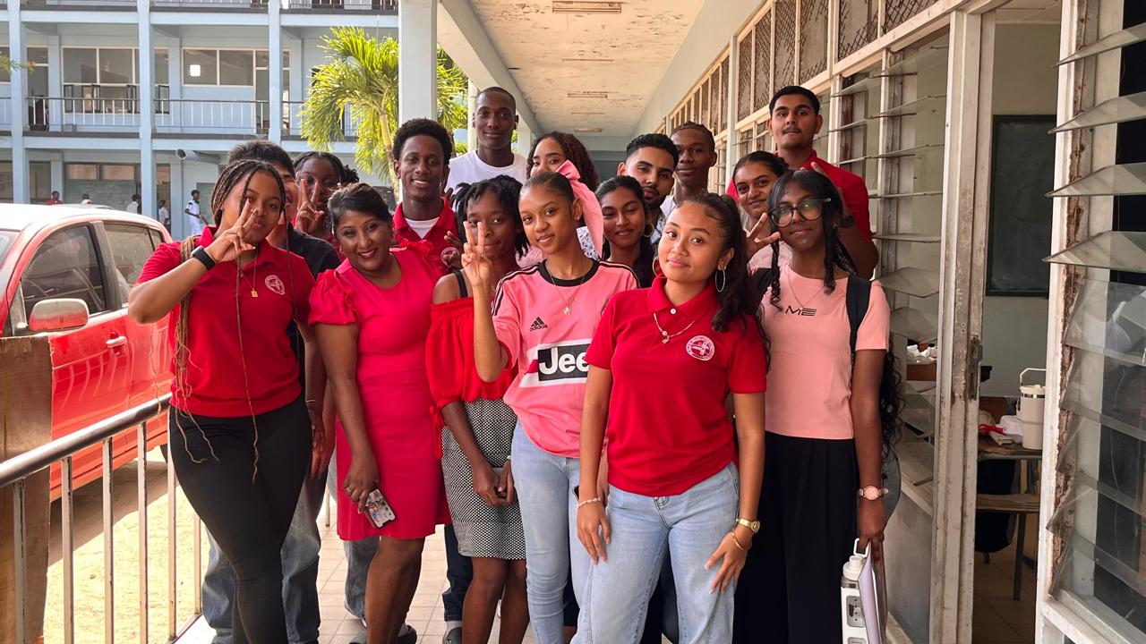
Thank you

